Slide 1

Subject:Mathematics for Artificial Intelligence Subject Code:23AIPC304
MANGALORE INSTITUTE OF TECHNOLOGY & ENGINEERING
(A Unit of Rajalaxmi Education Trust®, Mangalore)
Autonomous Institute affiliated to VTU, Belagavi, Approved by AICTE, New Delhi
Accredited by NAAC with A+ Grade & ISO 9001:2015 Certified Institution

Slide 2
Module 2: Markov Chain Process & Dimensionality Reduction | No. of Hrs : 6+5
Principal Component Analysis : Problem Setting, Maximum Variance Perspective, Projection Perspective, Eigenvector Computation and Low-Rank Approximations. Reinforcement Learning(RL), Uncertain knowledge and reasoning: Uncertainty, Probability, Joint probability, Baye’s theorem, Bayesian belief network, Inference in belief network, temporal model, Markov Decision process(MDP) Text book 1: Ch 10 Text book 2 : Ch 11.12 &Ch 12

Slide 3
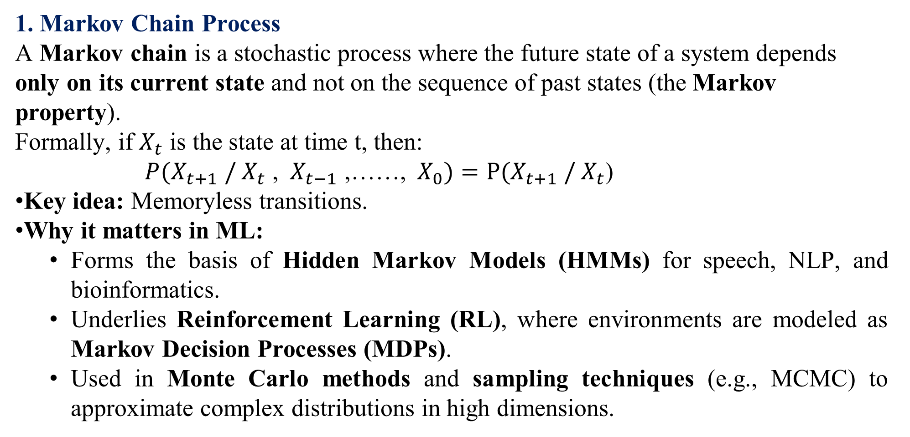
Markov Chain Process & Dimensionality

Slide 4
2. Dimensionality
Dimensionality refers to the number of features or variables representing data.
Low-dimensional data → Easy to visualize, simple models.
High-dimensional data (curse of dimensionality) → Distances lose meaning, models overfit, computations become expensive.
Why it matters in ML:
High-dimensional spaces require dimensionality reduction techniques such as PCA, SVD, Autoencoders.
Many ML algorithms (clustering, regression, classification) suffer when dimension grows without enough samples.
Sampling methods (like Markov Chains) are often needed to explore high-dimensional probability distributions efficiently.

Slide 5
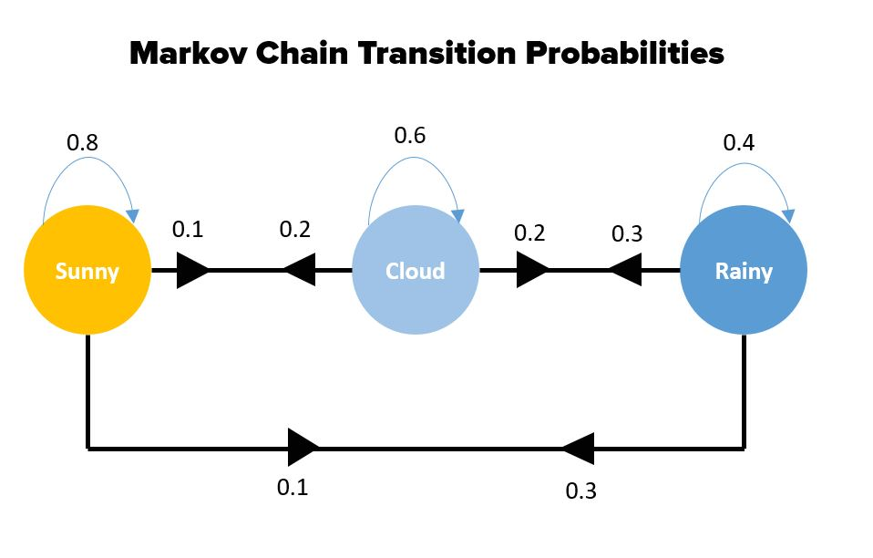
Simple Weather Markov Chain – A clear state diagram showing transitions—e.g., between "Sunny," "Cloudy," and "Rainy"—with probabilities labeled on arrows. This represents a classic, low-dimensional example of a Markov chain.

Slide 6
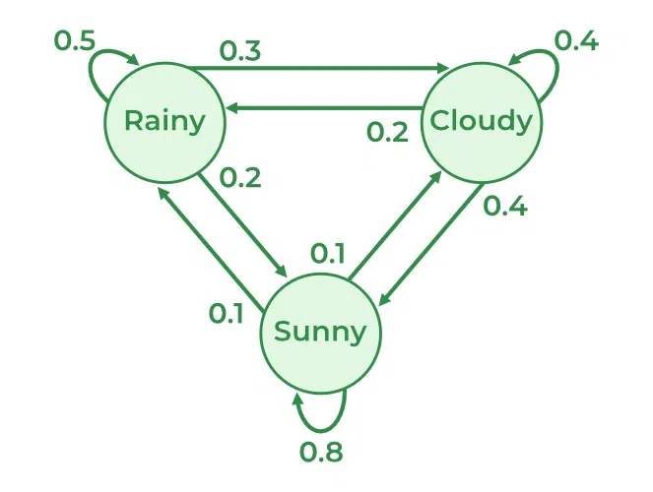
Generic Markov State Diagram – A more abstract network of states connected by probabilistic transitions, useful for grasping the general structure.

Slide 7

Hidden Markov Model (HMM) – Illustrates hidden states (e.g., x1,x2x_1, x_2x1​,x2​) and observations (y1,y2y_1, y_2y1​,y2​), showing how only the hidden layer affects observed outputs. This is key for sequence models and inference tasks.

Slide 8
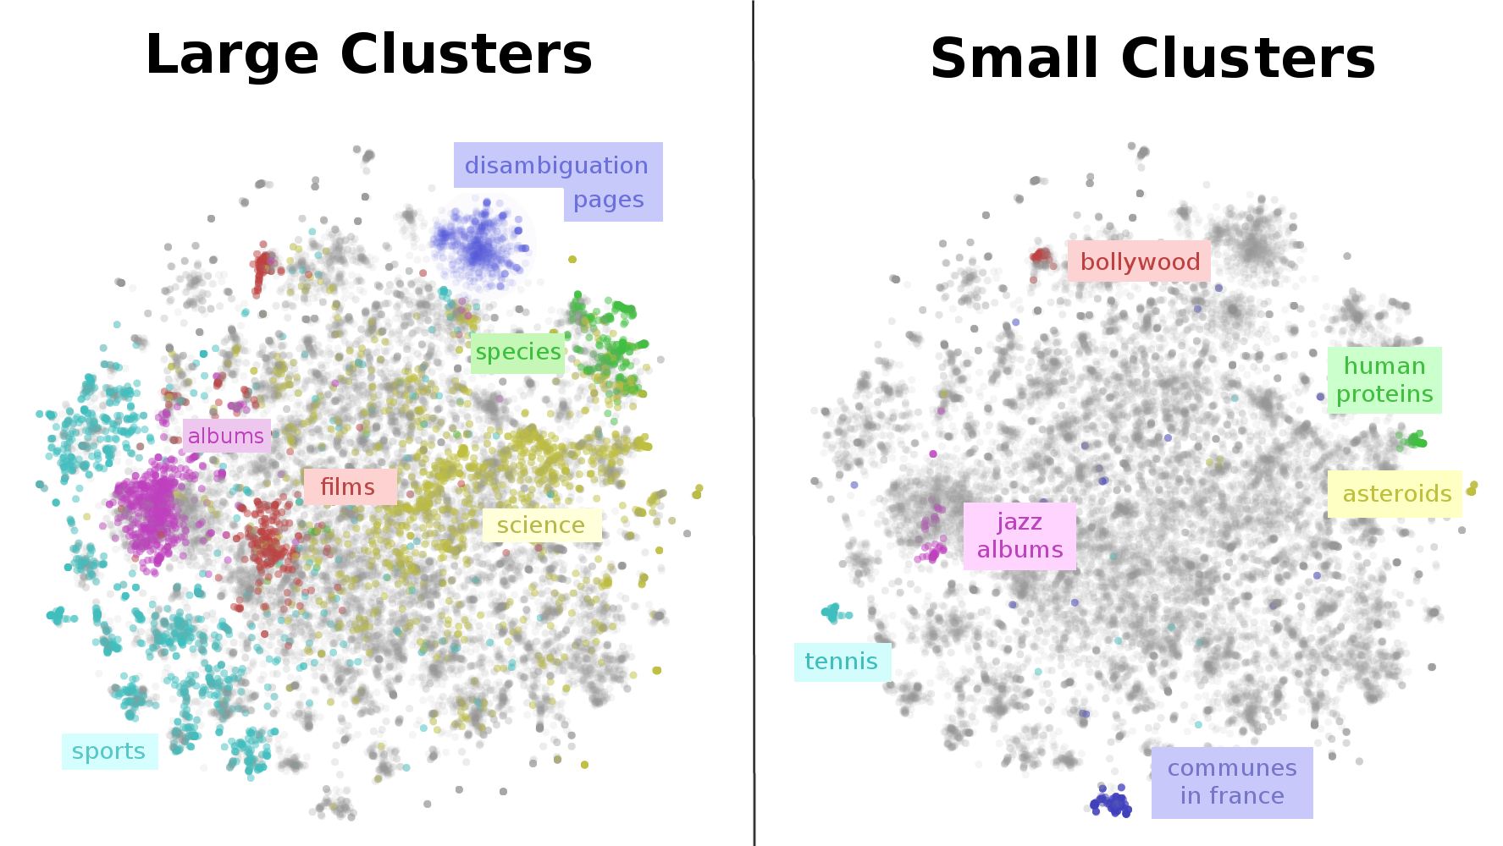
High-Dimensional Representation (t-SNE) – Offers a glimpse into dimensionality reduction: a 2D map of a high-dimensional dataset (e.g., Wikipedia articles) clustered by similarity. It highlights how we transform complex, high-dimensional data into interpretable visualizations.

Slide 9
PCA for Dimensionality Reduction
Problem Setting:
We are often given a dataset with a large number of features (dimensions).
Example: An image dataset where each pixel is a feature, or a sensor dataset with hundreds of measurements.
High dimensionality makes computation expensive, visualization hard, and models prone to overfitting (“curse of dimensionality”).
Goal: Reduce the number of features (dimensions) while retaining as much of the “important” information (variance/structure) in the data as possible.

Slide 10
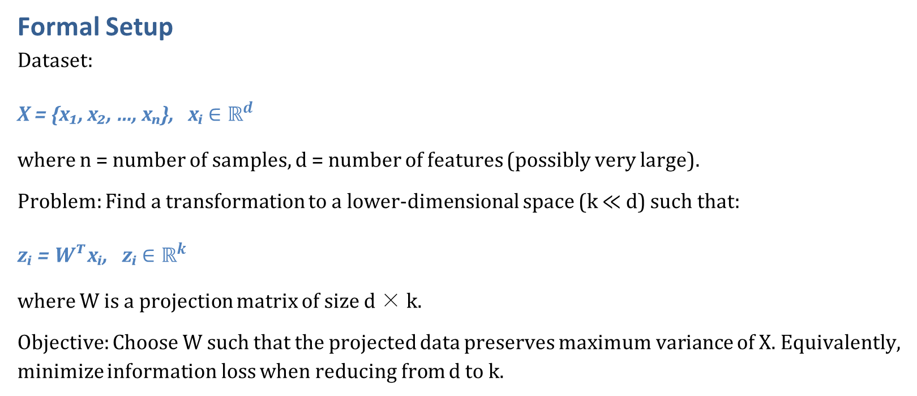

Slide 11
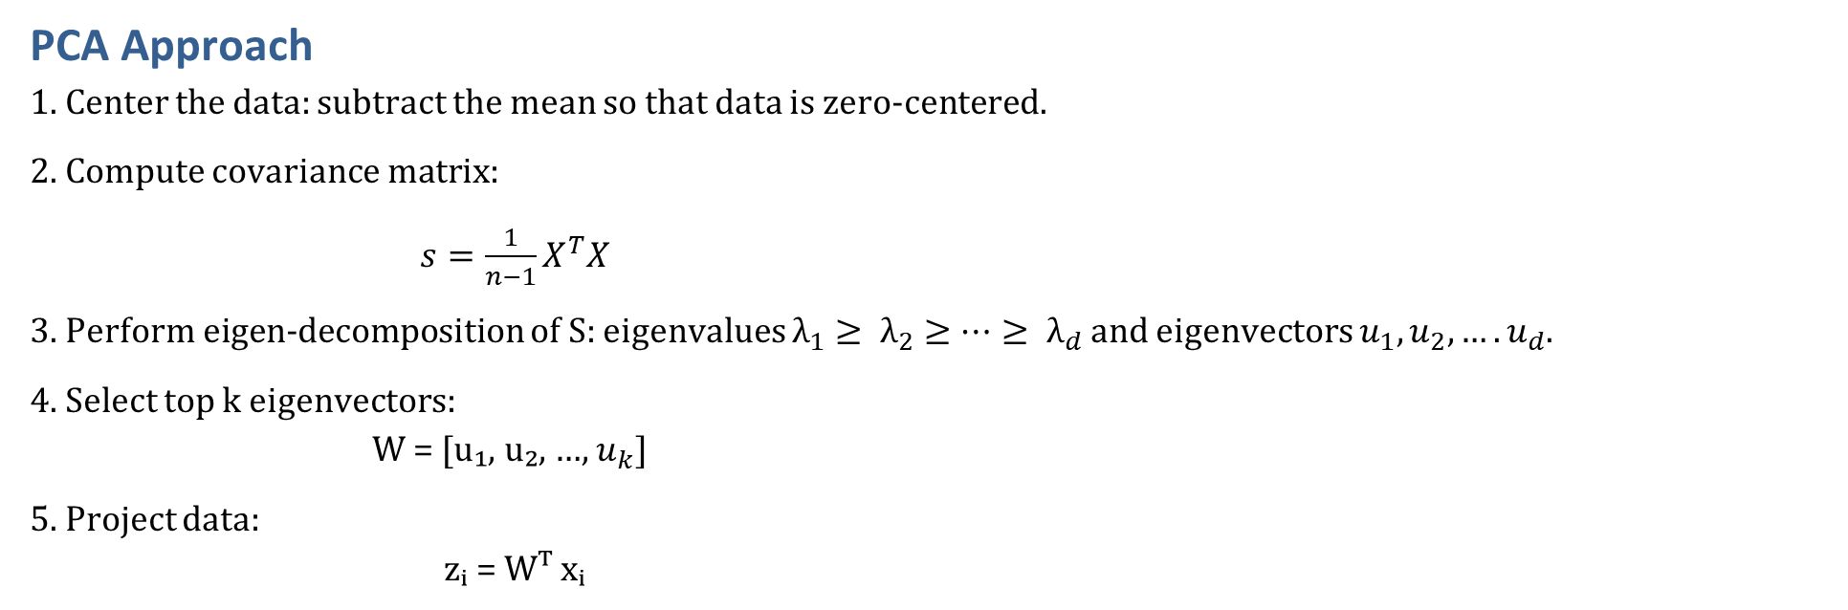

Slide 12
Example Problem: Image Compression with PCA
Context: We are working with a dataset of grayscale face images. Each image has size 64 × 64, i.e., d = 4096 pixel features. The dataset contains n = 1000 images.
Problem: Directly storing or processing images in 4096-dimensional space is computationally expensive. Many pixel features are correlated (e.g., nearby pixels in an image are similar), meaning there is redundancy. We want a more compact representation of each image that preserves most of its distinguishing features.

Slide 13
Mathematical Formulation:
X = {x₁, x₂, …, x₁₀₀₀}, xᵢ ∈ ℝ⁴⁰⁹⁶
Find W ∈ ℝ^(4096 × k), where k ≪ 4096
New representation: zᵢ = Wᵀ xᵢ, zᵢ ∈ ℝᵏ
Reconstruction (approx): x̂ᵢ = W zᵢ
Variance retained ≈ (Σ_{j=1}^k λ_j) / (Σ_{j=1}^4096 λ_j)

Slide 14
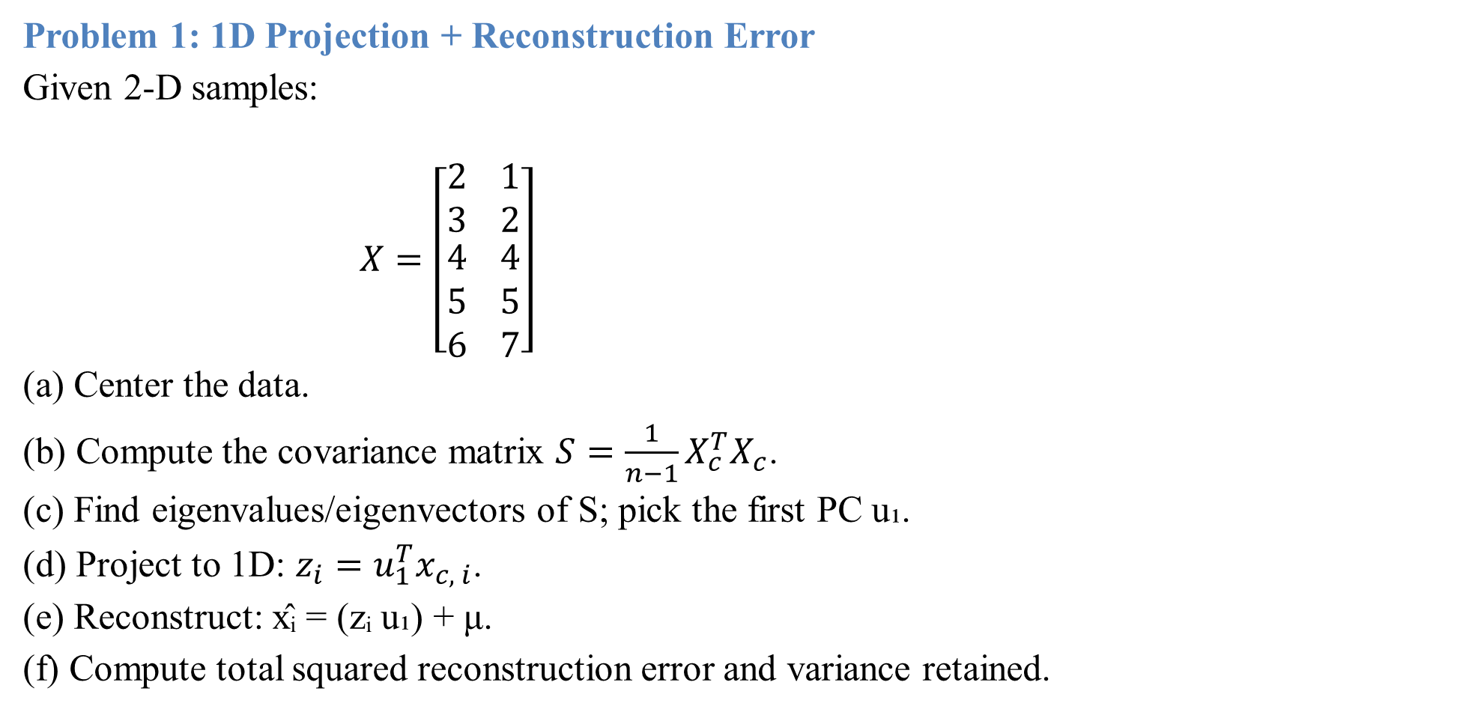

Slide 15
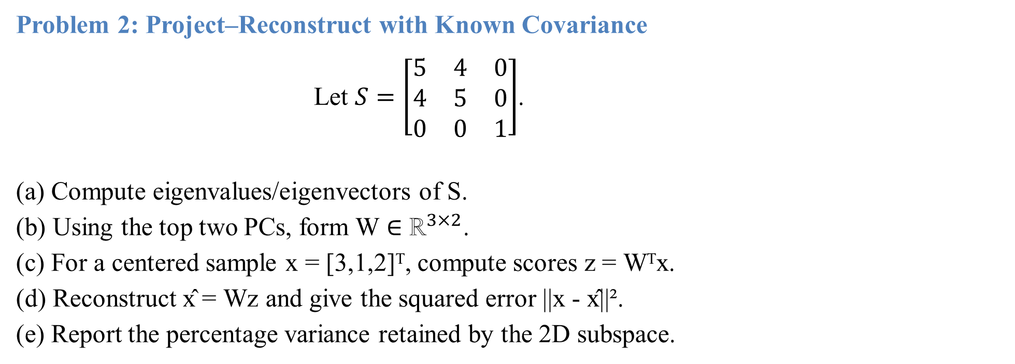

Slide 16
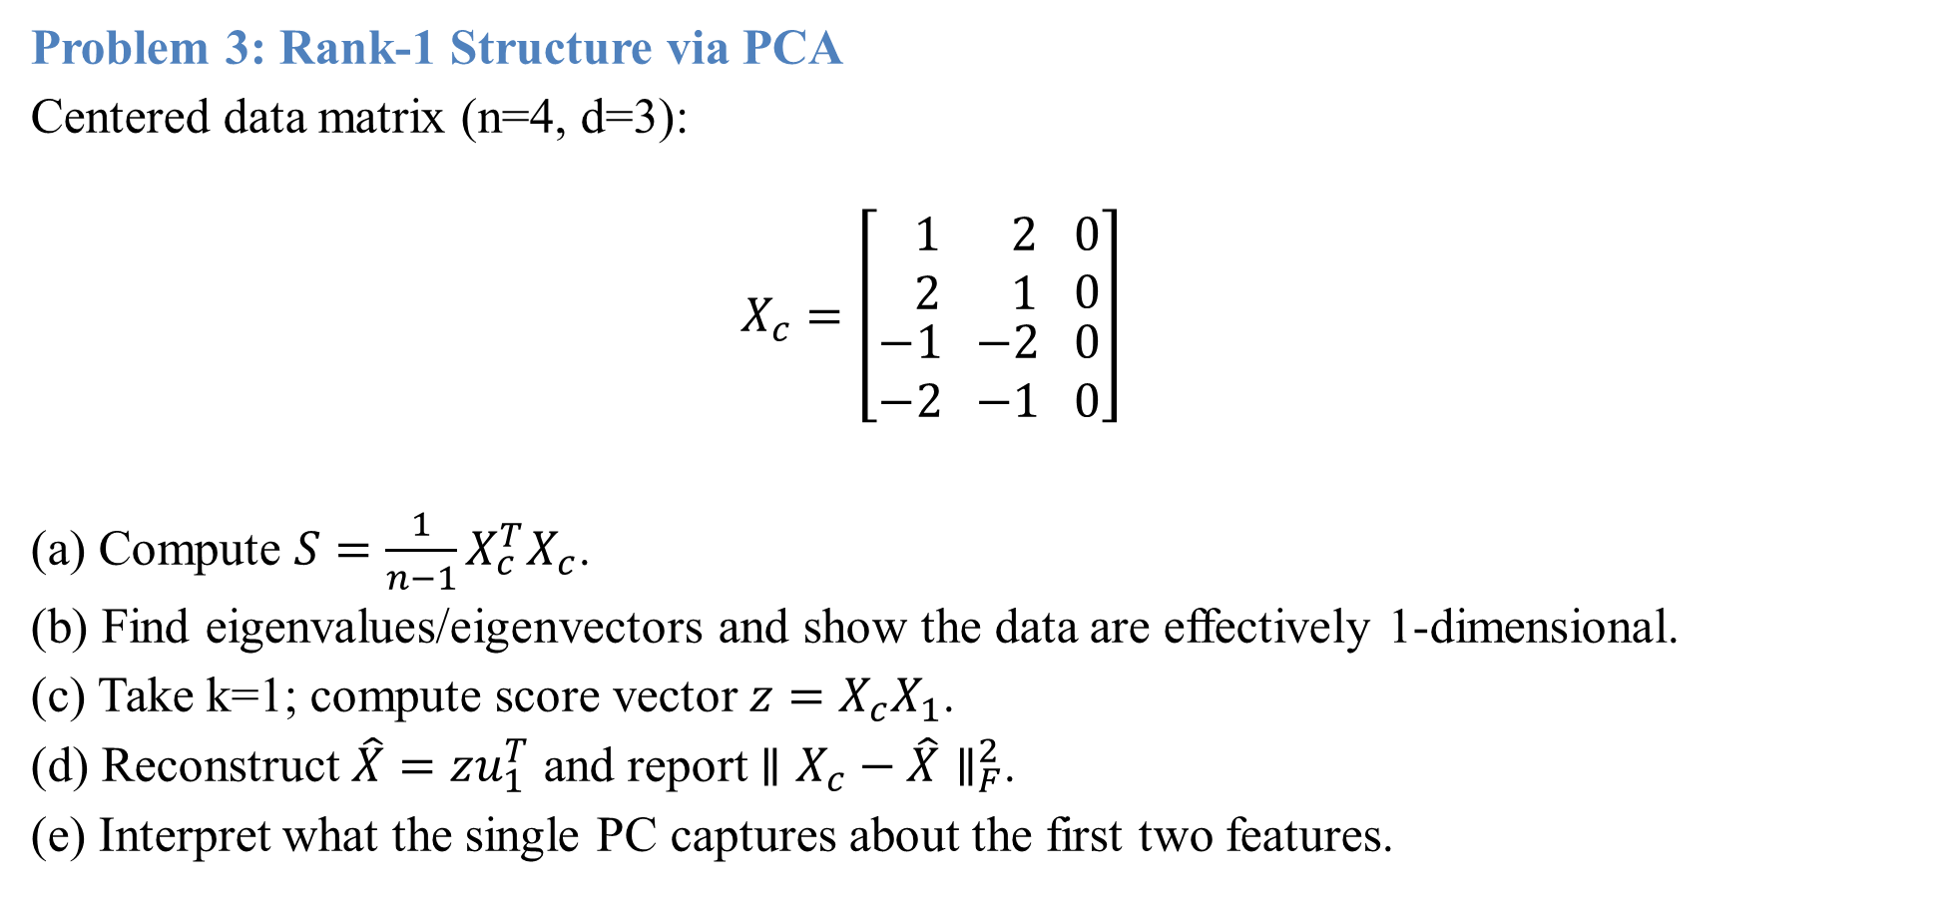

Slide 17
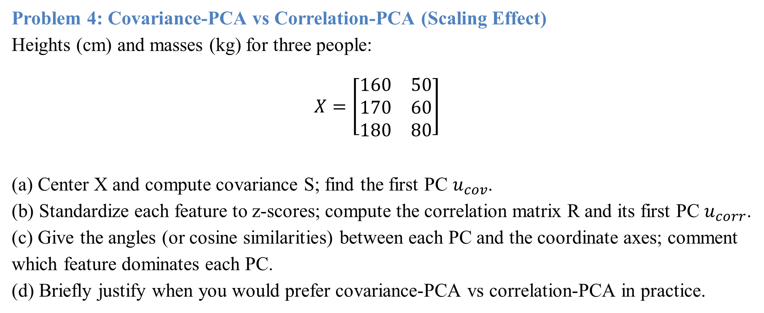

Slide 18
Maximum Variance Perspective
Introduction:
In many machine learning and data analysis problems, we deal with high-dimensional datasets. Such data often contains redundancy, correlations among features, or noise. To extract meaningful patterns, we reduce the dimensionality of the data while preserving as much information as possible. One natural approach is to represent the data in a lower-dimensional space such that the new features capture the maximum variability in the dataset. This is the Maximum Variance Perspective, which forms the core idea behind Principal Component Analysis (PCA).
From this viewpoint, the best projection of data onto a new axis (or component) is the one along which the variance of the projected data is maximized. Naturally, higher variance means greater spread, which corresponds to more information and less redundancy.

Slide 19
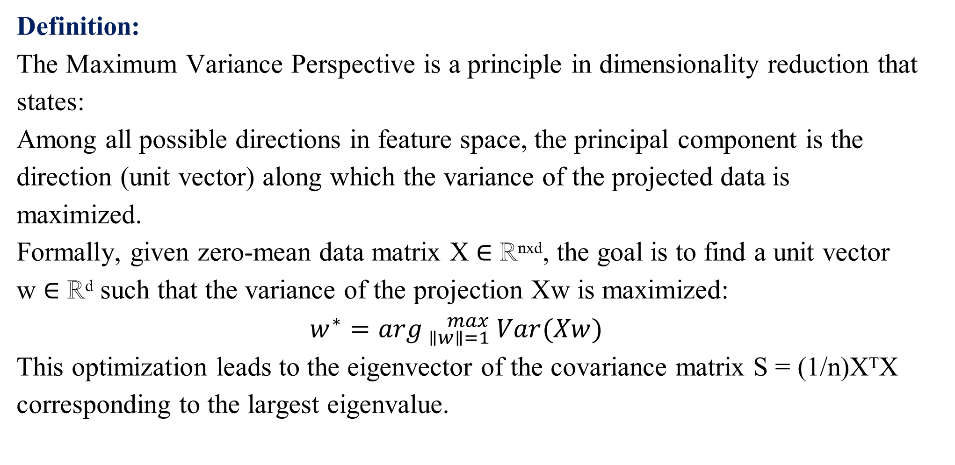

Slide 20
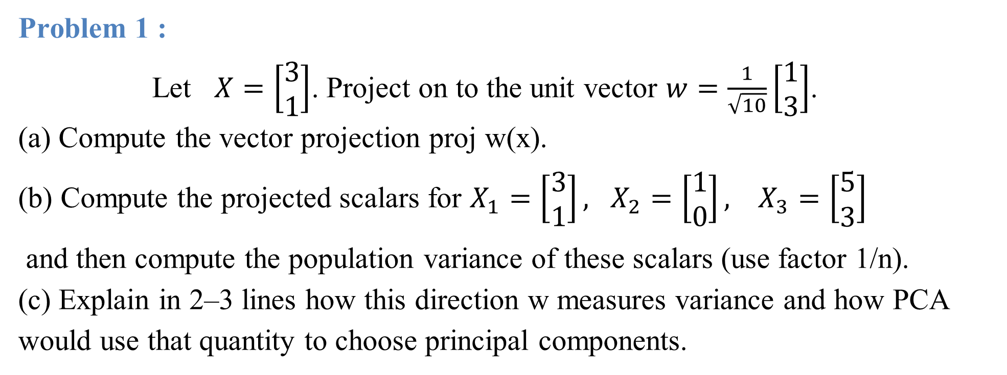

Slide 21
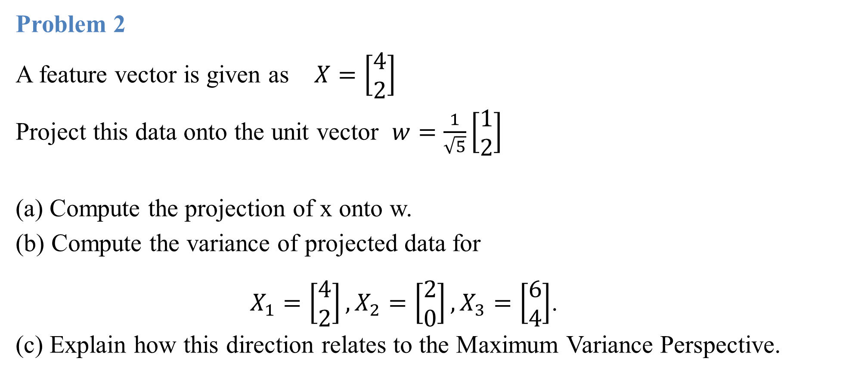

Slide 22
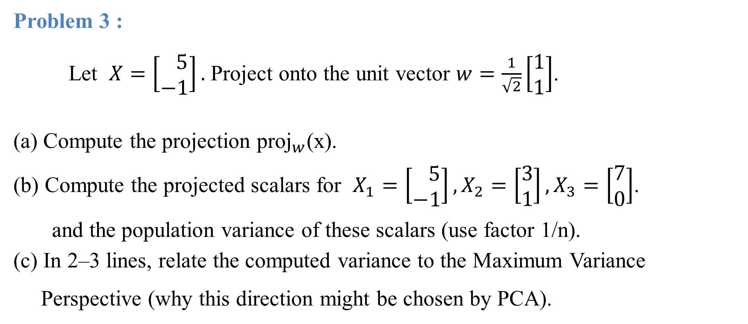

Slide 23
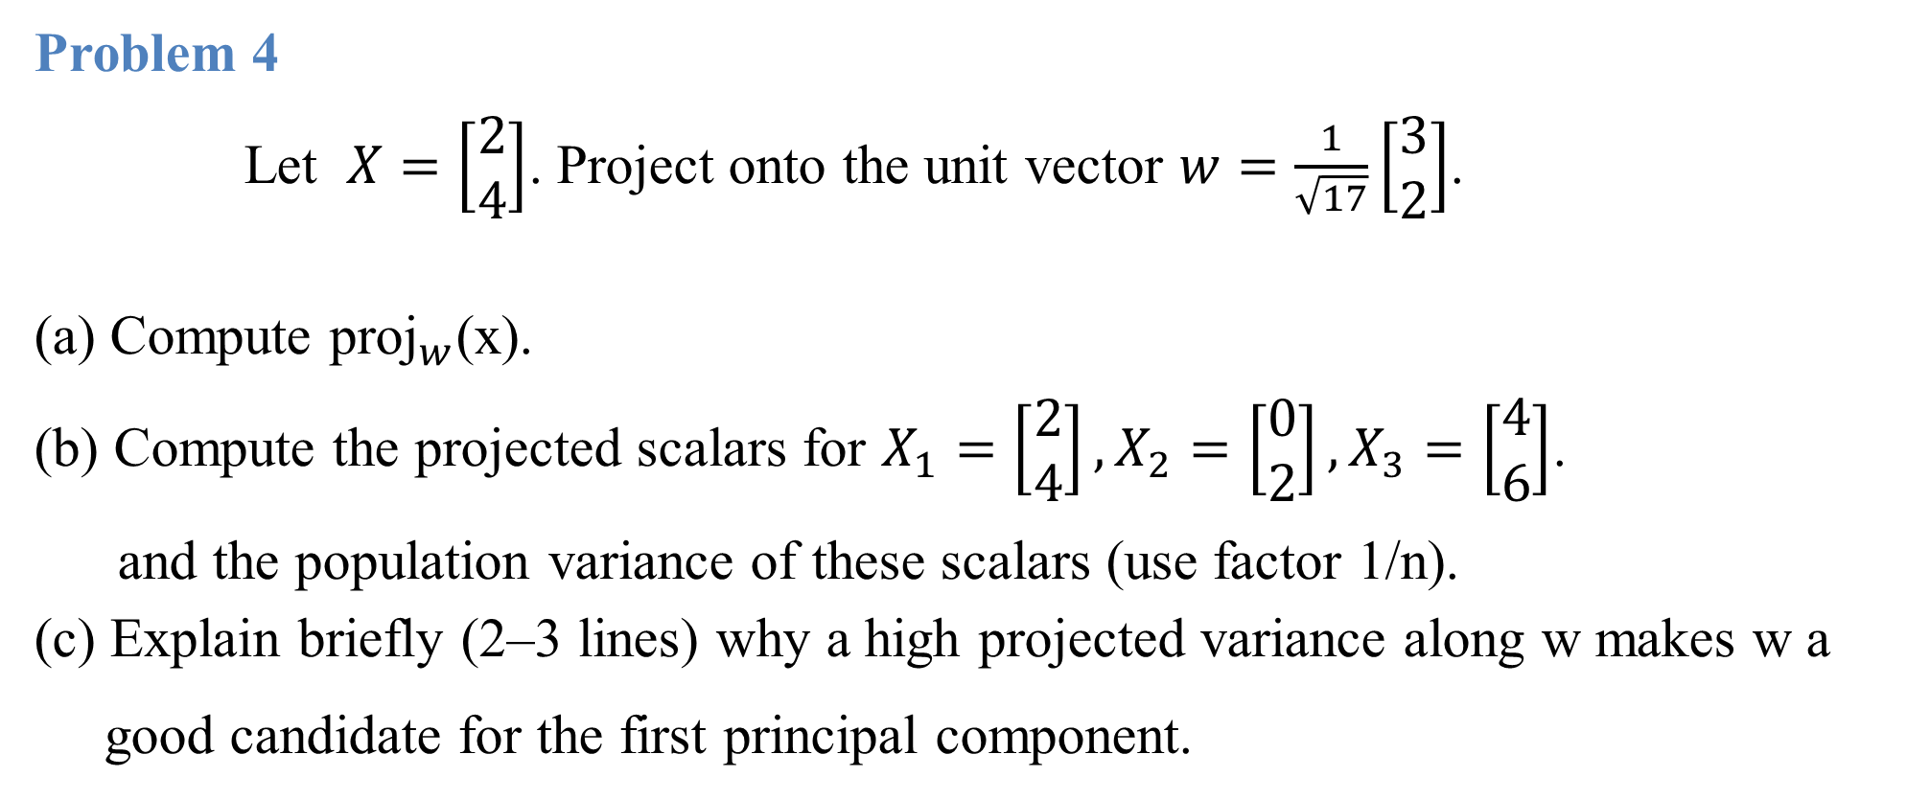

Slide 24
Projection Perspective
1. Introduction
Projection is one of the most fundamental concepts in linear algebra, geometry, and data science. The basic idea is: given a vector and a subspace (like a line or a plane), projection finds the 'shadow' or the 'closest point' of that vector on the subspace. - In geometry, it’s like shining a light and observing the shadow of an object on a surface. - In linear algebra, projection gives the best approximation of a vector within a subspace. - In machine learning & data science, projection is widely used in dimensionality reduction (PCA), approximations, and least squares solutions. The essence: projection extracts the component of one vector in the direction of another (or a subspace).

Slide 25
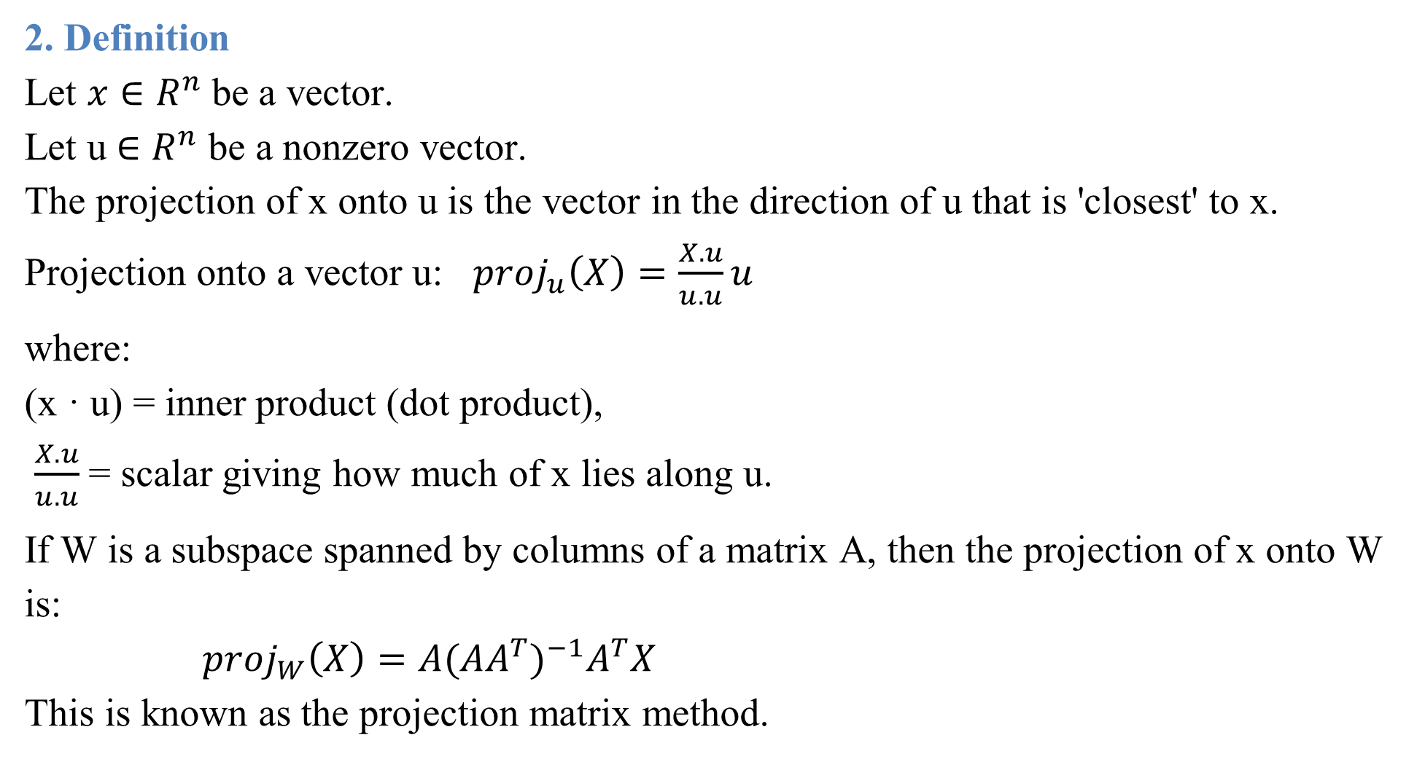

Slide 26
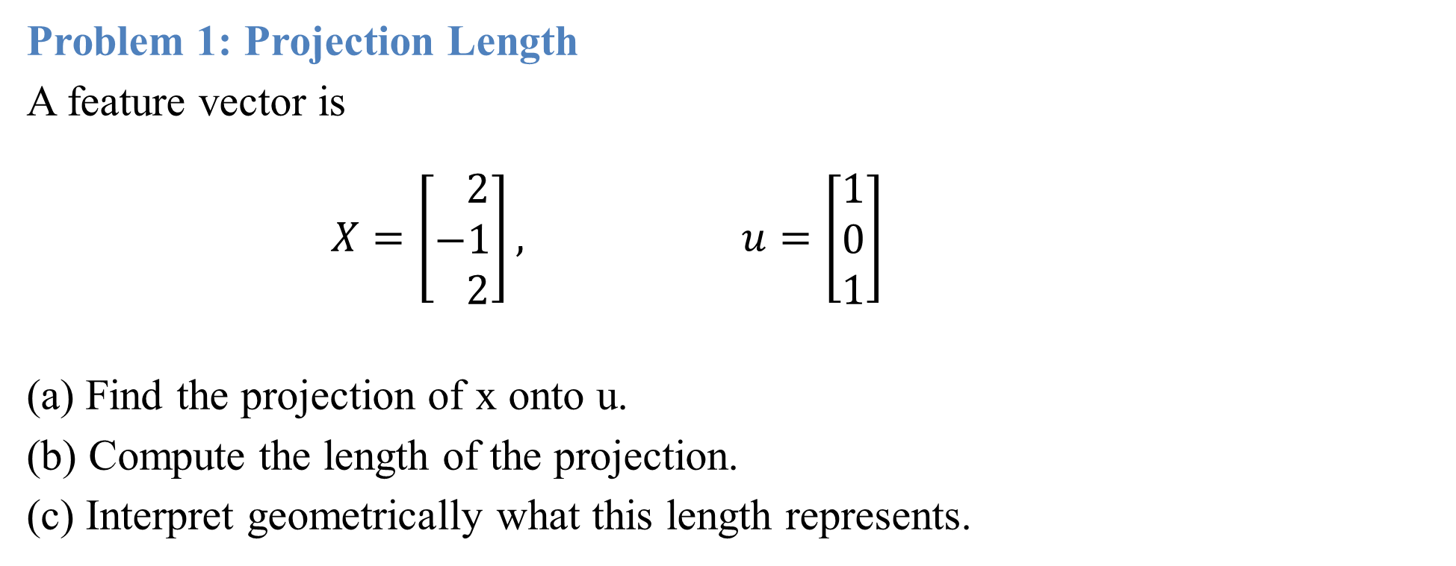

Slide 27
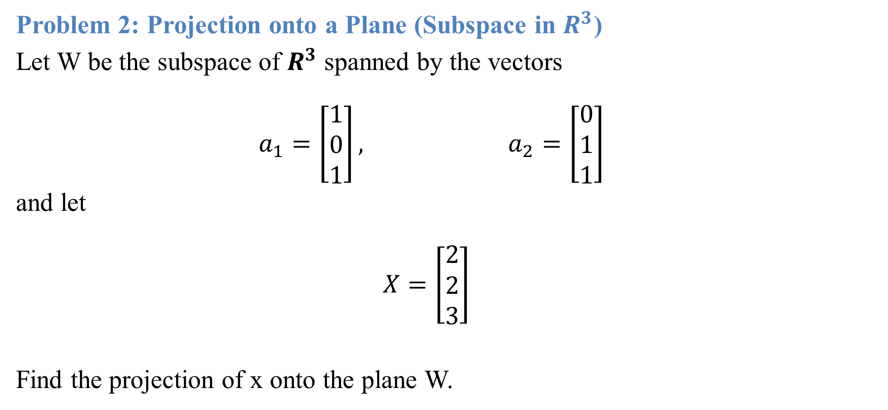

Slide 28
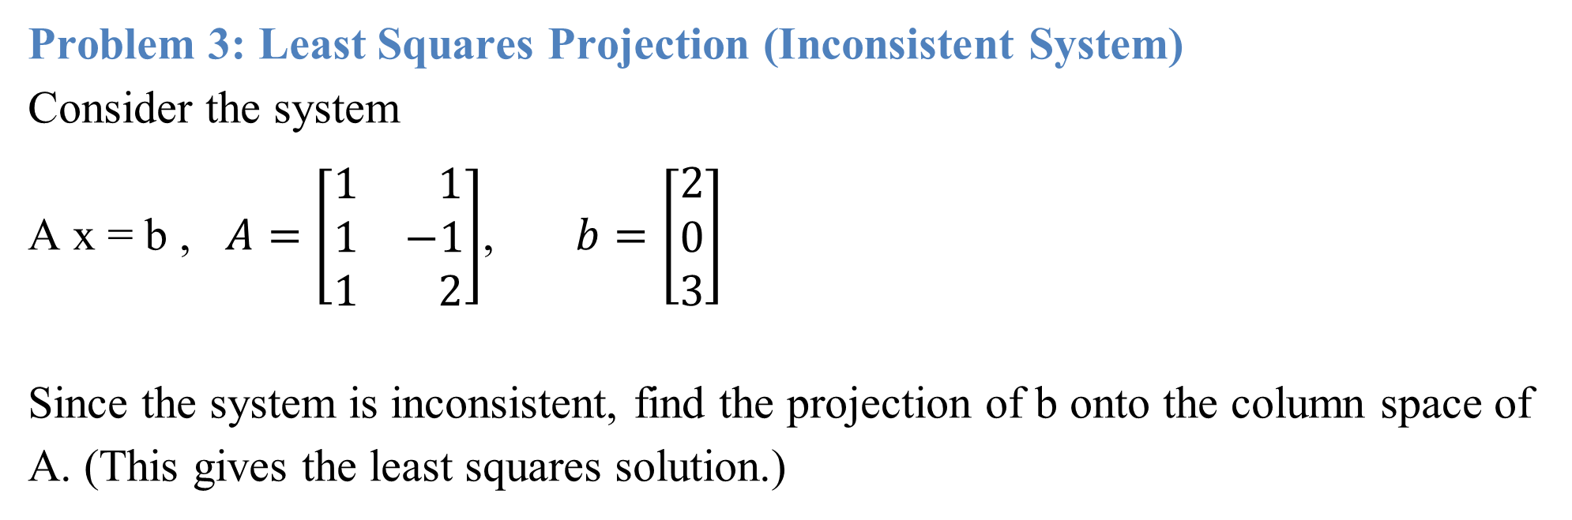

Slide 29
Eigenvector Computation and Low-Rank Approximations
Introduction:
Eigenvectors and low-rank approximations are fundamental tools in linear algebra and data science for uncovering structure and simplifying complexity. Eigenvectors reveal the invariant directions of a transformation, while eigenvalues quantify how these directions are scaled. Their computation underpins applications from solving differential equations to Google’s PageRank and PCA. Low-rank approximations, on the other hand, compress large matrices into simpler forms that preserve essential information, enabling efficient storage, computation, and noise reduction. Together, they form the mathematical backbone of modern machine learning, data compression, and scientific computing.

Slide 30
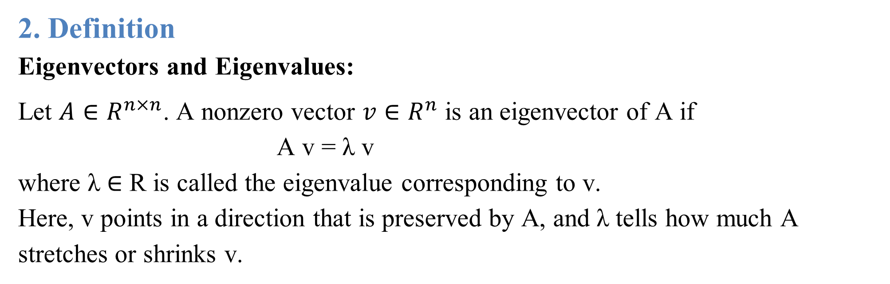

Slide 31
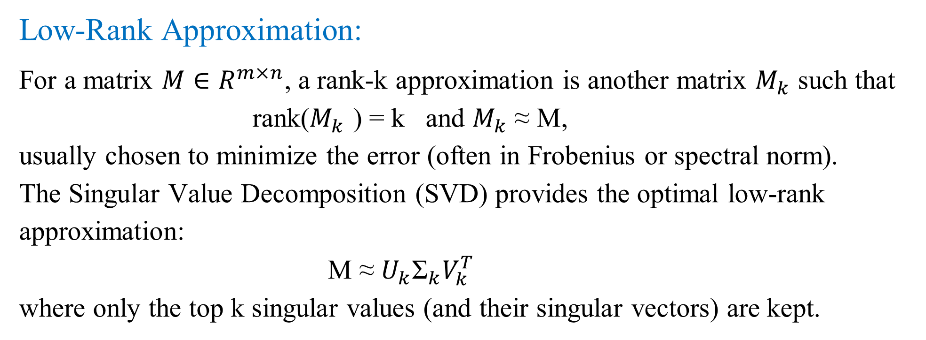

Slide 32
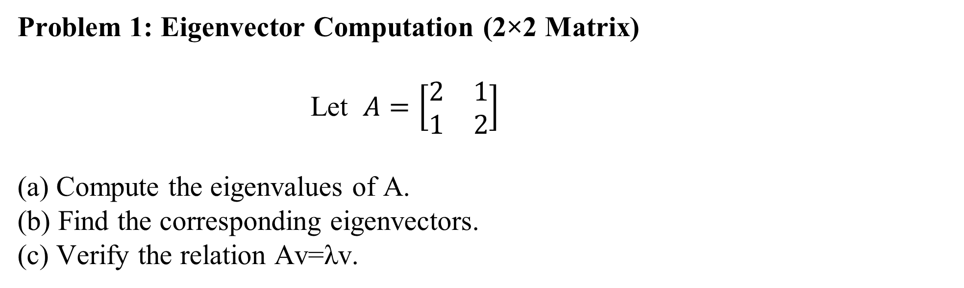

Slide 33
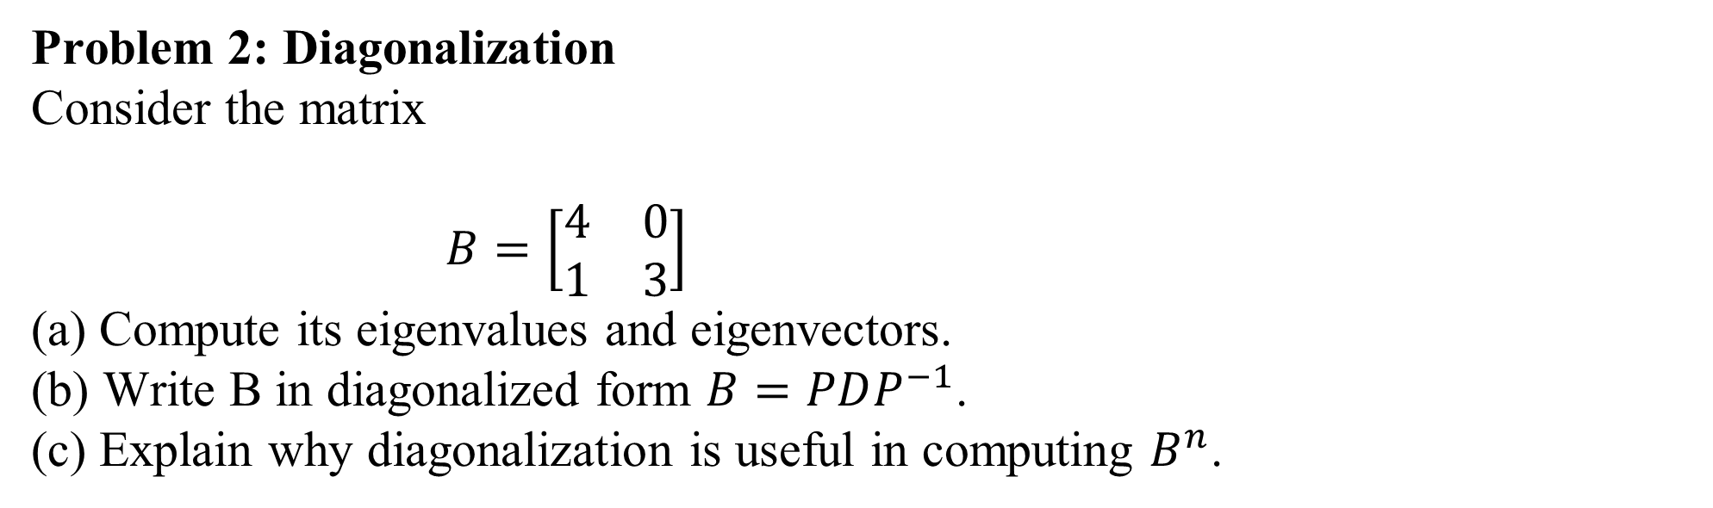

Slide 34
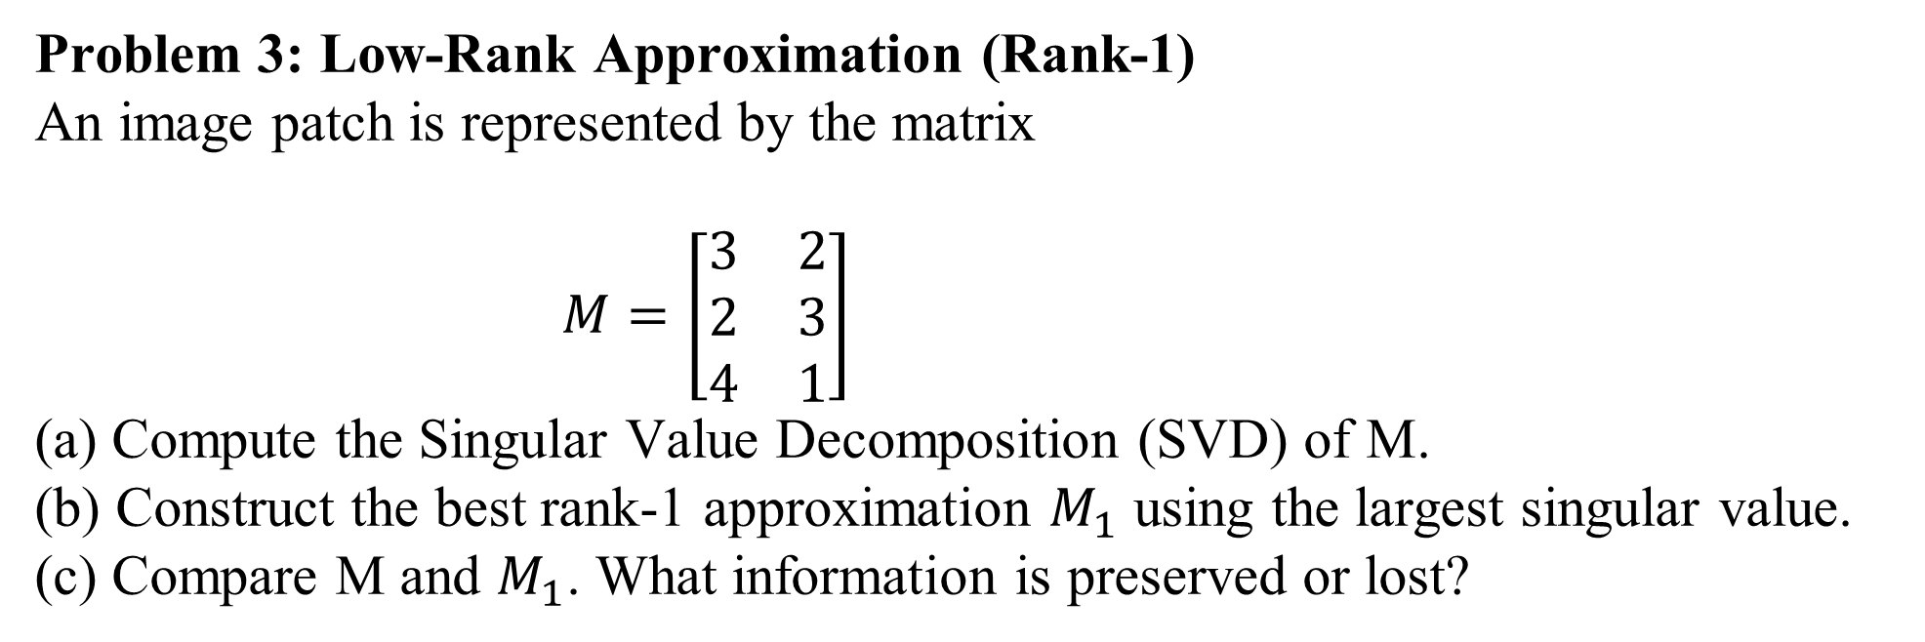

Slide 35
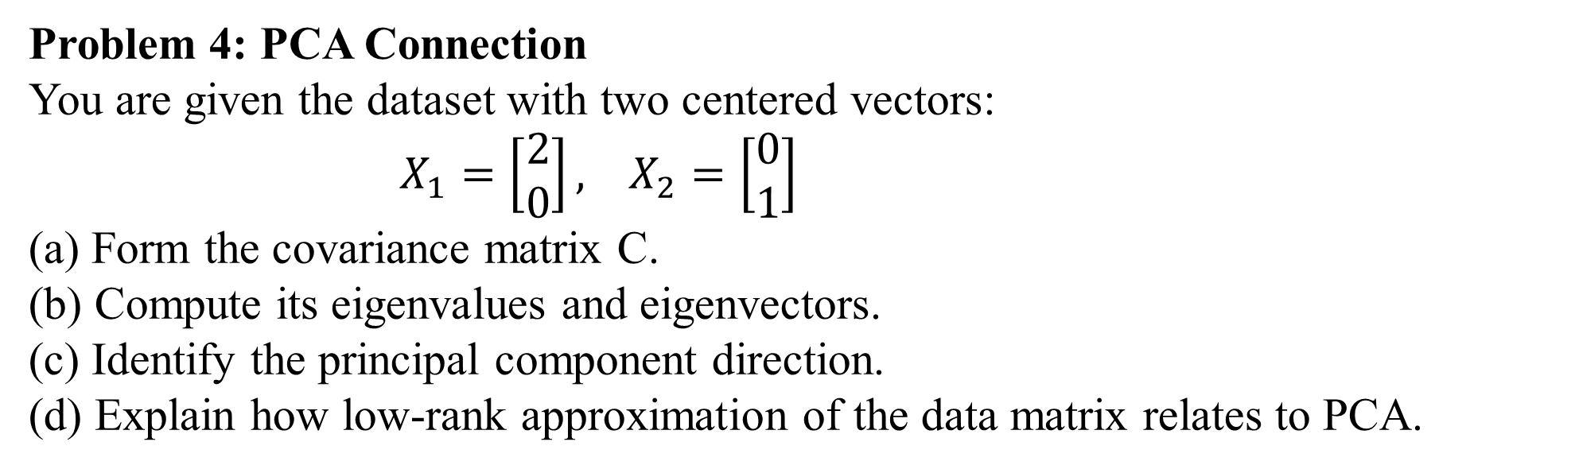

Slide 36
Reinforcement Learning (RL)
1. Introduction
Reinforcement Learning (RL) is a branch of machine learning where an agent learns to make decisions by interacting with an environment to achieve a goal. Unlike supervised learning, where the model learns from labeled data, RL is trial-and-error-based. The agent receives feedback in the form of rewards or penalties after performing actions, and it aims to maximize the cumulative reward over time.
RL has applications in robotics, autonomous vehicles, game playing (like Chess, Go, and video games), recommendation systems, and many real-world decision-making problems. Its power comes from the ability to learn optimal behavior in dynamic and uncertain environments without explicit instructions.

Slide 37
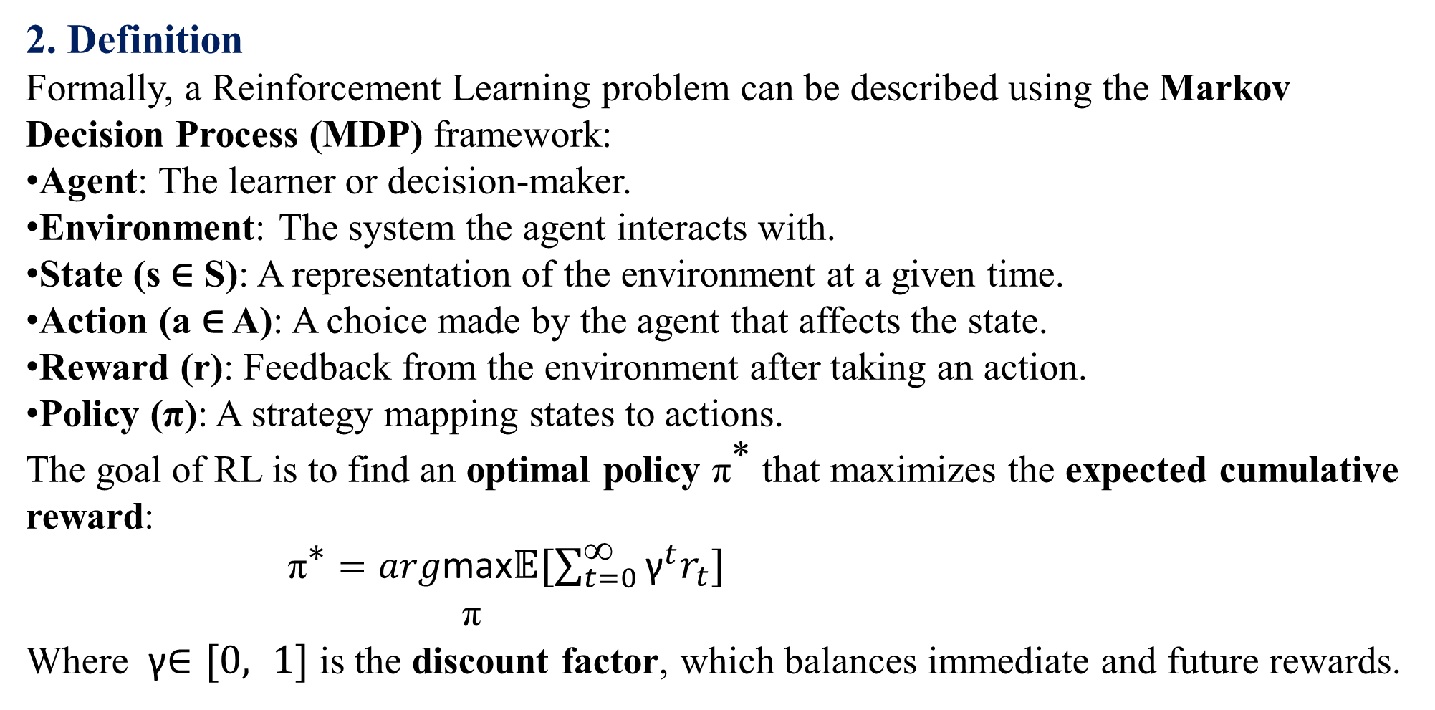

Slide 38
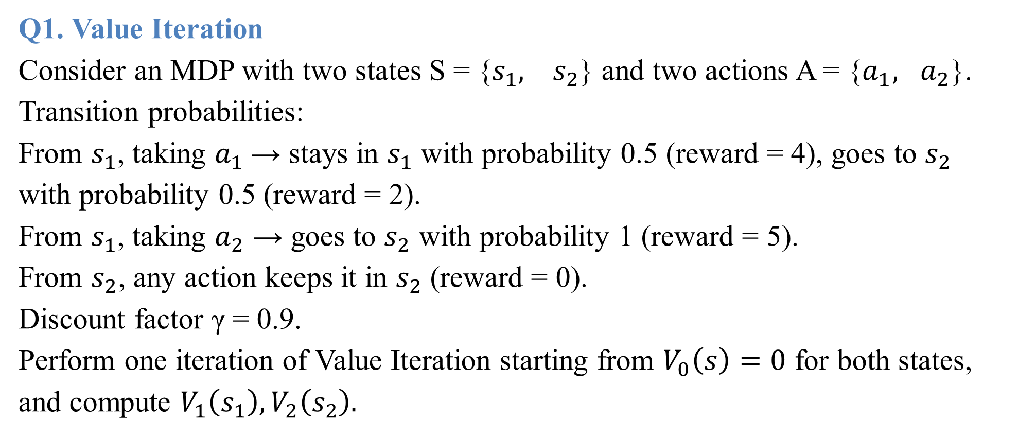

Slide 39
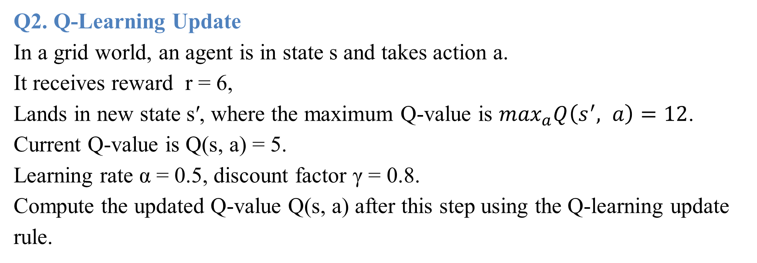

Slide 40
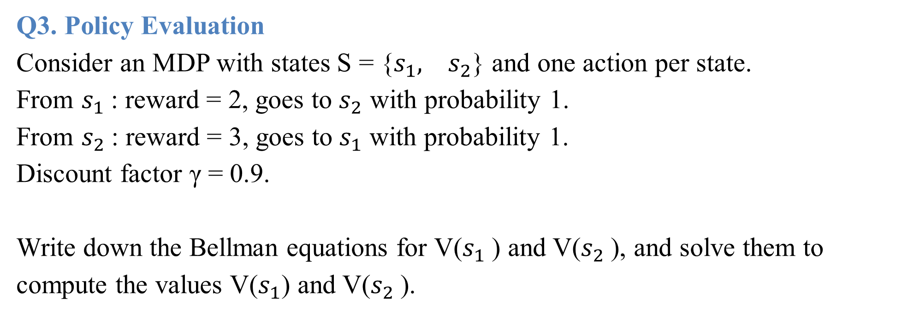

Slide 41
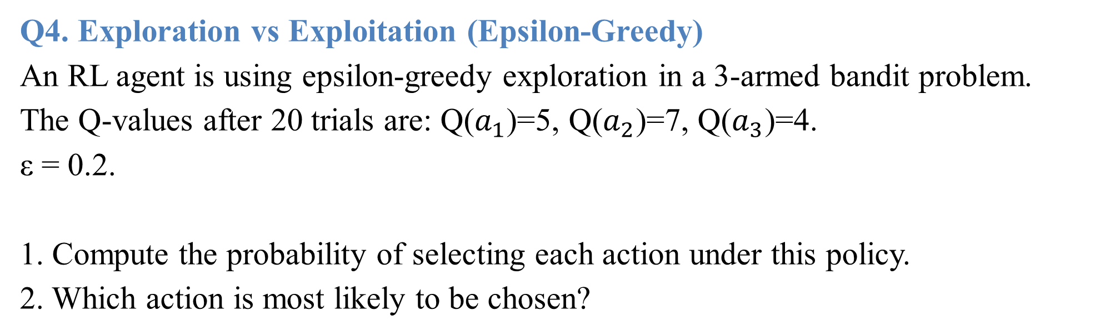

Slide 42
Uncertain Knowledge and Reasoning – Introduction
In real-world situations, information is rarely complete, consistent, or perfectly reliable. Unlike in pure mathematics or logic, where statements are either true or false, knowledge in everyday life and artificial intelligence often involves uncertainty.
For example:
A doctor diagnosing a patient does not always have complete information. Symptoms
may suggest multiple possible diseases.
A weather forecast may say “70% chance of rain,” indicating uncertainty rather than
certainty.
A robot navigating in an unknown environment may have incomplete sensor data.
Thus, uncertain knowledge refers to information that cannot be stated with absolute
certainty. Reasoning under uncertainty is the process of making rational decisions, predictions, or inferences despite having incomplete, noisy, or probabilistic data.

Slide 43
Why is Uncertainty Important?
Incomplete knowledge – We may not have access to all facts.
Noisy data : Sensor readings, survey results, or experiments may have errors.
Ambiguity : Multiple explanations may fit the same evidence.
Dynamic environments : The world changes, and knowledge may become outdated.
Approaches to Handle Uncertainty
Probability Theory : Uses probabilistic models (e.g., Bayes’ theorem) to measure
degrees of belief.
Fuzzy Logic : Handles vague concepts (e.g., “the room is warm”) by assigning partial
truth values between 0 and 1.
Belief Networks (Bayesian Networks) – Graphical models representing probabilistic
dependencies between variables.
Dempster Shafer Theory : A framework for reasoning with incomplete evidence.
Non-monotonic Logic : Allows conclusions to be withdrawn if new evidence
contradicts them.

Slide 44
Applications of Uncertain Reasoning:
Medical diagnosis (disease prediction from symptoms).
Weather forecasting.
Robotics (navigation with incomplete sensor data).
Natural Language Processing (understanding ambiguous human language).
Machine learning & AI (decision-making in uncertain environments).

Slide 45
Uncertainty
Definition :
Uncertainty is the lack of complete certainty about knowledge, facts, or outcomes. In Artificial Intelligence and reasoning systems, uncertainty arises when information is incomplete, inaccurate, unclear, or probabilistic. It represents the degree of belief or confidence in an event rather than absolute truth.

Slide 46
Q1. Probability of Event
A medical test detects a disease with 90% accuracy. The disease occurs in 1% of the population. If a person tests positive, what is the probability that the person actually has the disease? (Use Bayes’ theorem.)
Q2. Fuzzy Logic
In a fuzzy set describing “tall people”:
A person of height 170 cm has membership degree 0.4.
A person of height 190 cm has membership degree 0.9.
If a rule is: IF person is tall THEN eligible for basketball team, determine the eligibility degree for a person with height 170 cm and 190 cm.

Slide 47
Q3. Bayesian Network Inference
Consider a Bayesian network for Rain (R) and Sprinkler (S) causing the Grass Wet (G):
P(R=1) = 0.2, P(S=1) = 0.5.
P(G=1 | R=1, S=1) = 0.95.
P(G=1 | R=1, S=0) = 0.9.
P(G=1 | R=0, S=1) = 0.8.
P(G=1 | R=0, S=0) = 0.0.
Find P(G=1), i.e., the probability that the grass is wet.

Slide 48
Q4. Decision-Making under Uncertainty
An autonomous car must decide whether to stop or go at a traffic signal if the sensor is unreliable.
Probability that the light is actually RED = 0.7, GREEN = 0.3.
If the car GOES on RED → penalty = -100.
If the car STOPS on GREEN → penalty = -10.
If the car GOES on GREEN → reward = +50.
If the car STOPS on RED → reward = 0.
Which action (STOP or GO) maximizes the expected utility? Show calculations.

Slide 49
Probability
Definition: Probability is a measure of the likelihood that a specific event will occur. It quantifies uncertainty and ranges from 0 (impossible event) to 1 (certain event). In AI and Machine Learning (ML), probability is used to model uncertainty in data, predictions, and decisions, allowing algorithms to make informed choices even when complete information is unavailable.
For example:
Predicting whether an email is spam based on features.
Estimating the chance of a patient having a disease given symptoms.
Classifying images where the model outputs a probability distribution over classes.

Slide 50
Q1. Naive Bayes Classification
A Naive Bayes classifier is trained to classify emails as Spam or Not Spam.
P(Spam) = 0.3, P(Not Spam) = 0.7
P(“offer ”| Spam) = 0.8, P(“ offer ” | Not Spam) = 0.1
P(“ free”| Spam) = 0.7, P(“ free”| Not Spam) = 0.05
If an email contains the words “offer” and “free,” compute the posterior probability that it is Spam.

Slide 51
Q2. Probability in Regression
A linear regression model predicts house prices. Assume the error term ϵ is normally distributed: ϵ∼N(0,42).
Predicted price for a house = 50 lakh.
Observed price = 56 lakh.
Compute the probability of observing a price of 56 lakh or higher using the standard normal distribution.

Slide 52
Q3. Conditional Probability in Classification
In a dataset of 10,000 images:
60% are cats, 40% are dogs.
A classifier detects cats with 90% accuracy and misclassifies dogs as cats 20% of the time.
If the classifier predicts an image as a cat, compute the probability that it actually is a cat.

Slide 53
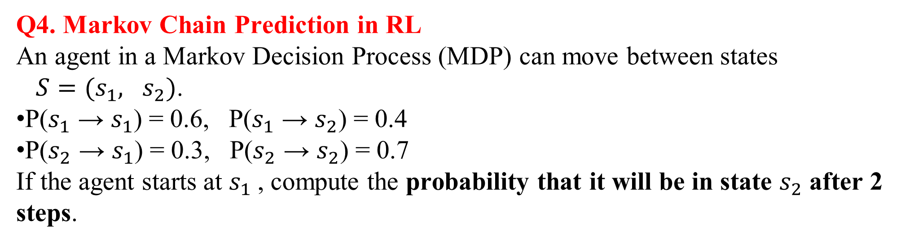

Slide 54
Joint Probability
Definition:
Joint Probability measures the probability of two or more events occurring simultaneously.
Mathematically, for two events A and B:
P(A∩B)=P(A and B)
Joint probabilities are essential for:
Naive Bayes classifiers (combining feature probabilities)
Bayesian Networks (modeling dependencies between variables)
Hidden Markov Models (HMMs) (joint probability over sequences of states and
observations)
Multivariate probability distributions in probabilistic machine learning models

Slide 55
Q1. Naive Bayes (Joint Probability)
In a spam detection system:
P(Spam) = 0.4, P(Not Spam) = 0.6
P(“ win ”| Spam) = 0.7, P(“ prize ”| Spam) = 0.6
P(“ win”| Not Spam) = 0.1, P(“ prize”| Not Spam) = 0.05
If an email contains the words “win” and “prize,” compute the joint probability of the email being Spam and containing these words:
P( Spam ∩ “ win ” ∩ “ prize ”)

Slide 56
Q2. Feature Joint Probability in Image Classification
A model classifies images as Cat or Dog based on two features: Fur Pattern (F) and Ear Shape (E).
P(F=striped | Cat) = 0.6, P(E=pointed | Cat) = 0.8
P(F=striped | Dog) = 0.3, P(E=pointed | Dog) = 0.4
P(Cat) = 0.5, P(Dog) = 0.5
Assuming features are independent given the class (Naive Bayes), compute the joint probability:
P(Cat ∩ F = striped ∩ E = pointed)

Slide 57
Q3. Joint Probability in Bayesian Networks
Consider a Bayesian network for Rain (R), Sprinkler (S), and Wet Grass (G):
P(R=1) = 0.2, P(S=1) = 0.5
P(G=1 | R=1, S=1) = 0.95, P(G=1 | R=1, S=0) = 0.9
P(G=1 | R=0, S=1) = 0.8, P(G=1 | R=0, S=0) = 0.0
Compute the joint probability:
P(R=1∩S=1∩G=1)

Slide 58
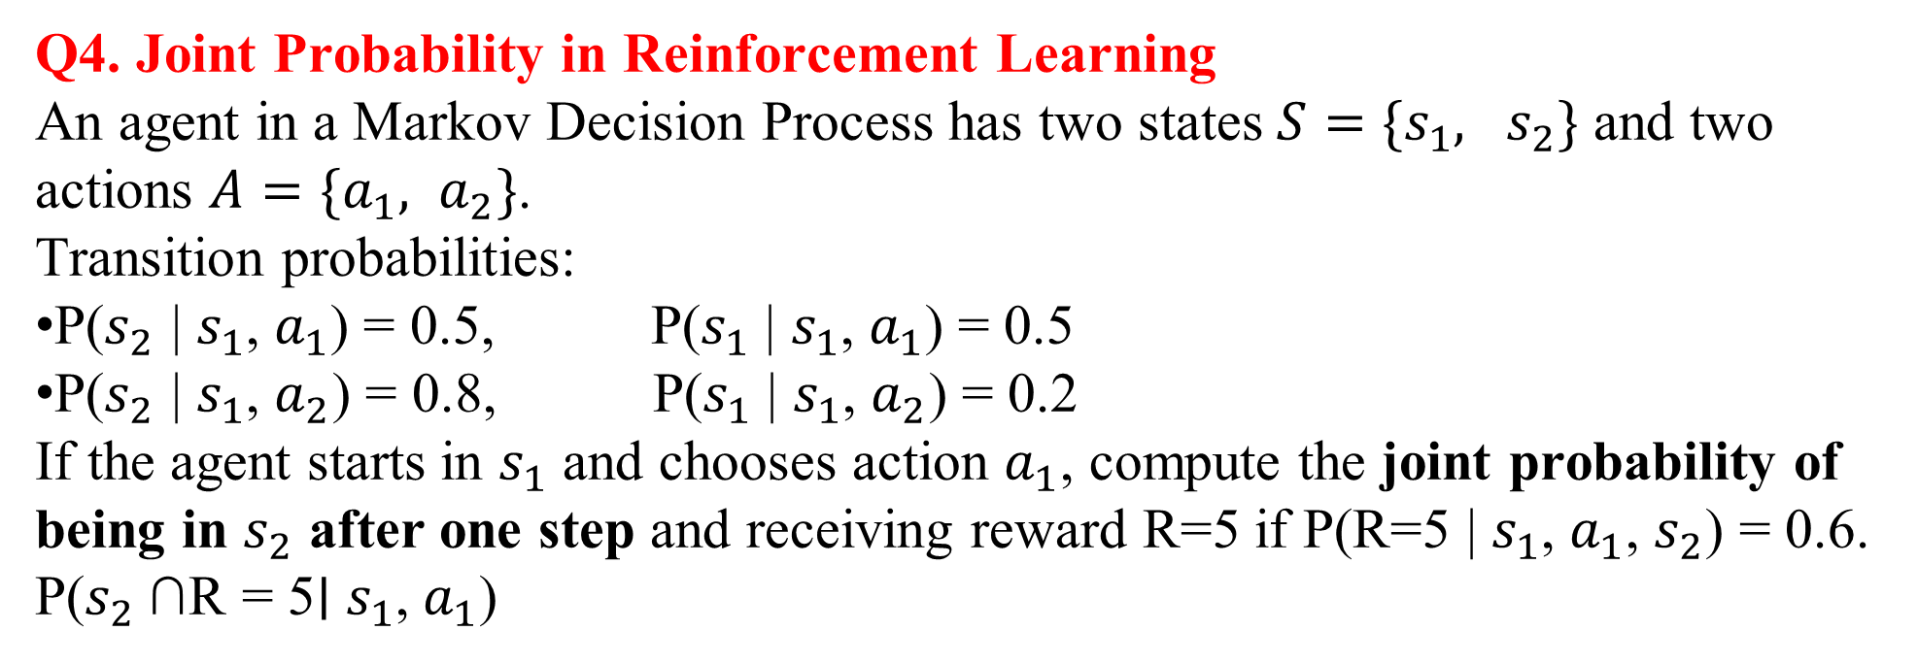

Slide 59
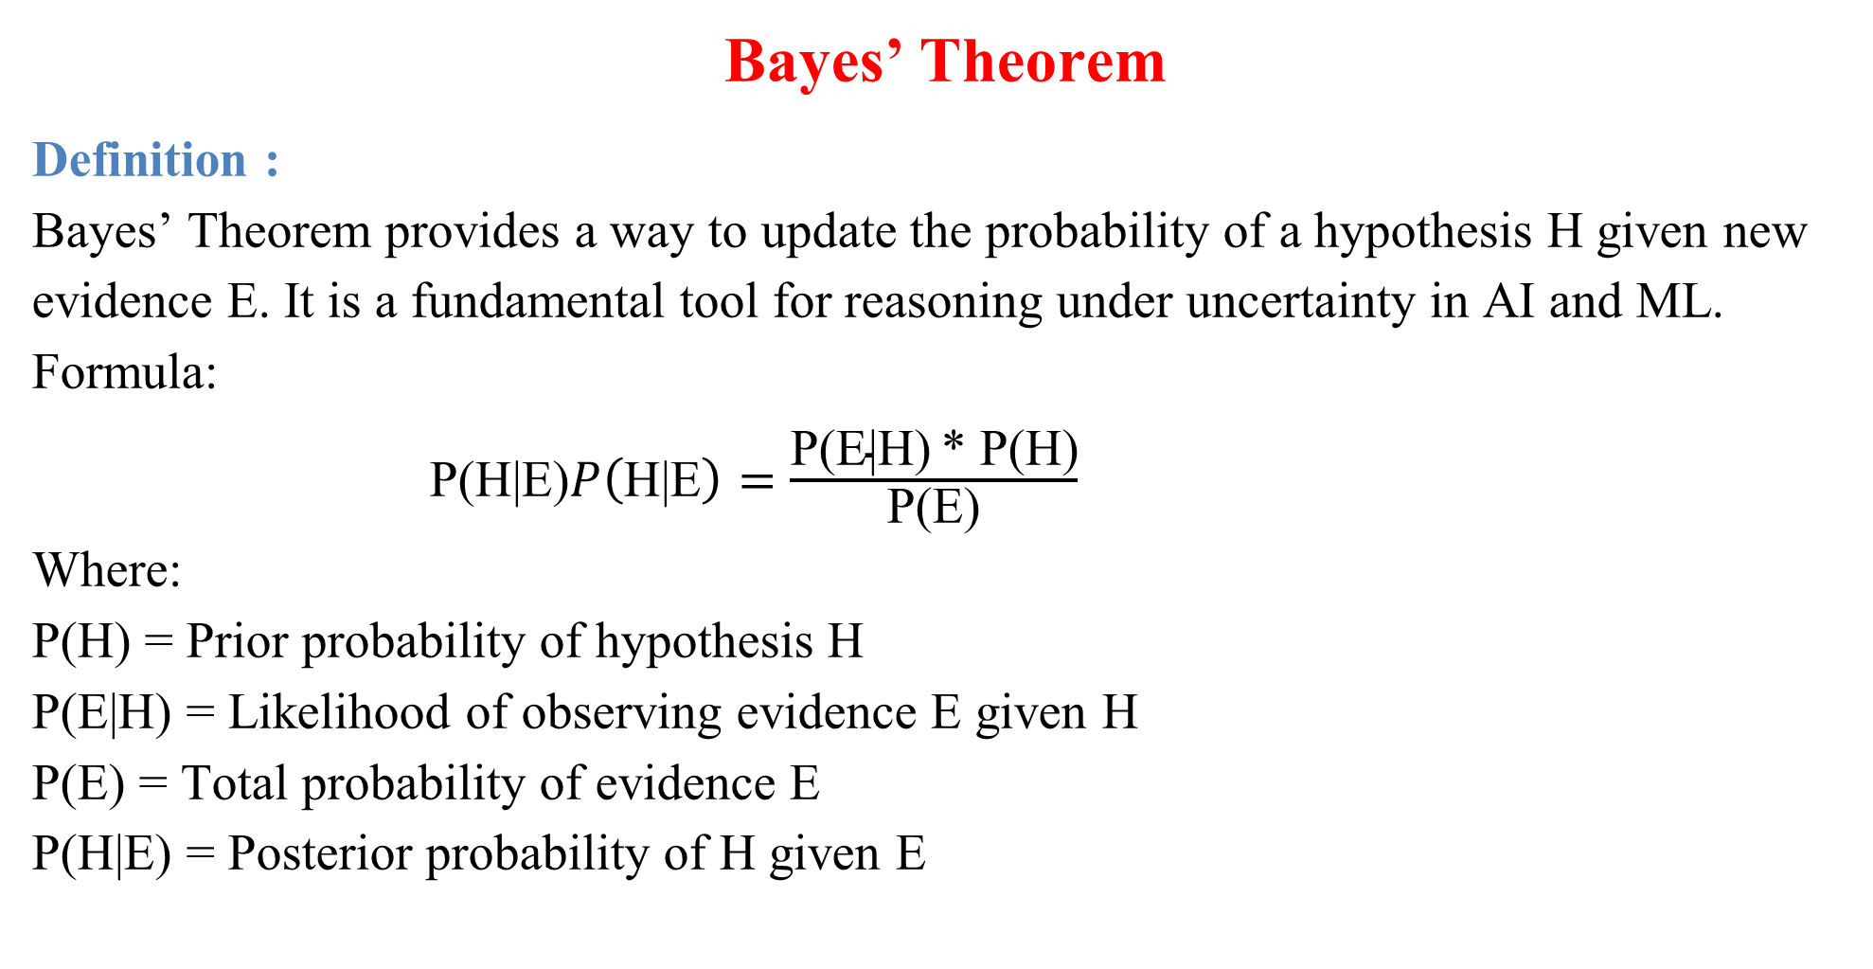

Slide 60
Q1. Spam Detection
A Naive Bayes spam filter: P(Spam) = 0.4, P(Not Spam) = 0.6 P(“ offer ”| Spam) = 0.7, P(“ offer ”| Not Spam) = 0.1 If an email contains the word “offer,” compute the posterior probability that it is Spam using Bayes’ theorem.
Q2. Medical Diagnosis
A disease occurs in 2% of a population. A diagnostic test detects the disease with 95% accuracy, but it has a 5% false positive rate. Compute the probability that a person actually has the disease given a positive test result.

Slide 61
Q3. Sentiment Analysis
In a dataset of movie reviews: P(Positive) = 0.6, P(Negative) = 0.4 P(word “great” | Positive) = 0.5, P(word “great” | Negative) = 0.1 If a review contains the word “great,” compute the probability that the review is positive.
Q4. Fault Detection in AI Systems
A sensor fails 1% of the time. A monitoring system flags an alarm if the sensor fails, with 90% detection probability. There is also a 2% false alarm rate when the sensor is working. If the system raises an alarm, compute the probability that the sensor actually failed.

Slide 62
Bayesian Belief Network (BBN):
Definition
A Bayesian Belief Network (BBN) is a probabilistic graphical model that represents a set of variables and their conditional dependencies using a directed acyclic graph (DAG). Each node corresponds to a random variable, and edges represent conditional dependencies between them. BBNs combine probability theory and graph theory to perform reasoning under uncertainty, making them widely used in AI/ML for classification, diagnosis, and decision-making.

Slide 63
Problem 1: Medical Diagnosis
A Bayesian Network is constructed for flu diagnosis with three nodes: F: Flu (Yes/No) C: Cough (Yes/No) Fv: Fever (Yes/No) The conditional probabilities are: P(F=Yes) = 0.1 P(C = Yes | F = Yes) = 0.8, P(C = Yes | F = No) = 0.2 P(Fv = Yes |F = Yes) = 0.7, P(Fv =Yes | F = No) = 0.1 If a patient has both cough and fever, compute the probability that they have flu using Bayes’ theorem and the network.

Slide 64
Problem 2: Spam Classification
A Bayesian Network is used for email spam detection with the following nodes: S: Spam (Yes/No) L: Contains link (Yes/No) W: Contains the word “free” (Yes/No) Given: P(S=Yes) = 0.3 P(L = Yes | S = Yes) = 0.7, P(L = Yes | S = No) = 0.2 P(W = Yes | S = Yes) = 0.8, P(W = Yes | S = No) = 0.1 If an email contains both a link and the word “free,” find the probability it is spam.

Slide 65
Problem 3: Fault Detection in AI System
An AI system has three nodes: F: System Fault (Yes/No) A: Alarm (Yes/No) S: Sensor reading abnormal (Yes/No) Probabilities: P(F=Yes) = 0.05 P(A = Yes | F = Yes) = 0.9, P(A = Yes | F = No) = 0.1 P(S = Yes | F = Yes) = 0.8, P(S = Yes | F = No) = 0.2 If both the alarm goes off and the sensor shows abnormal behavior, compute the probability that the system has a fault.

Slide 66
Problem 4: Weather Prediction for ML System
A Bayesian Network for predicting whether students attend an online ML class has three nodes: R: Rain (Yes/No) T: Traffic (Yes/No) A: Attendance (Yes/No) Probabilities: P(R=Yes) = 0.3 P(T = Yes | R = Yes) = 0.6, P(T = Yes | R = No) = 0.2 P(A = Yes | T = Yes) = 0.4, P(A = Yes | T = No) = 0.9 If it is raining and traffic is heavy, calculate the probability that attendance is high.

Slide 67
Inference in Belief Networks
Definition:
Inference in a Bayesian Belief Network (BBN) is the process of computing the probability of one or more unknown variables given evidence about other variables. It uses Bayes' rule, conditional independence, and the network's graphical structure to update beliefs. Common inference methods include exact inference (enumeration, variable elimination) and approximate inference (Monte Carlo sampling, likelihood weighting).

Slide 68
Problem 1: Medical Diagnosis
A belief network models disease diagnosis: Flu (F) → Fever (Fe) Flu (F) → Cough (C) Given: P(F=1) = 0.1 P(Fe=1 | F=1) = 0.8, P(Fe=1 | F=0) = 0.2 P(C=1 | F=1) = 0.7, P(C=1 | F=0) = 0.3 Compute P(F=1 | Fe=1, C=1).

Slide 69
Problem 2: Spam Classification
A belief network has: Spam (S) → Contains “Free” (F) Spam (S) → Contains “Win” (W) Given: P(S=1) = 0.4 P(F=1 | S=1) = 0.9, P(F=1 | S=0) = 0.2 P(W=1 | S=1) = 0.8, P(W=1 | S=0) = 0.1 Find P(S=1 | F=1, W=1).

Slide 70
Problem 3: Weather Prediction
Network: - Rain (R) → Wet Grass (G) - Sprinkler (S) → Wet Grass (G) Given: - P(R=1) = 0.3, P(S=1) = 0.4 - P(G=1 | R=1, S=1) = 0.95 - P(G=1 | R=1, S=0) = 0.9 - P(G=1 | R=0, S=1) = 0.8 - P(G=1 | R=0, S=0) = 0.0 Compute P(R=1 | G=1).

Slide 71
Problem 4: Fault Detection in a Machine
Network: Power Failure (P) → Machine Fails (M) Overheating (O) → Machine Fails (M) Given: P(P=1) = 0.05, P(O=1) = 0.1 P(M=1 | P=1, O=1) = 0.99 P(M=1 | P=1, O=0) = 0.9 P(M=1 | P=0, O=1) = 0.8 P(M=1 | P=0, O=0) = 0.01 Compute P(O=1 | M=1).

Slide 72
Temporal Models
Definition: Temporal Models
A Temporal Model is a probabilistic model that represents how a system evolves over time, capturing dependencies between past, present, and future states. These models extend Bayesian Networks by incorporating the time dimension, making them suitable for sequential data. Common types include: Hidden Markov Models (HMMs): used when the system has hidden (latent) states and observable outputs. Dynamic Bayesian Networks (DBNs): generalization of HMMs with complex dependencies across time slices. Kalman Filters: used for continuous state and observation spaces. Applications in AI/ML: speech recognition, activity recognition, predictive maintenance, stock prediction, reinforcement learning, and time-series forecasting.

Slide 73
Problem 1: Speech Recognition with HMM
States = {Silent, Speaking} Transition probabilities: P(Speaking → Speaking) = 0.7, P(Speaking → Silent) = 0.3 P(Silent → Silent) = 0.6, P(Silent → Speaking) = 0.4 Observation probabilities: P(word detected | Speaking) = 0.9 P(word detected | Silent) = 0.1 Question: If the system starts in Silent, compute the probability of the sequence [Silent → Speaking → Speaking] with observations [no word, word, word].

Slide 74
Problem 2: Predictive Maintenance with DBN
States = {Working, Faulty} Transition probabilities: P(Working → Working) = 0.8, P(Working → Faulty) = 0.2 P(Faulty → Faulty) = 0.6, P(Faulty → Working) = 0.4 Observation probabilities: If Working: P(Low vibration) = 0.85, P(High vibration) = 0.15 If Faulty: P(Low vibration) = 0.3, P(High vibration) = 0.7 Question: If the machine starts in Working and we observe [Low Vibration, High Vibration], compute the probability that it is in the Faulty state at the end.

Slide 75
Problem 3: Stock Market Prediction (HMM)
Hidden states = {Bull, Bear} Transition matrix: [[0.7, 0.3], [0.4, 0.6]] (rows: from Bull/Bear) Emission probabilities: Bull → P(Rise)=0.8, P(Fall)=0.2 Bear → P(Rise)=0.3, P(Fall)=0.7 Question: Given observations [Rise, Fall, Rise], compute the most likely hidden state sequence using the Viterbi Algorithm.

Slide 76
Problem 4: Human Activity Recognition with DBN
States = {Walking, Running} Transition probabilities: Walking → Walking = 0.6, Walking → Running = 0.4 Running → Running = 0.7, Running → Walking = 0.3 Observation probabilities: Walking → Low Acceleration = 0.8, High Acceleration = 0.2 Running → Low Acceleration = 0.3, High Acceleration = 0.7 Question: If observations are [Low, High, High], compute the probability that the person is Running at the last time step.

Slide 77
Markov Decision Process (MDP)
Definition: Markov Decision Process (MDP)
A Markov Decision Process (MDP) is a mathematical framework for modeling decision-making in environments where outcomes are partly random and partly under the control of an agent. An MDP is defined by the 5-tuple: MDP = (S, A, P, R, γ) S: Set of states A: Set of actions P(s’| s, a): Transition probability (probability of reaching state s' from state s by taking action a) R(s, a): Reward function (immediate reward received after action a in state s) γ (gamma): Discount factor, 0 ≤ γ < 1, which balances immediate vs. future rewards The goal is to find an optimal policy π* that maximizes the expected cumulative (discounted) reward.

Slide 78
Problem 1: Autonomous Taxi MDP
An autonomous taxi operates in a small grid world with: States (S): {At pickup, On route, At destination} Actions (A): {Pick up passenger, Drive, Drop off passenger} Rewards: Pickup = +5 Drop off = +10 Wrong action = -5 Task: Construct the MDP model (S, A, R) and determine the optimal policy for maximizing total reward.

Slide 79
Problem 2: Recommendation System MDP
A movie recommendation system is modeled as an MDP: States: {User satisfied, User neutral, User dissatisfied} Actions: {Recommend popular movie, Recommend niche movie} Rewards: If user satisfied = +10 If neutral = 0 If dissatisfied = -5 Transition probabilities: Popular movie → satisfied (0.6), neutral (0.3), dissatisfied (0.1) Niche movie → satisfied (0.4), neutral (0.4), dissatisfied (0.2) Task: Compute the expected reward for each action and recommend the best action.

Slide 80
Problem 3: Robot Navigation in Warehouse
A robot moves in a warehouse: States: {Start, Middle, Goal} Actions: {Left, Right} Rewards: If robot reaches Goal → Reward = +20 If robot crashes into wall → Reward = -10 Discount factor = 0.9 Task: Formulate the Bellman equation for the value function and compute the value of being at the 'Start' state.

Slide 81
Problem 4: Healthcare Treatment MDP
In a healthcare AI model: States: {Healthy, Sick, Critical} Actions: {No treatment, Basic treatment, Advanced treatment} Rewards: Healthy = +10 Sick = -5 Critical = -20 Transition dynamics: No treatment: Sick → Critical with probability 0.6 Basic treatment: Sick → Healthy (0.5), Sick (0.3), Critical (0.2) Advanced treatment: Sick → Healthy (0.7), Sick (0.2), Critical (0.1) Task: Build the MDP model and compute the best treatment action for the 'Sick' state.

