Slide 1

Subject:Mathematics for Artificial Intelligence Subject Code:23AIPC304
MANGALORE INSTITUTE OF TECHNOLOGY & ENGINEERING
(A Unit of Rajalaxmi Education Trust®, Mangalore)
Autonomous Institute affiliated to VTU, Belagavi, Approved by AICTE, New Delhi
Accredited by NAAC with A+ Grade & ISO 9001:2015 Certified Institution

Slide 2
Module 1: Vectors and Matrix Decomposition | No.of Hrs: 5+5
Vector Spaces, Linear Independence, Basis & Rank, Norms, Inner Product, Lengths & Distances, Orthogonal Projections, Rotations, Matrix Decompositions: Eigenvalues and Eigenvector, Cholesky Decomposition, Eigen decomposition and Diagonalization, Singular Value Decomposition, Matrix Approximation.

Slide 3
The Role of Mathematics in Deep Learning
Mathematics provides the language and logic behind deep learning algorithms. Mastery of mathematical principles empowers students to move beyond using AI tools to innovating and improving them for real-world applications like healthcare, finance, robotics, and natural language processing.

Slide 4
Vector Space:
A vector space is a fundamental concept in linear algebra that refers to a collection of vectors, which can be added together and multiplied ("scaled") by numbers (called scalars), and still remain within the space. These vectors follow specific algebraic rules like associativity, distributivity, and the existence of a zero vector.

Slide 5
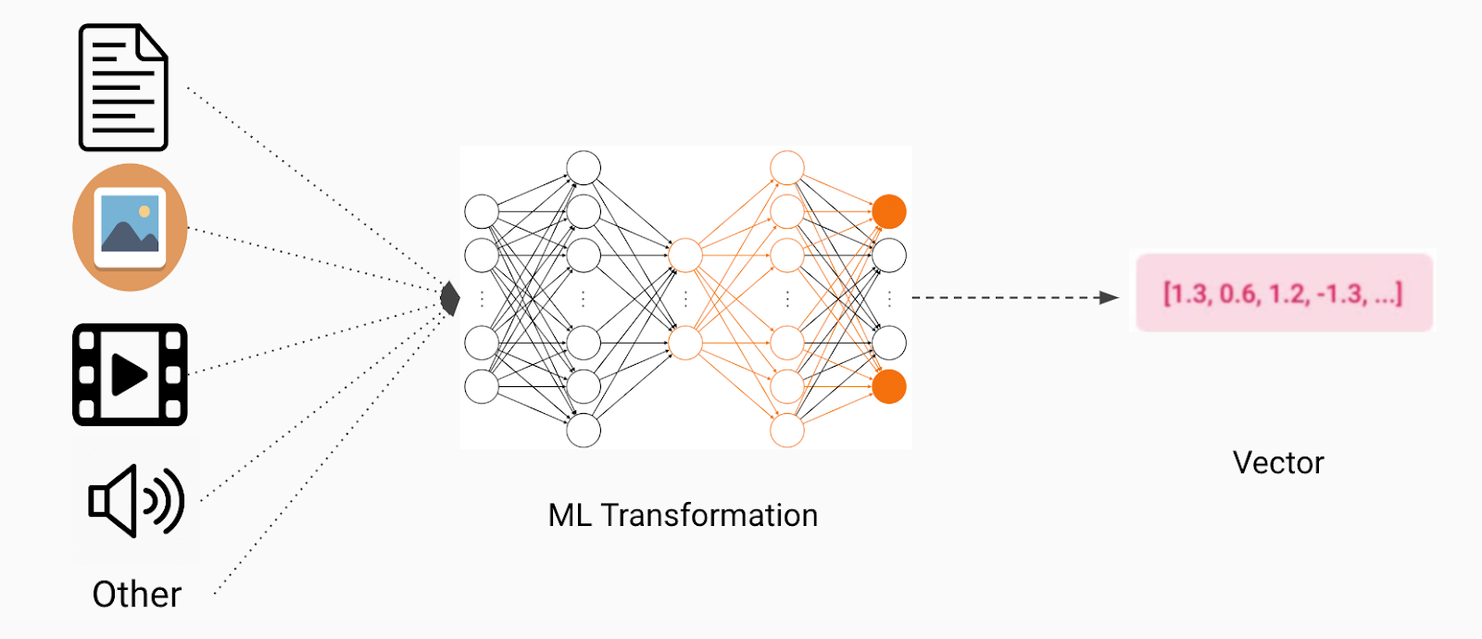
Vector as Input Embeddings Raw data like words, images, audio gets encoded into dense vector embeddings. These vectors represent semantic meaning in a high‑dimensional space. For example, NLP embeddings place semantically similar words near each other

Slide 6
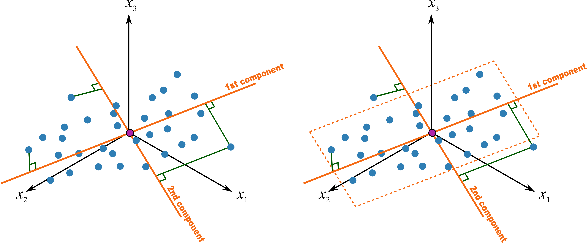
Vector Spaces & Feature Representations Vectors represent features (e.g. RGB for colors, user-item ratings, or text features). Machines analyze these using linear algebra operations like dot products, scaling, and projections

Slide 7

Weights & Activations in Neural Networks In a neural network even a simple multilayer perceptron input vectors are multiplied by weight vectors per neuron, summed with bias, then passed through activation functions to produce output vectors. During training, backpropagation adjusts weight vectors in vector space to minimize prediction error

Slide 8
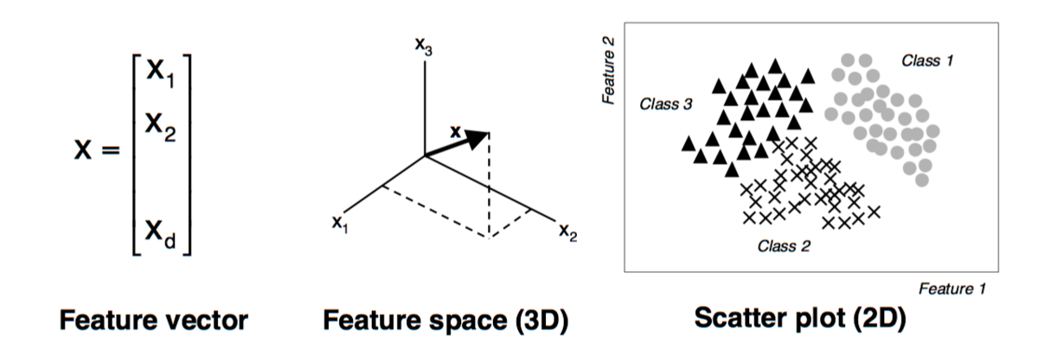
Embeddings & Similarity Search After training, embeddings (e.g. for documents, users, or images) can be stored in a vector database. Queries are converted to vectors, and the most semantically similar items are retrieved via nearest-neighbor search in vector space

Slide 9
Definition:
A vector space over a field 𝔽 (usually ℝ or ℂ) is a set V equipped with two operations:
Vector addition: u + v ∈ V for all u, v ∈ V
Scalar multiplication: a ⋅ v ∈ V for all v ∈ V and a ∈ F
This space must satisfy axioms like:
u + v = v + u (commutativity)
a (b c) = (a b) c (associativity of scalar multiplication)
Existence of zero vector 0 ∈ V such that v + 0 = v
etc.

Slide 10
Groups
1. Introduction:
A group is a fundamental concept in abstract algebra. It provides a mathematical way to study symmetry and structure, and is widely used in many areas of mathematics, physics, and computer science — including Artificial Intelligence (AI), particularly in:
Geometric transformations (e.g., image recognition)
Symmetry-based deep learning models (e.g., equivariant neural networks)
Cryptography in AI security
Reinforcement learning with structured actions

Slide 11
2. Definition of a Group : A group is a set G with a binary operation ∗ (e.g., addition or multiplication) that satisfies the following four axioms:
If the operation is also commutative (i.e., a ∗ b = b ∗ a), then the group is called an Abelian group.

Slide 12
Examples:
Integers under Addition
Set: Z (set of all integers)
Operation: Addition +
Why it's a group:
Closure: a + b ∈ Z for all a, b ∈ Z
Associativity: (a + b) + c = a + (b + c)
Identity: 0 ∈ Z and a + 0 = a
Inverses: For every a, the inverse is −a, since a + (−a) = 0
So it satisfies all group axioms. Hence it is a Group

Slide 13
Example 2: A 2 × 2 Invertible Matrices under Multiplication
Set: GL(2, R) : Set of all invertible 2×2 real matrices
Operation: Matrix multiplication
Why it's a group :
Closure: Product of invertible matrices is invertible
Associativity: Matrix multiplication is associative
Identity: Identity matrix I satisfies AI = IA = A
Inverses: Every element in GL(2, R) has an inverse
Hence, it's a Group
Note: GL (2, R) stands for the General Linear Group of degree 2 over the real numbers R.
Formally: GL (2, R) = {A∈R^{2×2} ∣det(A)| ≠ 0}

Slide 14
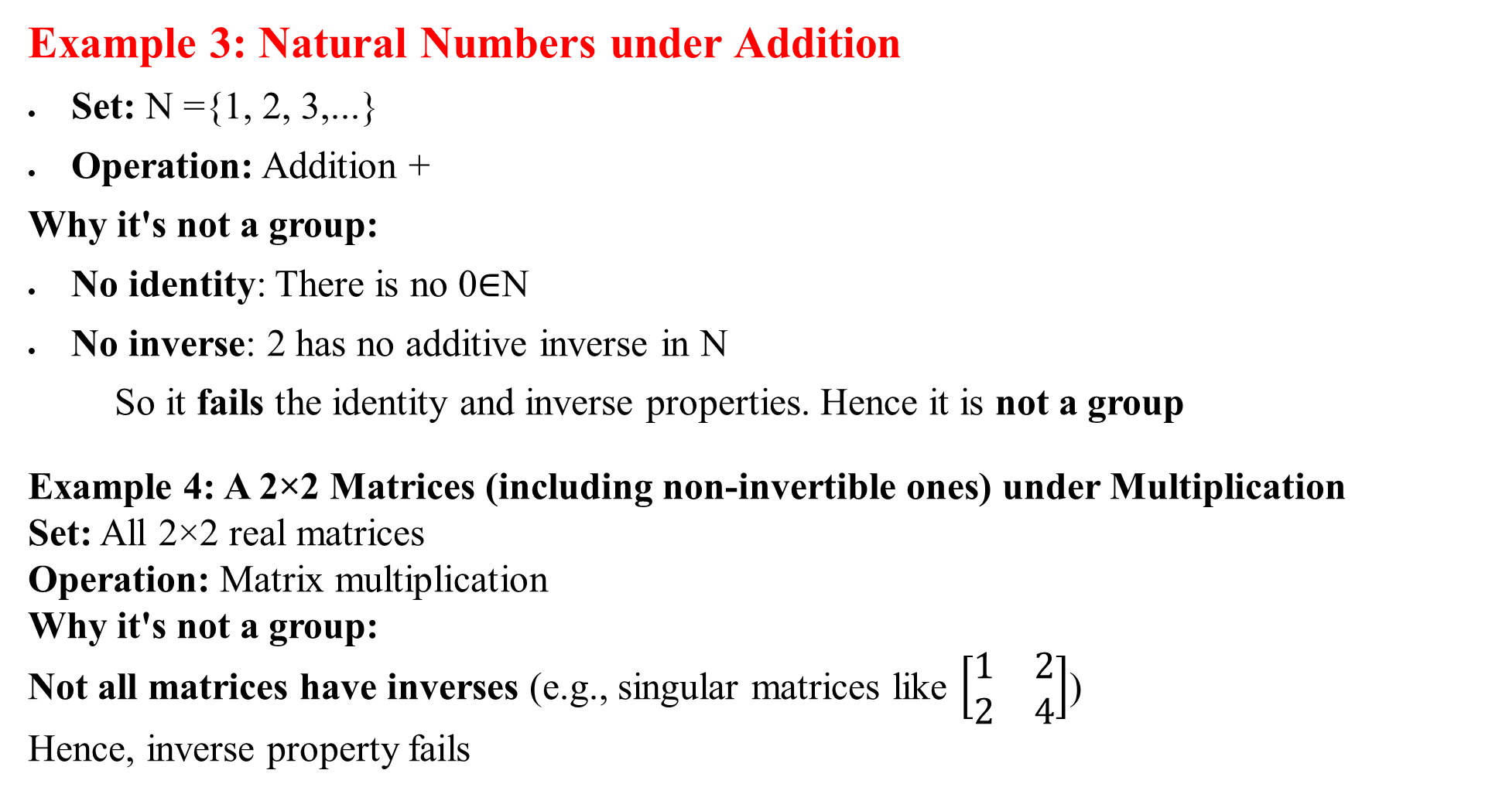
Example 3: Natural Numbers under Addition
Set: N ={1, 2, 3,...}
Operation: Addition +
Why it's not a group:
No identity: There is no 0∈N
No inverse: 2 has no additive inverse in N
So it fails the identity and inverse properties. Hence it is not a group
Example 4: A 2×2 Matrices (including non-invertible ones) under Multiplication
Set: All 2×2 real matrices
Operation: Matrix multiplication
Why it's not a group:
Not all matrices have inverses (e.g., singular matrices like $\left[\begin{matrix}1 & 2 \\ 2 & 4\end{matrix}\right]$)
Hence, inverse property fails

Slide 15
What is R^{n} (Read as “R to the power n”)?
Definition:
R^{n} = {x⃗ = (x₁, x₂,..…, x_{n}) ∣ x_{i} ​∈ R for i = 1, 2,…..., n}
It is the set of all ordered n-tuples of real numbers.
Each element is a vector of n real numbers
It forms an n-dimensional real vector space
Examples:
R¹: Real line → Scalars like (2), (5.7)
R²: 2D plane → Vectors like (1, 3), (−2, 0)
R³: 3D space → Vectors like (4,−1,7)
R¹⁰⁰: 100-dimensional space. Used in ML/AI for high-dimensional feature vectors

Slide 16
What is a Vector Space:
A vector space is a set V with two operations
Let u⃗ = (u₁, u₂…..u_{n}), v⃗ = (v₁, v₂......,v_{n}), and a ∈ R
Addition: u⃗ + v⃗ = (u₁ + v₁,.....,u_{n} + v_{n})
Scalar multiplication: au⃗=(au₁,.....,au_{n})
These operations must satisfy eight axioms (associativity, distributivity, identity elements, inverses, etc.).

Slide 17
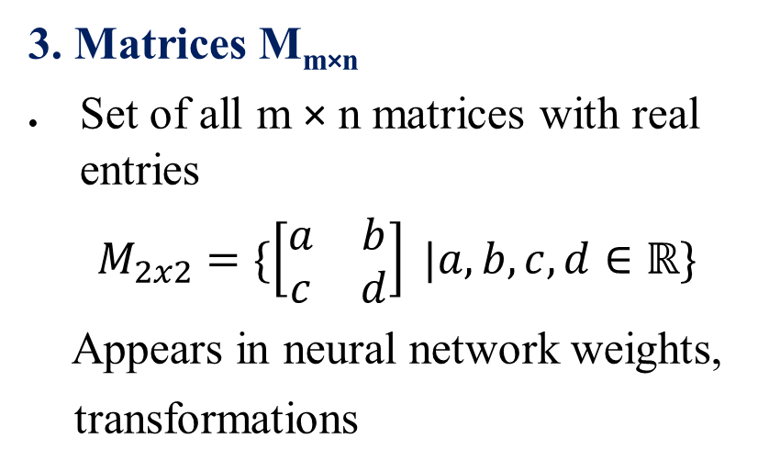
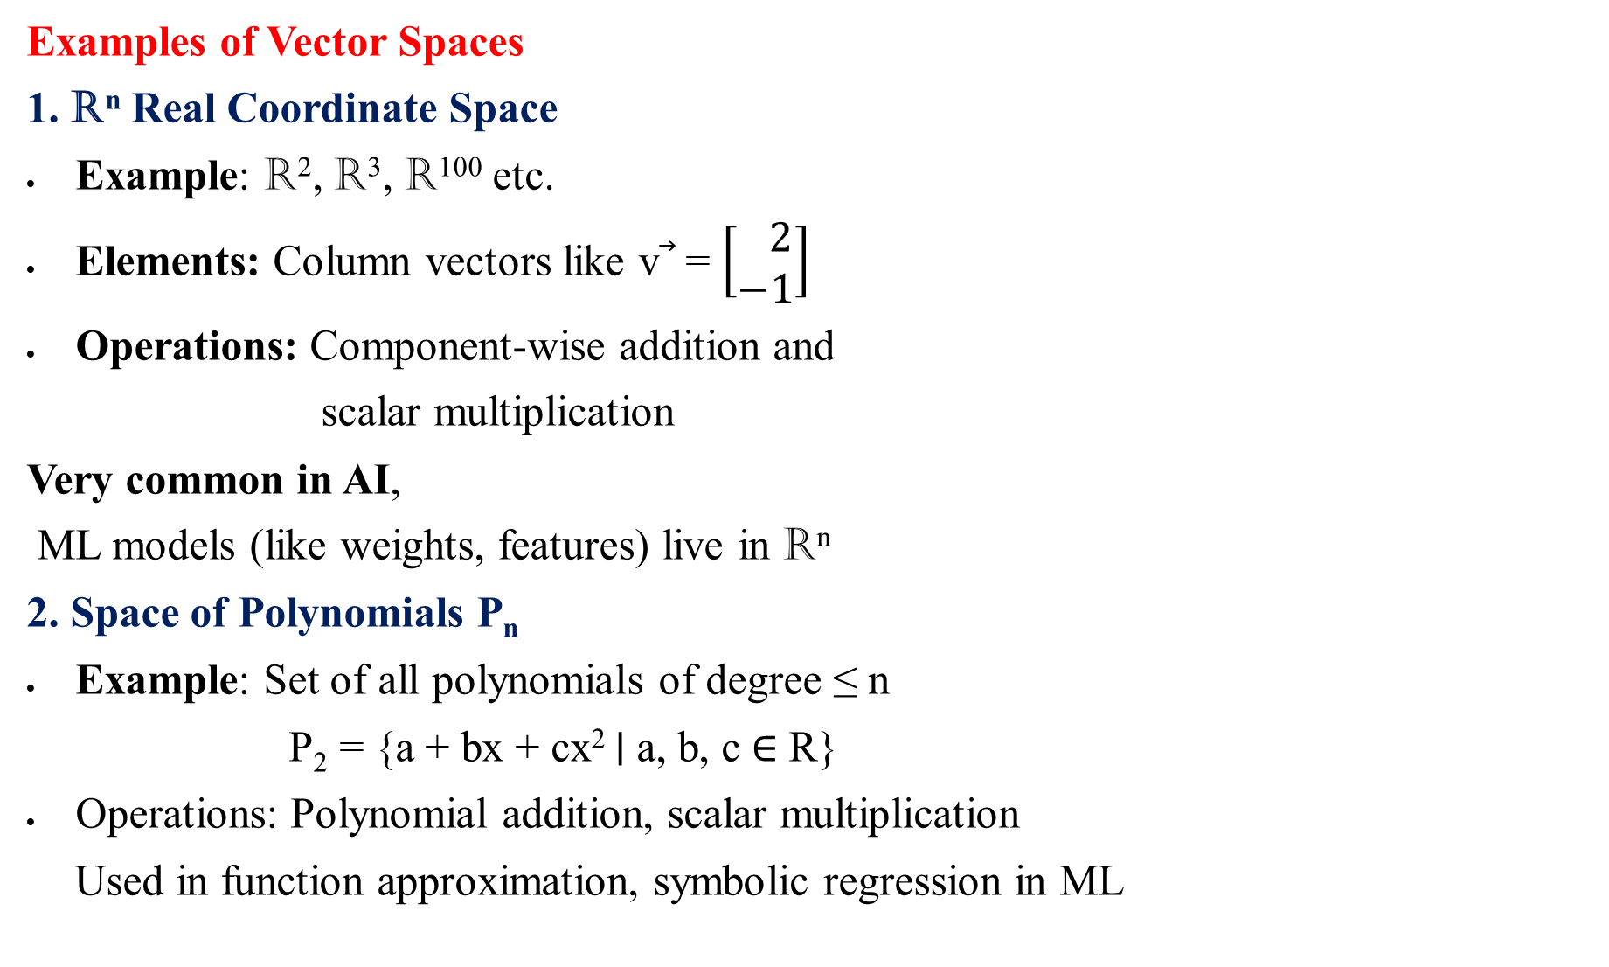
Examples of Vector Spaces
1. R^{n} Real Coordinate Space
Example: R², R³, R¹⁰⁰ etc.
Elements: Column vectors like v⃗ = $\left[\begin{matrix} 2 \\ −1\end{matrix}\right]$
Operations: Component-wise addition and
scalar multiplication
Very common in AI,
ML models (like weights, features) live in R^{n}
2. Space of Polynomials P_{n}​
Example: Set of all polynomials of degree ≤ n
P₂​ = {a + bx + cx² ∣ a, b, c ∈ R}
Operations: Polynomial addition, scalar multiplication
Used in function approximation, symbolic regression in ML
3. Matrices M_{m×n}
Set of all m × n matrices with real entries
$M_{2x2}=\{\left[\begin{matrix}a & b \\ c & d\end{matrix}\right] |a,b,c,d∈ℝ\}$
Appears in neural network weights,
transformations

Slide 18
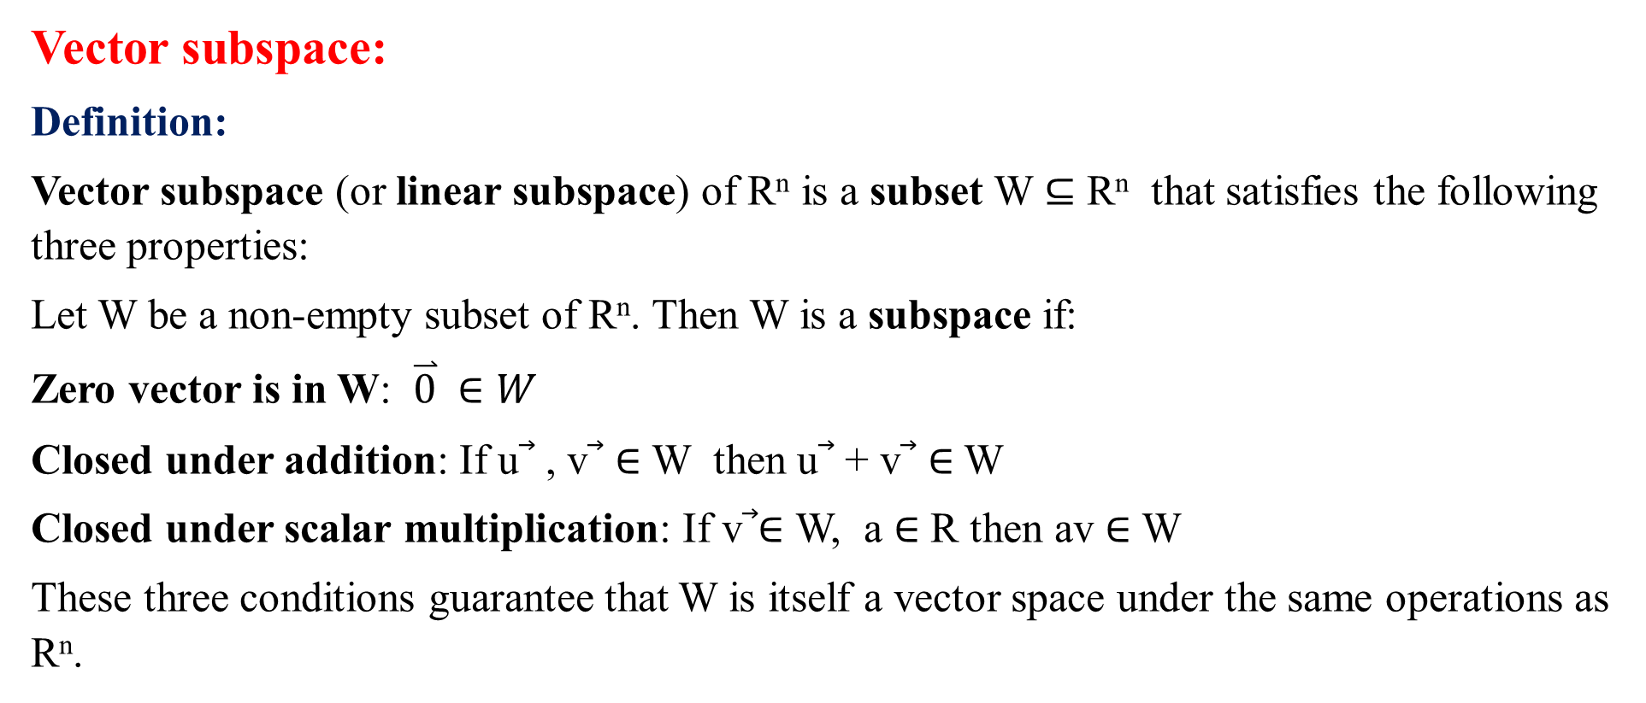
Vector subspace:
Definition:
Vector subspace (or linear subspace) of R^{n} is a subset W ⊆ R^{n} that satisfies the following three properties:
Let W be a non-empty subset of R^{n}. Then W is a subspace if:
Zero vector is in W: $\overset{⃑}{0} ∈W$
Closed under addition: If u⃗ , v⃗ ∈ W then u⃗ + v⃗ ∈ W
Closed under scalar multiplication: If v⃗∈ W, a ∈ R then av ∈ W
These three conditions guarantee that W is itself a vector space under the same operations as R^{n}.

Slide 19
Linear Dependent Vectors
Introduction
In vector algebra, we often work with a set of vectors. A key question is: Are these vectors independent, or can some of them be written using others? This leads us to the idea of linear dependence.
Definition: Linear Dependence
A set of vectors {v₁, v₂, ..., vₙ} is said to be linearly dependent if there exist scalars (real numbers) a₁, a₂, ..., aₙ, not all zero, such that: a₁v₁ + a₂v₂ + ... + aₙvₙ = 0 This means at least one vector can be written as a combination of the others.
Key Idea
If one vector depends on the others, they are linearly dependent.
If no vector depends on others, they are linearly independent.

Slide 20


Example 2: 3D Vectors
Let: $v_{1}$ = $\left[\begin{matrix}1 \\ 2 \\ 3\end{matrix}\right], v_{2}=\left[\begin{matrix}2 \\ 4 \\ 6\end{matrix}\right], v_{3}=\left[\begin{matrix}3 \\ 6 \\ 9\end{matrix}\right]$ All vectors are multiples of v₁: v₂ = 2*v₁, v₃ = 3*v₁ That means: -2*v₁ + v₂ = 0 or -3*v₁ + v₃ = 0 Hence, the set is linearly dependent.
Example 1: 2D Vectors
Let: $v_{1}=\left[\begin{matrix}2 \\ 4\end{matrix}\right], v_{2}=\left[\begin{matrix}1 \\ 2\end{matrix}\right]$ Try to find a₁, a₂ (not both zero) such that: a₁v₁ + a₂v₂ = 0 Try a₁ = 1, a₂ = -2: 1* $\left[\begin{matrix}2 \\ 4\end{matrix}\right]$ + (-2)* $\left[\begin{matrix}1 \\ 2\end{matrix}\right]$ = $\left[\begin{matrix}0 \\ 0\end{matrix}\right]$ So the vectors are linearly dependent.

Slide 21

Problems:
1. Consider $R^{4}$ with
$x_{1}=\left[\begin{matrix} 1 \\ 2 \\ \begin{matrix}−3 \\ 4\end{matrix}\end{matrix}\right]$, $x_{2}=\left[\begin{matrix}1 \\ 1 \\ \begin{matrix}0 \\ 2\end{matrix}\end{matrix}\right]$ , $x_{3}=\left[\begin{matrix}−1 \\ −2 \\ \begin{matrix} 1 \\ 1\end{matrix}\end{matrix}\right]$.
Check they are linearly dependent?
2. Given
$y_{1}=\left[\begin{matrix} 2 \\ 1 \\ \begin{matrix}−1 \\ 0\end{matrix}\end{matrix}\right]$, $y_{2}=\left[\begin{matrix} 4 \\ 2 \\ \begin{matrix}−2 \\ 0\end{matrix}\end{matrix}\right]$ , $y_{3}=\left[\begin{matrix}1 \\ 0 \\ \begin{matrix}1 \\ 3 \end{matrix}\end{matrix}\right]$.
Are the vectors linearly dependent?
3. Given
$z_{1}=\left[\begin{matrix} 1 \\ −1 \\ \begin{matrix} 0 \\ 2\end{matrix}\end{matrix}\right]$, $z_{2}=\left[\begin{matrix} 0 \\ 2 \\ \begin{matrix} 1 \\ −1\end{matrix}\end{matrix}\right]$ , $z_{3}=\left[\begin{matrix}1 \\ 1 \\ \begin{matrix}1 \\ 1\end{matrix}\end{matrix}\right]$.
Are the vectors are linearly dependent?

Slide 22
Linear Independent Vectors
Introduction
In vector algebra, we often need to determine whether a set of vectors contains any redundancy. This leads us to the concept of linear independence. A set of vectors is linearly independent if no vector in the set can be written as a combination of the others.
Definition: Linear Independence
A set of vectors {v₁, v₂, ..., vₙ} is said to be linearly independent if the only solution to the equation: a₁v₁ + a₂v₂ + ... + aₙvₙ = 0 is: a₁ = a₂ = ... = aₙ = 0 This means none of the vectors can be written as a combination of the others.
Key Idea
If no vector in the set can be formed from a combination of the others, the vectors are linearly independent.
Linear independence implies uniqueness in representation.

Slide 23
Example 1: 2D Vectors
Let: v₁ = [1, 0], v₂ = [0, 1] Try to find scalars a₁, a₂ such that: a₁v₁ + a₂v₂ = [0, 0] This gives: a₁ * [1, 0] + a₂ * [0, 1] = [a₁, a₂] = [0, 0] → a₁ = 0, a₂ = 0 Since the only solution is the trivial one, the vectors are linearly independent.
Example 2: 3D Vectors
Let: v₁ = [1, 0, 0], v₂ = [0, 1, 0], v₃ = [0, 0, 1] These are the standard basis vectors in ℝ³. Suppose a₁v₁ + a₂v₂ + a₃v₃ = [0, 0, 0] Then: a₁ * [1, 0, 0] + a₂ * [0, 1, 0] + a₃ * [0, 0, 1] = [a₁, a₂, a₃] = [0, 0, 0] → a₁ = a₂ = a₃ = 0 Hence, these vectors are linearly independent.

Slide 24
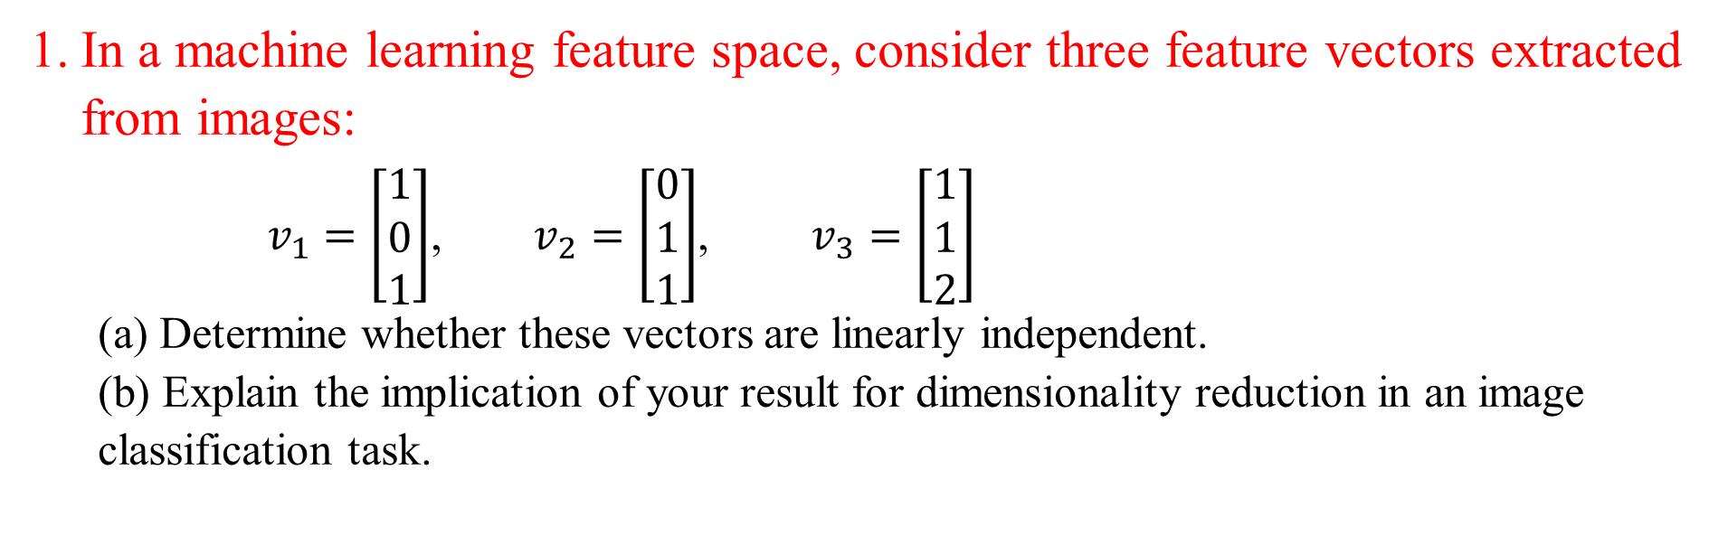
In a machine learning feature space, consider three feature vectors extracted from images:
$v_{1}=\left[\begin{matrix}1 \\ 0 \\ 1\end{matrix}\right]$, $v_{2}=\left[\begin{matrix}0 \\ 1 \\ 1\end{matrix}\right]$, $v_{3}=\left[\begin{matrix}1 \\ 1 \\ 2\end{matrix}\right]$ (a) Determine whether these vectors are linearly independent. (b) Explain the implication of your result for dimensionality reduction in an image classification task.
Solution: (a) Linear (in)dependence

Slide 25
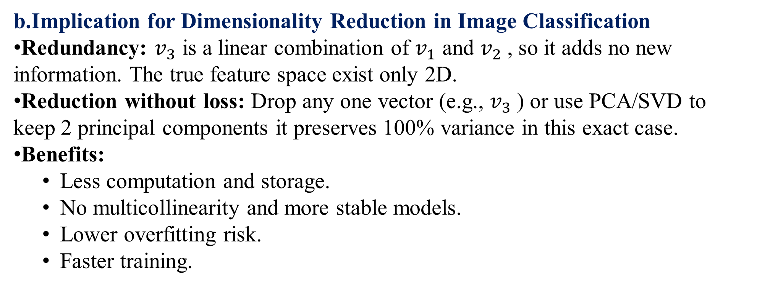
b.Implication for Dimensionality Reduction in Image Classification
Redundancy: $v_{3}$ is a linear combination of $v_{1}$ and $v_{2}$​, so it adds no new information. The true feature space exist only 2D.
Reduction without loss: Drop any one vector (e.g., $v_{3}$​) or use PCA/SVD to keep 2 principal components it preserves 100% variance in this exact case.
Benefits:
Less computation and storage.
No multicollinearity and more stable models.
Lower overfitting risk.
Faster training.

Slide 26
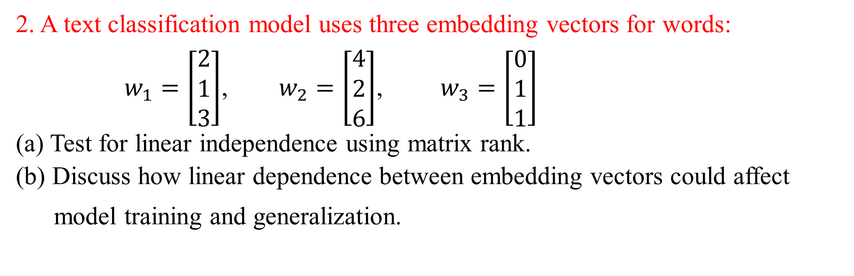
2. A text classification model uses three embedding vectors for words: $w_{1}=\left[\begin{matrix}2 \\ 1 \\ 3\end{matrix}\right]$, $w_{2}=\left[\begin{matrix}4 \\ 2 \\ 6\end{matrix}\right]$, $w_{3}=\left[\begin{matrix}0 \\ 1 \\ 1\end{matrix}\right]$ (a) Test for linear independence using matrix rank. (b) Discuss how linear dependence between embedding vectors could affect
model training and generalization.
Solution: (a) Linear independence (matrix rank)

Slide 27
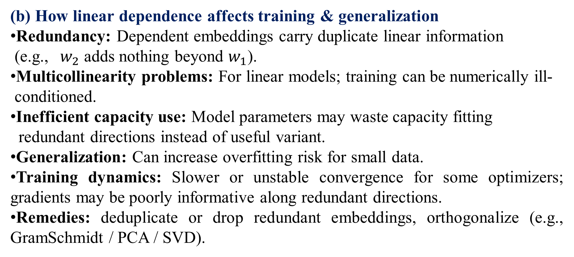
(b) How linear dependence affects training & generalization
Redundancy: Dependent embeddings carry duplicate linear information
(e.g., ${ w}_{2}$ adds nothing beyond $w_{1}$​).
Multicollinearity problems: For linear models; training can be numerically ill-
conditioned.
Inefficient capacity use: Model parameters may waste capacity fitting
redundant directions instead of useful variant.
Generalization: Can increase overfitting risk for small data.
Training dynamics: Slower or unstable convergence for some optimizers; gradients may be poorly informative along redundant directions.
Remedies: deduplicate or drop redundant embeddings, orthogonalize (e.g., GramSchmidt / PCA / SVD).

Slide 28
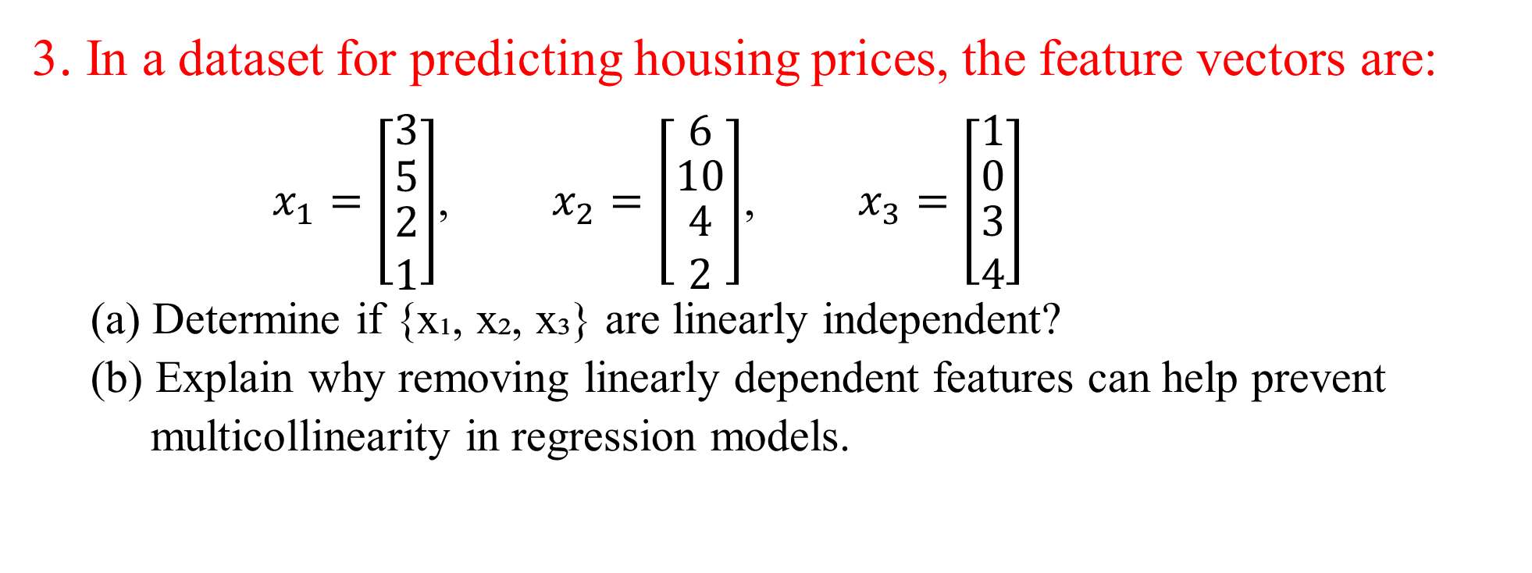
3. In a dataset for predicting housing prices, the feature vectors are:
$x_{1}=\left[\begin{matrix}3 \\ \begin{matrix}5 \\ \begin{matrix}2 \\ 1\end{matrix}\end{matrix}\end{matrix}\right]$, $x_{2}=\left[\begin{matrix}6 \\ \begin{matrix}10 \\ \begin{matrix}4 \\ 2\end{matrix}\end{matrix}\end{matrix}\right]$, $x_{3}=\left[\begin{matrix}1 \\ \begin{matrix}0 \\ \begin{matrix}3 \\ 4\end{matrix}\end{matrix}\end{matrix}\right]$ (a) Determine if {x₁, x₂, x₃} are linearly independent? (b) Explain why removing linearly dependent features can help prevent
multicollinearity in regression models.
Solution: (a) Linear independence/Dependence

Slide 29
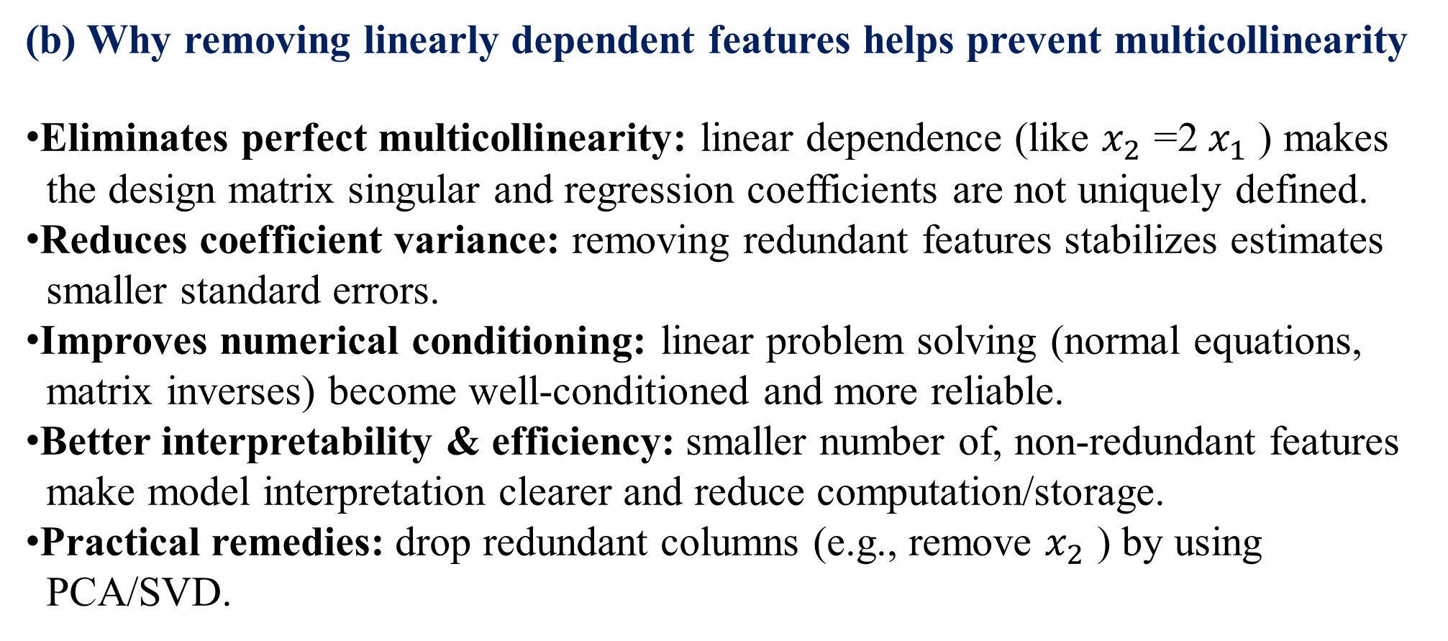
(b) Why removing linearly dependent features helps prevent multicollinearity
Eliminates perfect multicollinearity: linear dependence (like $x_{2}$ =2 $x_{1}$ ​) makes
the design matrix singular and regression coefficients are not uniquely defined.
Reduces coefficient variance: removing redundant features stabilizes estimates
smaller standard errors.
Improves numerical conditioning: linear problem solving (normal equations,
matrix inverses) become well-conditioned and more reliable.
Better interpretability & efficiency: smaller number of, non-redundant features
make model interpretation clearer and reduce computation/storage.
Practical remedies: drop redundant columns (e.g., remove $x_{2}$ ​) by using
PCA/SVD.

Slide 30
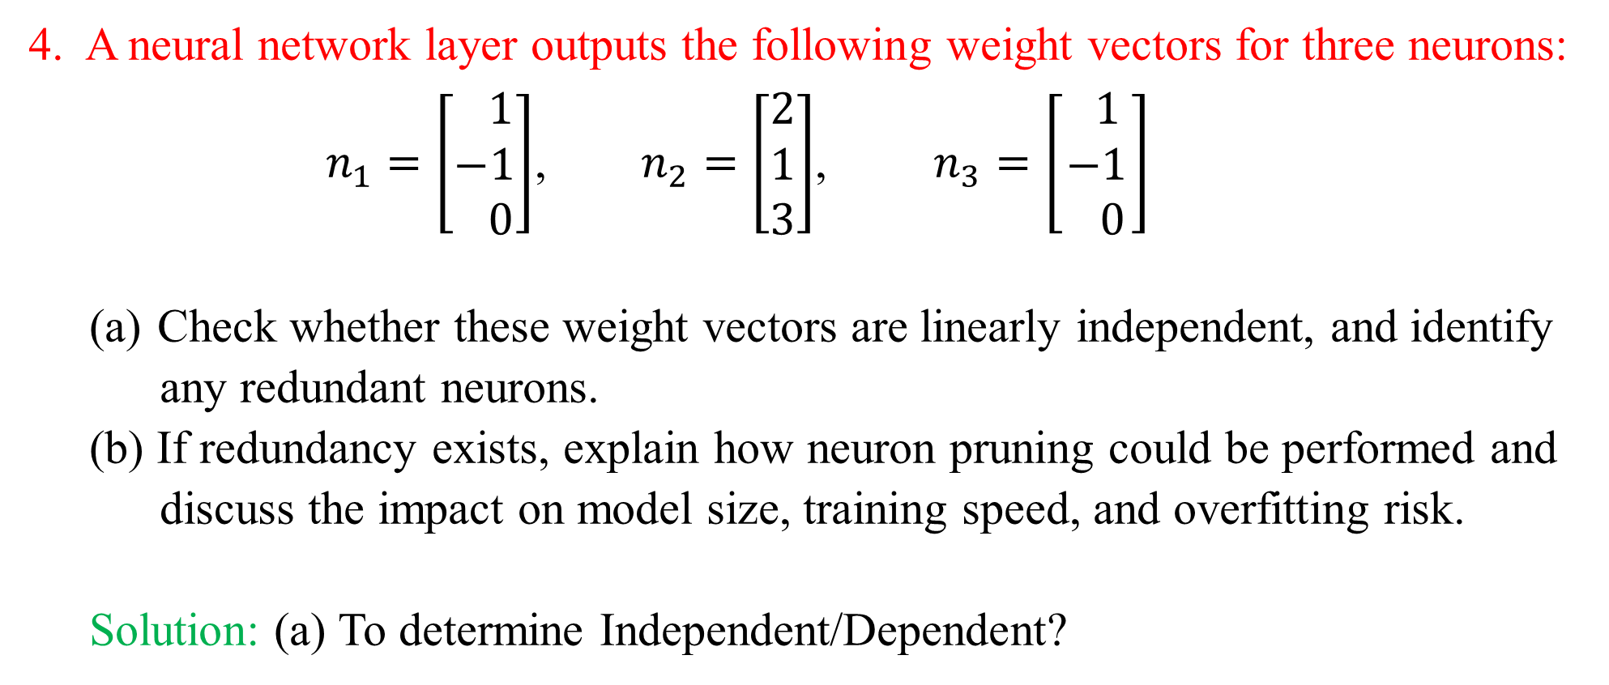
4. A neural network layer outputs the following weight vectors for three neurons:
$n_{1}=\left[\begin{matrix} 1 \\ −1 \\ 0\end{matrix}\right]$, $n_{2}=\left[\begin{matrix}2 \\ 1 \\ 3\end{matrix}\right]$, $n_{3}=\left[\begin{matrix} 1 \\ −1 \\ 0\end{matrix}\right]$
Check whether these weight vectors are linearly independent, and identify
any redundant neurons. (b) If redundancy exists, explain how neuron pruning could be performed and
discuss the impact on model size, training speed, and overfitting risk.
Solution: (a) To determine Independent/Dependent?

Slide 31
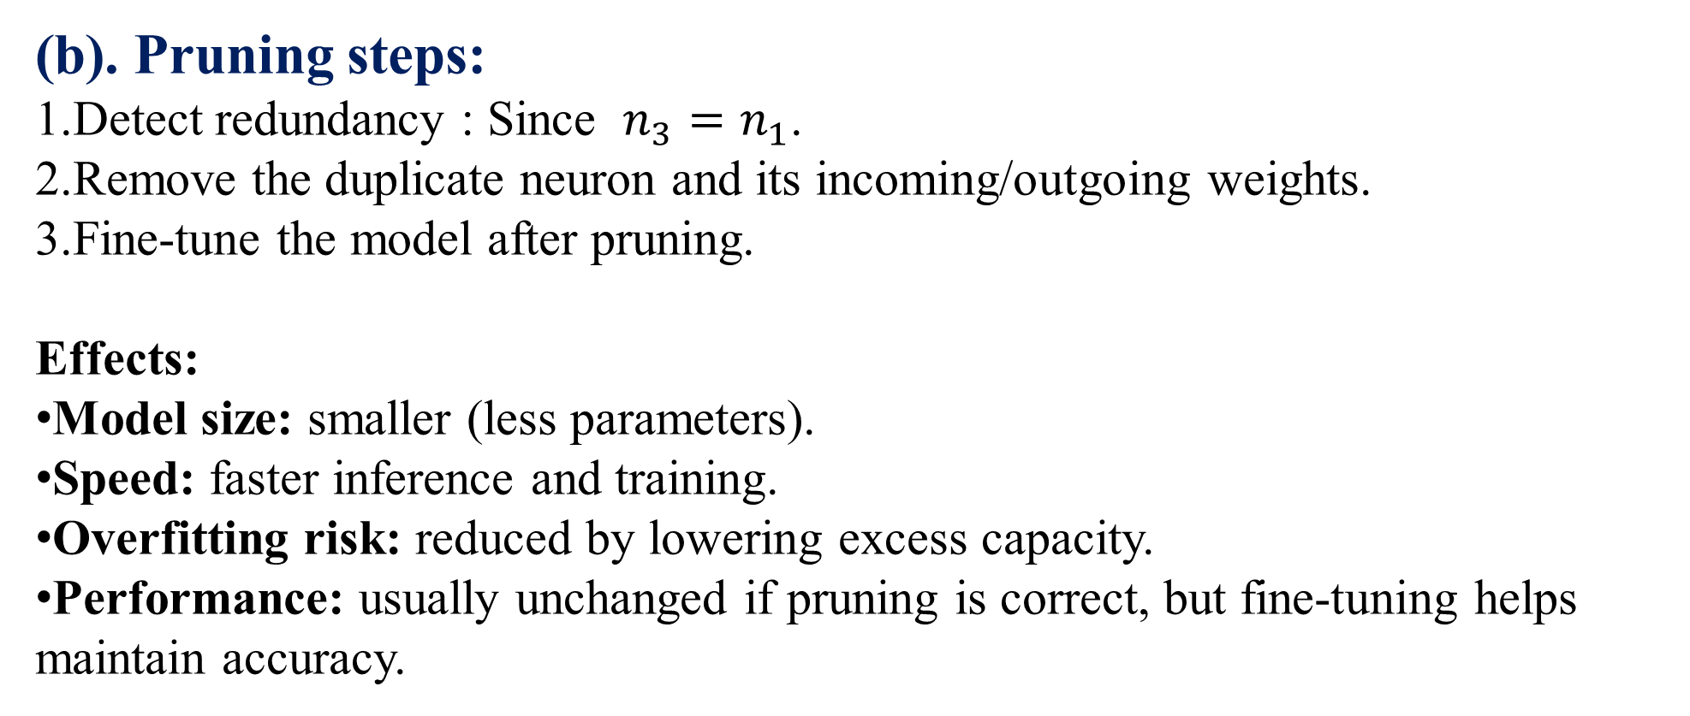
(b). Pruning steps:
Detect redundancy : Since $n_{3}=n_{1}$​.
Remove the duplicate neuron and its incoming/outgoing weights.
Fine-tune the model after pruning.
Effects:
Model size: smaller (less parameters).
Speed: faster inference and training.
Overfitting risk: reduced by lowering excess capacity.
Performance: usually unchanged if pruning is correct, but fine-tuning helps maintain accuracy.

Slide 32
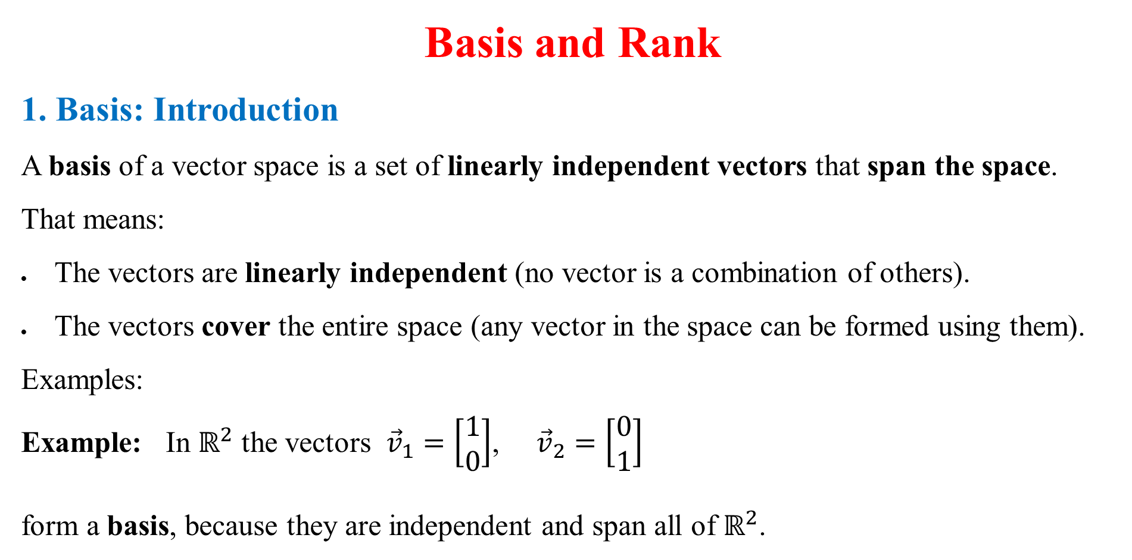
Basis and Rank
1. Basis: Introduction
A basis of a vector space is a set of linearly independent vectors that span the space.
That means:
The vectors are linearly independent (no vector is a combination of others).
The vectors cover the entire space (any vector in the space can be formed using them).
Examples:
Example: In $ℝ^{2}$ the vectors ${\vec{v}}_{1}=\left[\begin{matrix}1 \\ 0\end{matrix}\right]$, ${\vec{v}}_{2}=\left[\begin{matrix}0 \\ 1\end{matrix}\right]$
form a basis, because they are independent and span all of $ℝ^{2}$.

Slide 33
2. Rank
Definition:
The rank of a matrix A∈R^{m×n} is defined as:
The maximum number of linearly independent rows or columns of the matrix.
Equivalently,
The dimension of the column space (or row space) of the matrix.
Example:
If a 3×3 matrix has 2 linearly independent rows, its rank is 2. This means one row can be written as a combination of the others.

Slide 34
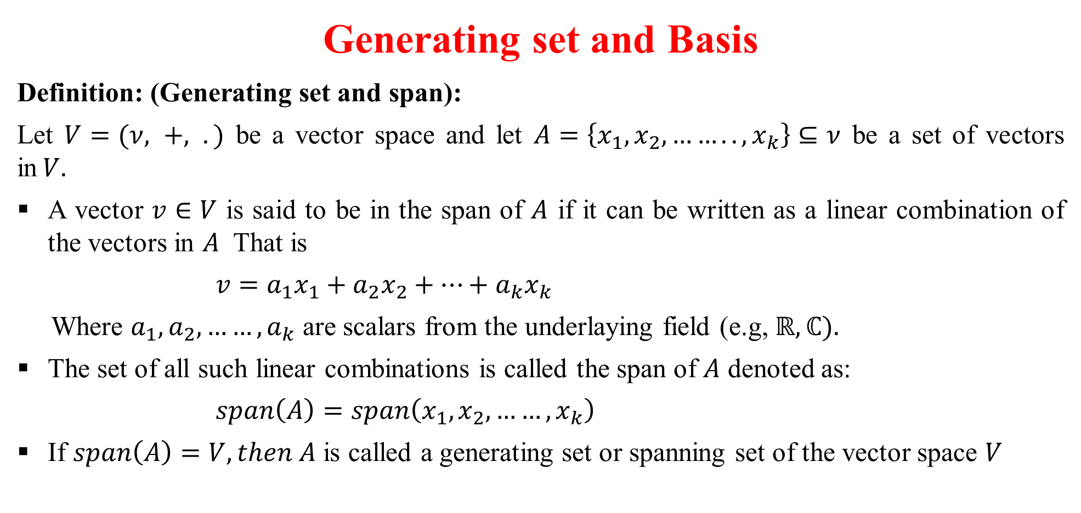
Generating set and Basis
Definition: (Generating set and span):
Let $V=(ν, +, .)$ be a vector space and let $A=\left\{x_{1}, x_{2},…….., x_{k}\right\}⊆ν$ be a set of vectors in$V.$
A vector $v∈V$ is said to be in the span of $A$ if it can be written as a linear combination of the vectors in $A$ That is
$v=a_{1}x_{1}+a_{2}x_{2}+…+a_{k}x_{k}$
Where $a_{1},a_{2},……,a_{k}$ are scalars from the underlaying field (e.g, $ℝ, ℂ).$
The set of all such linear combinations is called the span of $A$ denoted as:
$span\left(A\right)=span\left(x_{1},x_{2},……,x_{k}\right)$
If $span\left(A\right)=V, then A$ is called a generating set or spanning set of the vector space $V$

Slide 35
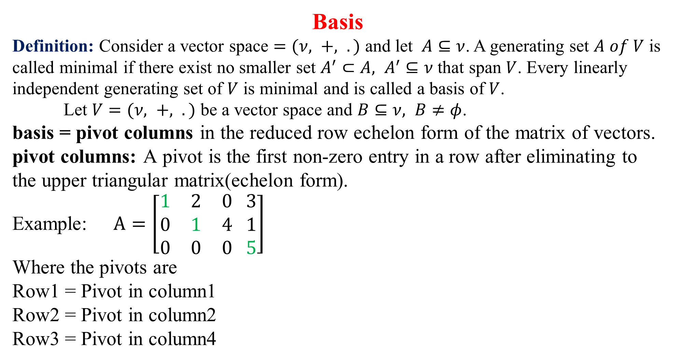
Basis
Definition: Consider a vector space $=(ν, +, .)$ and let $A⊆ν$. A generating set $A of V$ is called minimal if there exist no smaller set $A^{′}⊂A, A^{′}⊆ν$ that span $V$. Every linearly independent generating set of $V$ is minimal and is called a basis of $V$.
Let $V=(ν, +, .)$ be a vector space and $B⊆ν, B≠φ$.
basis = pivot columns in the reduced row echelon form of the matrix of vectors.
pivot columns: A pivot is the first non-zero entry in a row after eliminating to the upper triangular matrix(echelon form).
Example: $A=\left[\begin{matrix}1 & 2 & 0 \\ 0 & 1 & 4 \\ 0 & 0 & 0\end{matrix} \begin{matrix}3 \\ 1 \\ 5\end{matrix}\right]$
Where the pivots are
Row1 = Pivot in column1
Row2 = Pivot in column2
Row3 = Pivot in column4

Slide 36
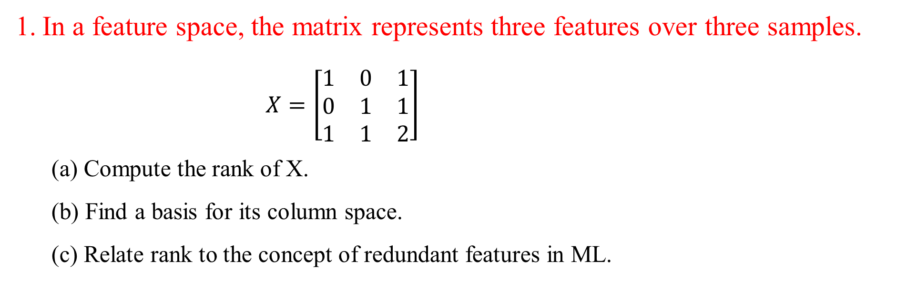
In a feature space, the matrix represents three features over three samples.
$X=\left[\begin{matrix}1 & 0 & 1 \\ 0 & 1 & 1 \\ 1 & 1 & 2\end{matrix}\right]$
(a) Compute the rank of X.
(b) Find a basis for its column space.
(c) Relate rank to the concept of redundant features in ML.

Slide 37
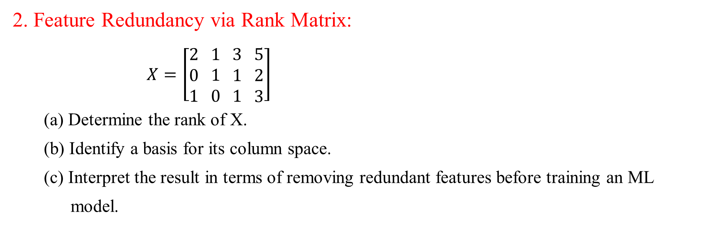
2. Feature Redundancy via Rank Matrix:
$X=\left[\begin{matrix}2 \\ 0 \\ 1\end{matrix} \begin{matrix}1 \\ 1 \\ 0\end{matrix} \begin{matrix}3 \\ 1 \\ 1\end{matrix} \begin{matrix}5 \\ 2 \\ 3\end{matrix}\right]$
(a) Determine the rank of X.
(b) Identify a basis for its column space.
(c) Interpret the result in terms of removing redundant features before training an ML
model.

Slide 38
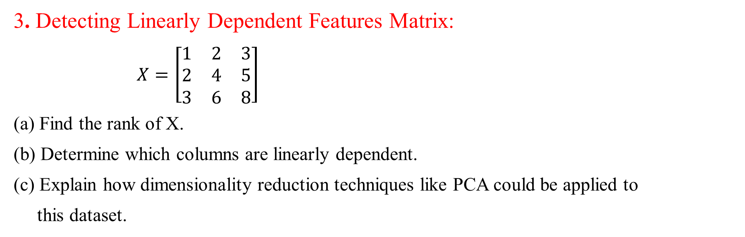
3. Detecting Linearly Dependent Features Matrix:
$X=\left[\begin{matrix}1 & 2 & 3 \\ 2 & 4 & 5 \\ 3 & 6 & 8\end{matrix}\right]$
(a) Find the rank of X.
(b) Determine which columns are linearly dependent.
(c) Explain how dimensionality reduction techniques like PCA could be applied to
this dataset.

Slide 39
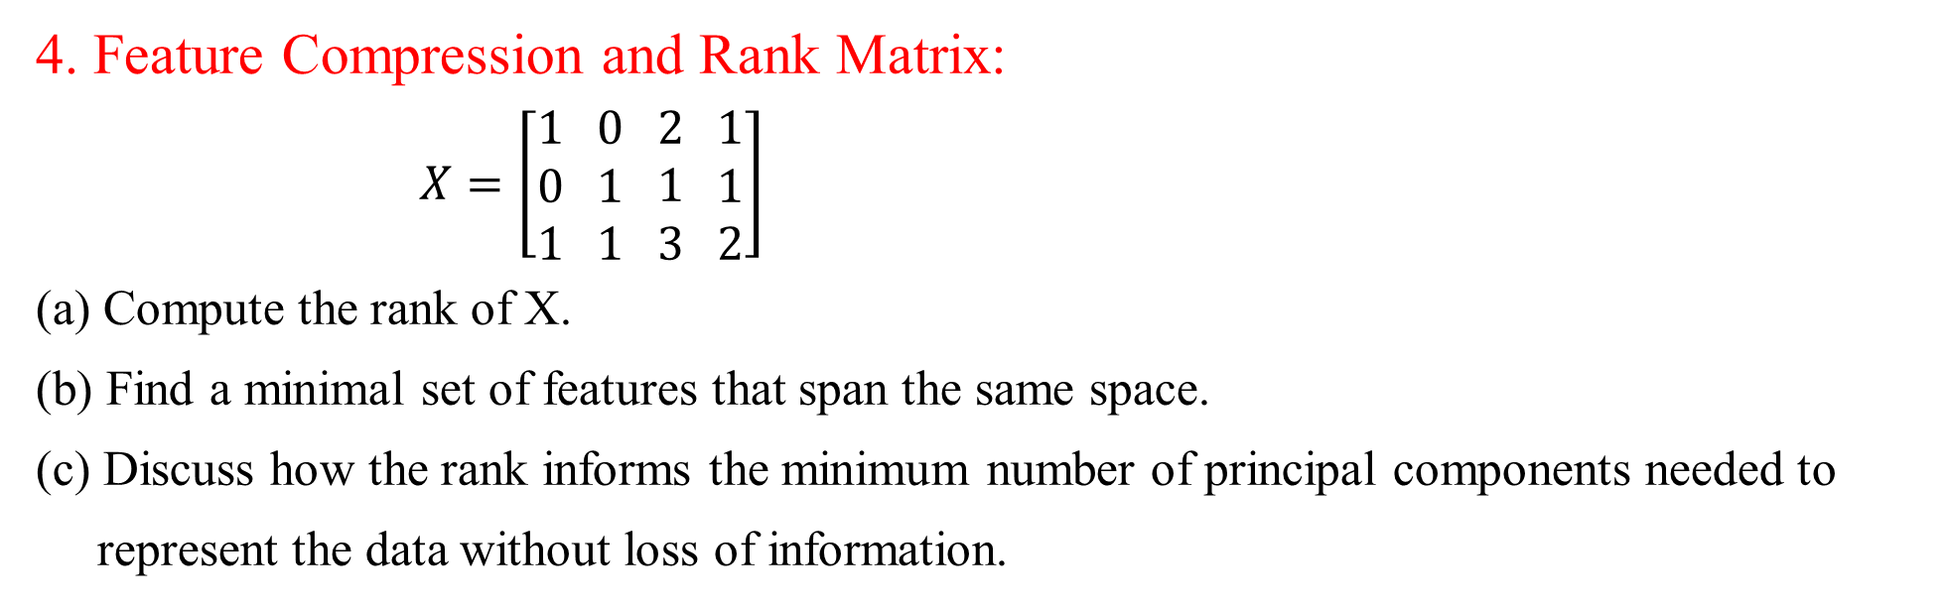
4. Feature Compression and Rank Matrix:
$X=\left[\begin{matrix}1 \\ 0 \\ 1\end{matrix} \begin{matrix}0 \\ 1 \\ 1\end{matrix} \begin{matrix}2 \\ 1 \\ 3\end{matrix} \begin{matrix}1 \\ 1 \\ 2\end{matrix}\right]$
(a) Compute the rank of X.
(b) Find a minimal set of features that span the same space.
(c) Discuss how the rank informs the minimum number of principal components needed to
represent the data without loss of information.

Slide 40
Analytic Geometry
Introduction:
Analytic Geometry, also known as Coordinate Geometry, is the study of geometric objects using a coordinate system. It provides the mathematical foundation for representing and manipulating data in multidimensional spaces, which is essential in Artificial Intelligence (AI) and Machine Learning (ML).

Slide 41
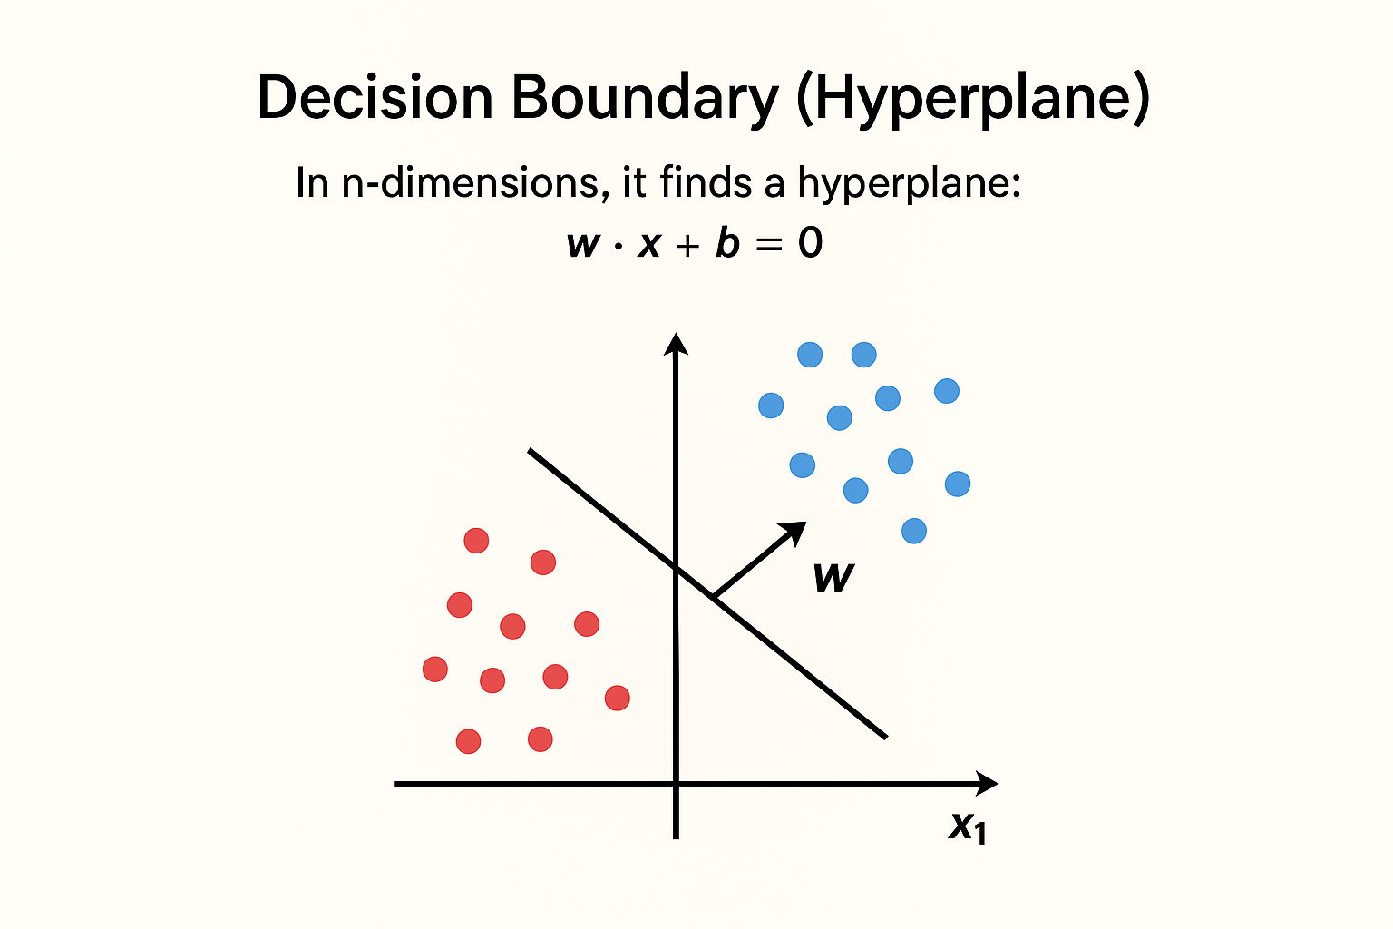
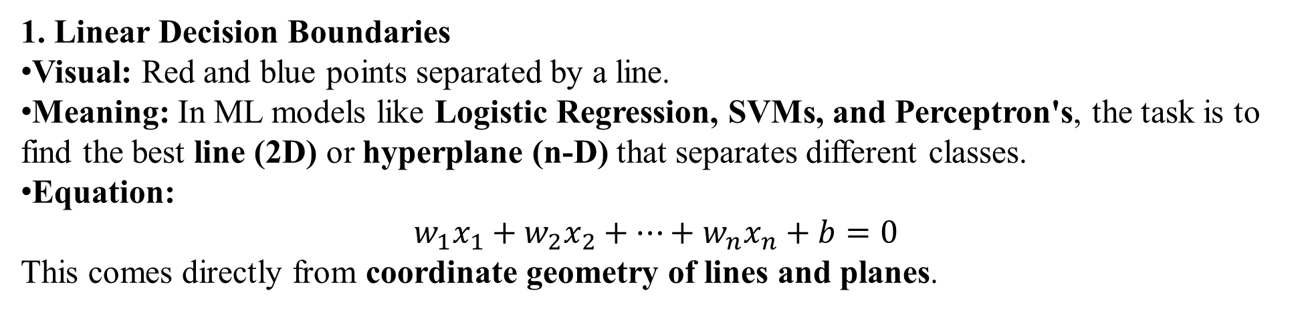
1. Linear Decision Boundaries
Visual: Red and blue points separated by a line.
Meaning: In ML models like Logistic Regression, SVMs, and Perceptron's, the task is to find the best line (2D) or hyperplane (n-D) that separates different classes.
Equation:
$$w_{1}x_{1}+w_{2}x_{2}+…+w_{n}x_{n}+b=0$$
This comes directly from coordinate geometry of lines and planes.

Slide 42
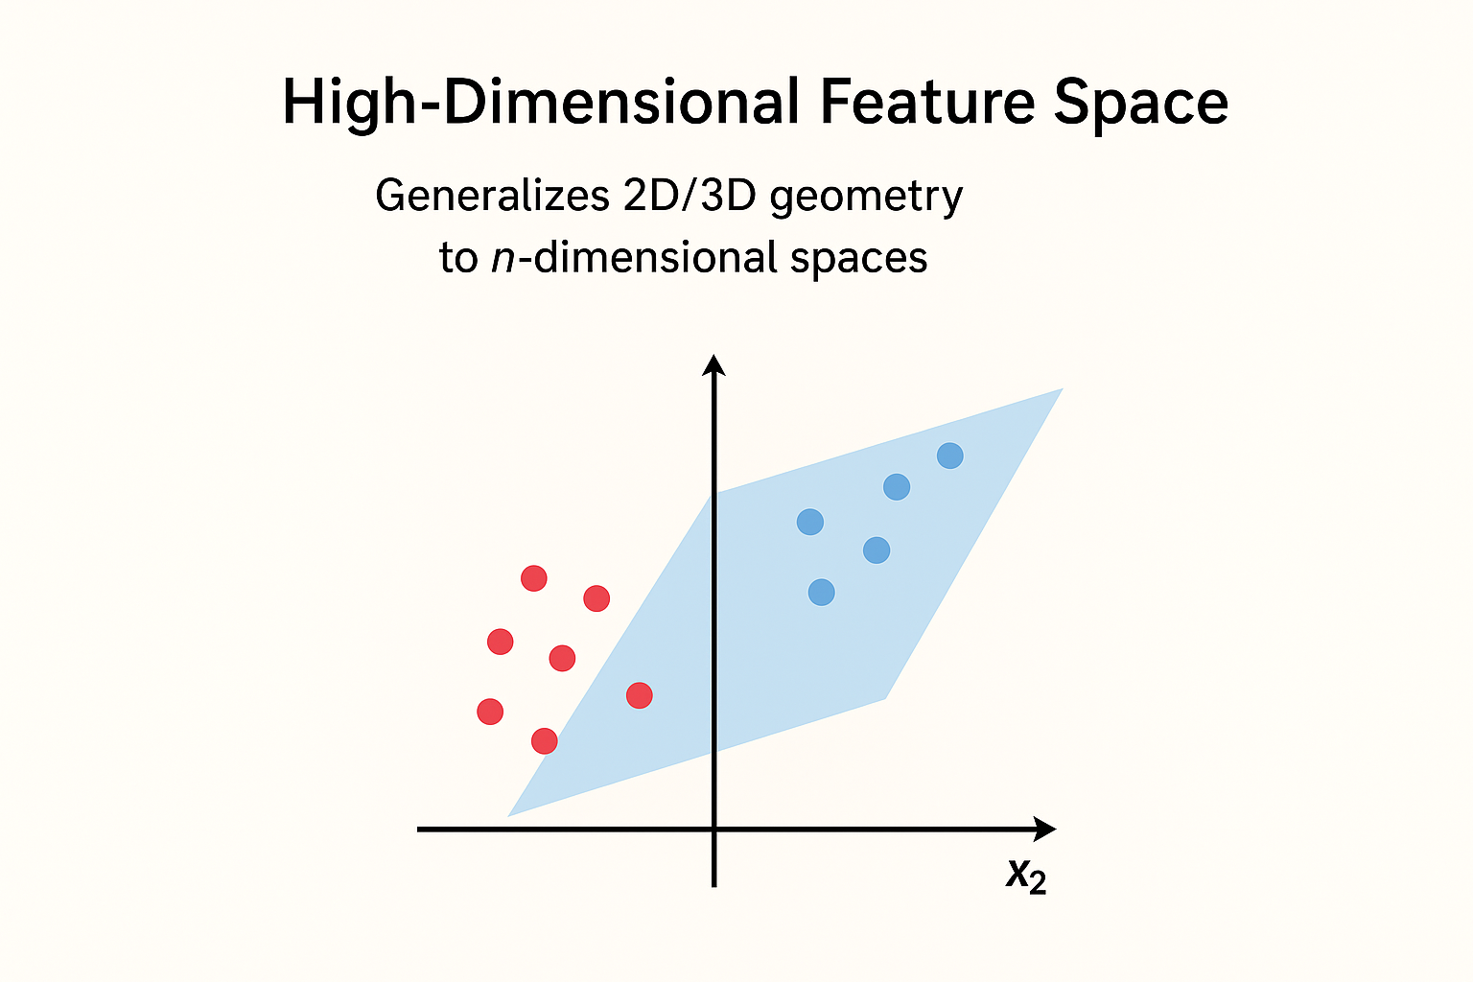
High-Dimensional Feature Space
Visual: A 3D axis with points separated by a plane.
Meaning: Data in AI often has hundreds of features. Analytic geometry generalizes 2D/3D geometry to n-dimensional spaces.
Application:
Feature engineering (representing data in new spaces)
Embeddings (like word embeddings in NLP)
Dimensionality reduction (mapping high-d data to lower-d spaces)

Slide 43
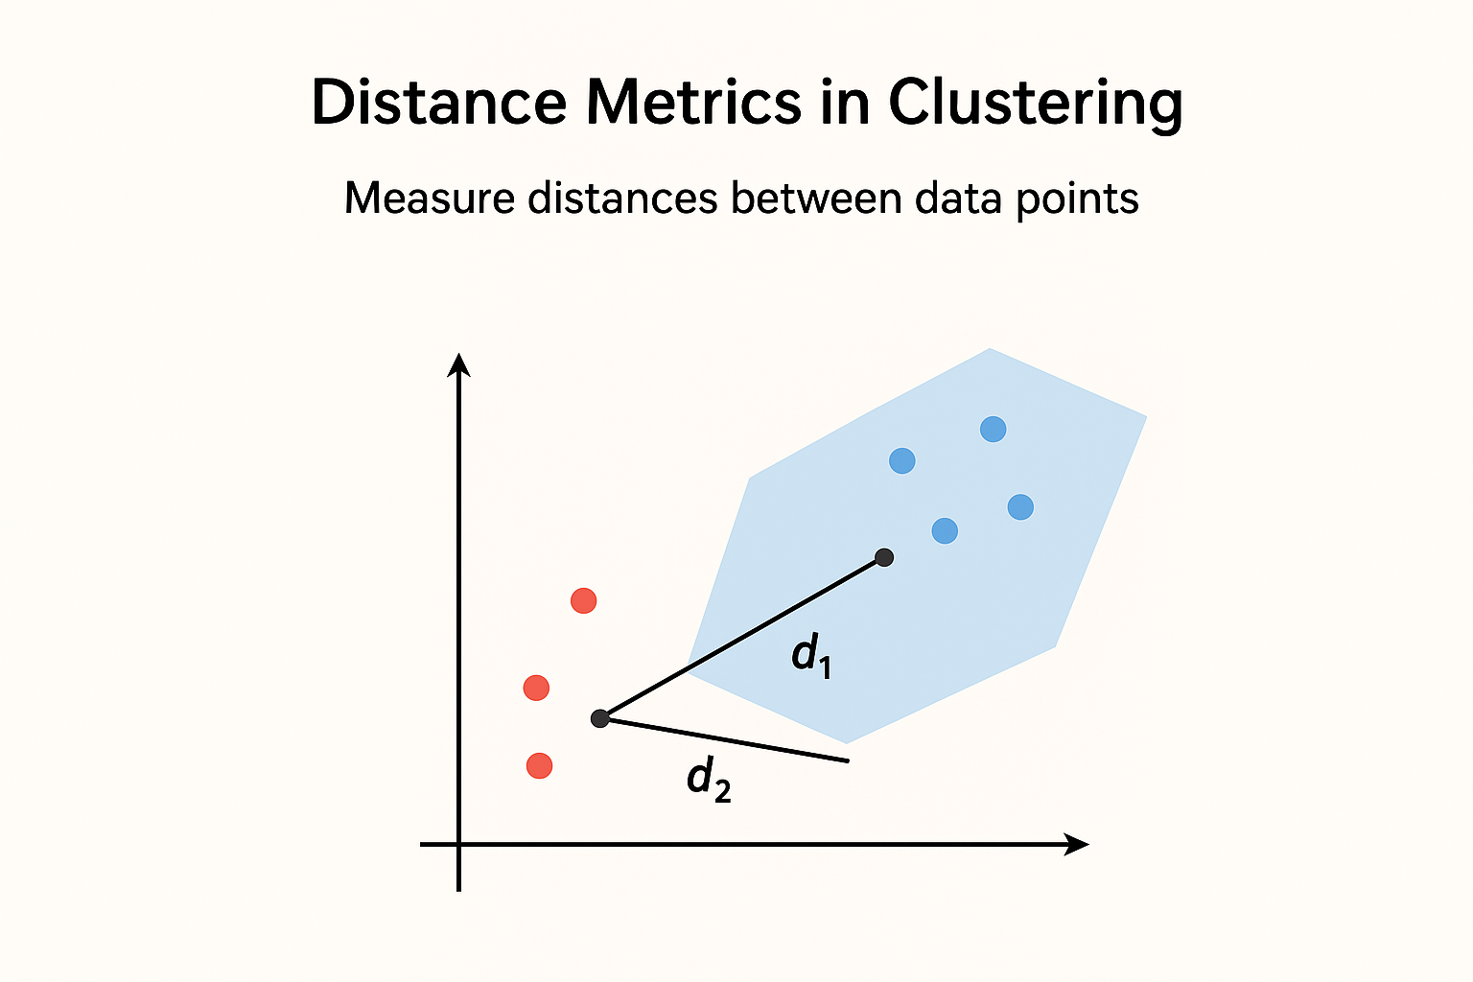
Distance Metrics in Clustering
Visual: Points grouped with circles around centroids.
Meaning: Algorithms like k-Means and k-Nearest Neighbors rely on distance formulas:
Euclidean Distance:​
Manhattan Distance, Cosine Similarity etc.
These are purely geometric measures in coordinate systems.

Slide 44
Norms
Introduction:
In mathematics, particularly in linear algebra and analytic geometry, a norm is a function that assigns a length or size to a vector. Just as the length of a line segment in 2D space can be measured using the Pythagorean theorem, norms help us quantify the magnitude of vectors in any dimension.
Norms are essential in machine learning, optimization, and AI, as they:
Measure error and distances.
Regularize models (e.g., L1, L2 regularization).
Define convergence in training algorithms.

Slide 45
Definition of a Norm
Let 𝑣 be a vector in ℝⁿ. A norm is a function ‖·‖ that maps 𝑣 to a non-negative real number, satisfying:
Non-negativity:
∥v∥ ≥ 0, and ∥v∥ = 0 ⟺ v = 0
2. Homogeneity (Scaling):
∥αv∥ = ∣α∣⋅∥v∥, for any scalar α
3. Triangle Inequality:
∥v + w∥ ≤ ∥v∥ + ∥w∥
A normed space is a vector space equipped with a norm.

Slide 46
Manhattan Norm (L₁ Norm)
Definition:
The Manhattan norm, also known as the L₁ norm or Taxicab norm, is a way of measuring the length or size of a vector in a vector space. For a vector: x = (x₁, x₂, ..., xₙ) ∈ ℝⁿ, The Manhattan norm is defined as: ‖x‖₁ = |x₁| + |x₂| + ... + |xₙ|
Why "Manhattan"?
It is called the Manhattan norm because it mimics the way distances are measured on a grid of city blocks (like in Manhattan, New York), where one can only move horizontally or vertically not diagonally.

Slide 47

City Planning & the Grid System
The 1811 Commissioners’ Plan introduced a rigid grid layout of 12 avenues and 155 streets that still defines Manhattan today.
This grid system is so iconic that the term Manhattan Distance in math/AI comes from it.
Central Park (designed 1857) was carved into the grid as a massive green oasis.

Slide 48
Example:
Let x = (3, -4, 1), then: ‖x‖₁ = |3| + |-4| + |1| = 3 + 4 + 1 = 8
Applications of L₁ Norm:
• Sparse models in machine learning (e.g., Lasso regression) • Optimization problems • Computer vision and image processing • Robust statistics

Slide 49
Euclidean Norm (L₂ Norm)
Definition:
The Euclidean norm, also known as the L₂ norm, is the most common way of measuring the length (or magnitude) of a vector. It is derived from the Pythagorean theorem. For a vector: x = (x₁, x₂, ..., xₙ) ∈ ℝⁿ, The Euclidean norm is defined as: ‖x‖₂ = √(x₁² + x₂² + ... + xₙ²)
Geometric Interpretation:
The Euclidean norm represents the straight-line (or shortest) distance from the origin to the point defined by the vector in n-dimensional space.

Slide 50
Example:
Let x = (3, 4), then: ‖x‖₂ = √(3² + 4²) = √(9 + 16) = √25 = 5
Comparison with Manhattan Norm (L₁):
• L₂ norm measures straight-line distance (Euclidean distance). • L₁ norm measures grid-like distance (sum of absolute values). • L₂ is sensitive to outliers due to squaring components.
Applications of L₂ Norm:
• Common in machine learning and statistics for measuring error (e.g., Mean Squared Error). • Used in physics to calculate distances, lengths, and magnitudes. • Important in optimization problems where smoothness is required.

Slide 51
L1 Regularization (Lasso) Loss function: L(θ) + λ ||w||₁ = L(θ) + λ Σ|wᵢ| Effect: Adds penalty proportional to absolute value of weights. Gradient involves sign(w), which means constant pressure regardless of weight size. Encourages sparsity: many weights become exactly 0. Performs feature selection automatically. Geometric view: Constraint region is a diamond (L1 ball). Corners cause solutions to stick at zero. | L2 Regularization (Edge) Loss function: L(θ) + λ ||w||₂² = L(θ) + λ Σ wᵢ² Effect: Adds penalty proportional to square of weights. Gradient is 2λwᵢ, so larger weights shrink more strongly. Encourages small but nonzero weights (smooth shrinkage). Prevents overfitting but does not produce sparsity. Geometric view: Constraint region is a circle (L2 ball). Smooth edges → weights shrink but don’t vanish.

Slide 52
1. A weight vector in a neural network layer is:
w = [0.5, -1.2, 0.8].
(a) Compute ||w||₁ and ||w||₂:
(b) Discuss which norm would promote sparsity(zeros) in weights.
(c) Relate L₁ and L₂ norms to regularization in ML models.
Solution: (a)

Slide 53
2. A weight vector in a neural network layer is: w = [-0.4, 0, 1.2, -0.8].
(a) Compute ||w||₁ and ||w||₂.
(b) Which norm would shrink all weights uniformly, and why?
(c) Explain how weight decay is mathematically related to one of these
norms.
Solution: (a)

Slide 54
3. Consider the weight vector of a model: w = [1, -2, 0, 0, 3].
(a) Compute ||w||₁ and ||w||₂.
(b) Which norm would shrink all weights uniformly, and why?
(c) Explain how weight decay is mathematically related to one of these
norms.
Solution: (a)

Slide 55
4. Given the weight vector: w = [2, -1, 2, -2].
(a) Compute ||w||₁ and ||w||₂:
(b) Discuss which norm would promote sparsity(zeros) in weights.
(c) Relate L₁ and L₂ norms to regularization in ML models.
5. For a weight vector: w = [0.1, -0.5, 0.9, -0.3, 0.7].
(a) Compute ||w||₁ and ||w||₂.
(b) Which norm would shrink all weights uniformly, and why?
(c) Explain how weight decay is mathematically related to one of these
norms.

Slide 56
Inner Products
Definition:
An inner product is a generalization of the dot product that allows the measurement of angles and lengths in vector spaces. It maps two vectors to a scalar and satisfies specific properties. For vectors: x = (x₁, x₂, ..., xₙ), y = (y₁, y₂, ..., yₙ) ∈ ℝⁿ, The inner product is defined as: ⟨x, y⟩ = x₁y₁ + x₂y₂ + ... + xₙyₙ
Properties of Inner Product:
• Linearity: ⟨ax + by, z⟩ = a⟨x, z⟩ + b⟨y, z⟩ • Symmetry: ⟨x, y⟩ = ⟨y, x⟩ • Positive Definiteness: ⟨x, x⟩ ≥ 0, and ⟨x, x⟩ = 0 iff x = 0

Slide 57
Dot Product
Definition
The dot product is an algebraic operation that takes two equal-length vectors and returns a single number. It is a specific case of the inner product in Euclidean space.
For vectors
x = (x₁, x₂, ..., xₙ) and y = (y₁, y₂, ..., yₙ) in ℝⁿ,
the dot product is defined as:
x · y = x₁y₁ + x₂y₂ + ... + xₙyₙ
Properties of Dot Product:
• Commutative: x · y = y · x
• Distributive over addition: x · (y + z) = x · y + x · z
• Scalar multiplication: (a · x) · y = a . (x · y)
• Norm relation: x · x = ‖x‖² (square of the Euclidean norm)

Slide 58
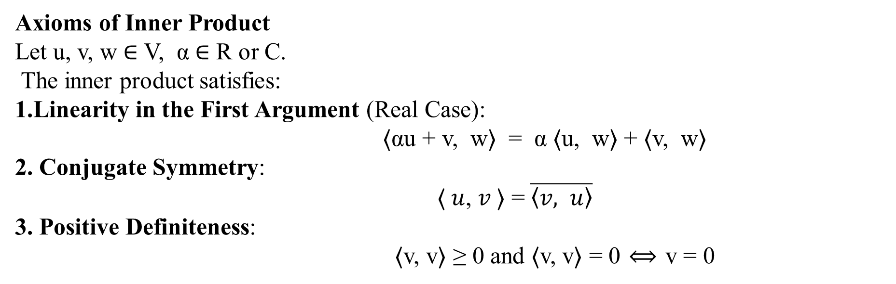
General Inner Product
Definition
A general inner product is a function that maps two vectors in a vector space to a scalar. It extends the concept of the dot product and is fundamental for defining length, angle, and orthogonality in both real and complex vector spaces, including function spaces.
Formally, for a real or complex vector space V, an inner product is a function: ⟨⋅ , ⋅⟩ : V × V → R or C
Axioms of Inner Product
Let u, v, w ∈ V, α ∈ R or C.
The inner product satisfies:
Linearity in the First Argument (Real Case):
⟨αu + v, w⟩ = α ⟨u, w⟩ + ⟨v, w⟩
2. Conjugate Symmetry:
⟨ $u$, $v$⟩ = ​$\overline{\left\langle v, u\right\rangle }$
3. Positive Definiteness:
⟨v, v⟩ ≥ 0 and ⟨v, v⟩ = 0 ⟺ v = 0

Slide 59
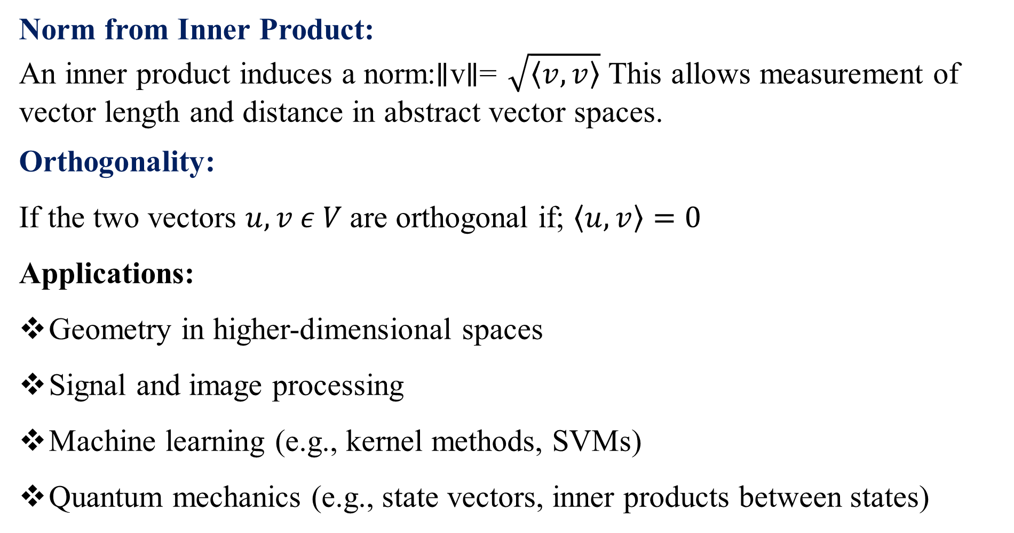
Norm from Inner Product:
An inner product induces a norm:∥v∥= $\sqrt{\left\langle v,v\right\rangle }$​ This allows measurement of vector length and distance in abstract vector spaces.
Orthogonality:
If the two vectors $u, v ε V$are orthogonal if; $\left\langle u, v\right\rangle =0$
Applications:
Geometry in higher-dimensional spaces
Signal and image processing
Machine learning (e.g., kernel methods, SVMs)
Quantum mechanics (e.g., state vectors, inner products between states)

Slide 60
Symmetric Positive Definite Matrices
1. Definition
A real symmetric matrix A ∈ ℝⁿˣⁿ is said to be positive definite (PD) if:
xᵀ A x > 0 for all x ∈ ℝⁿ
That is, the quadratic form xᵀ A x is strictly positive for all non-zero vectors x.
2. Symmetric Matrix
A matrix A ∈ ℝⁿˣⁿ is symmetric if: A = Aᵀ All positive definite matrices must be symmetric, but not all symmetric matrices are positive definite.

Slide 61
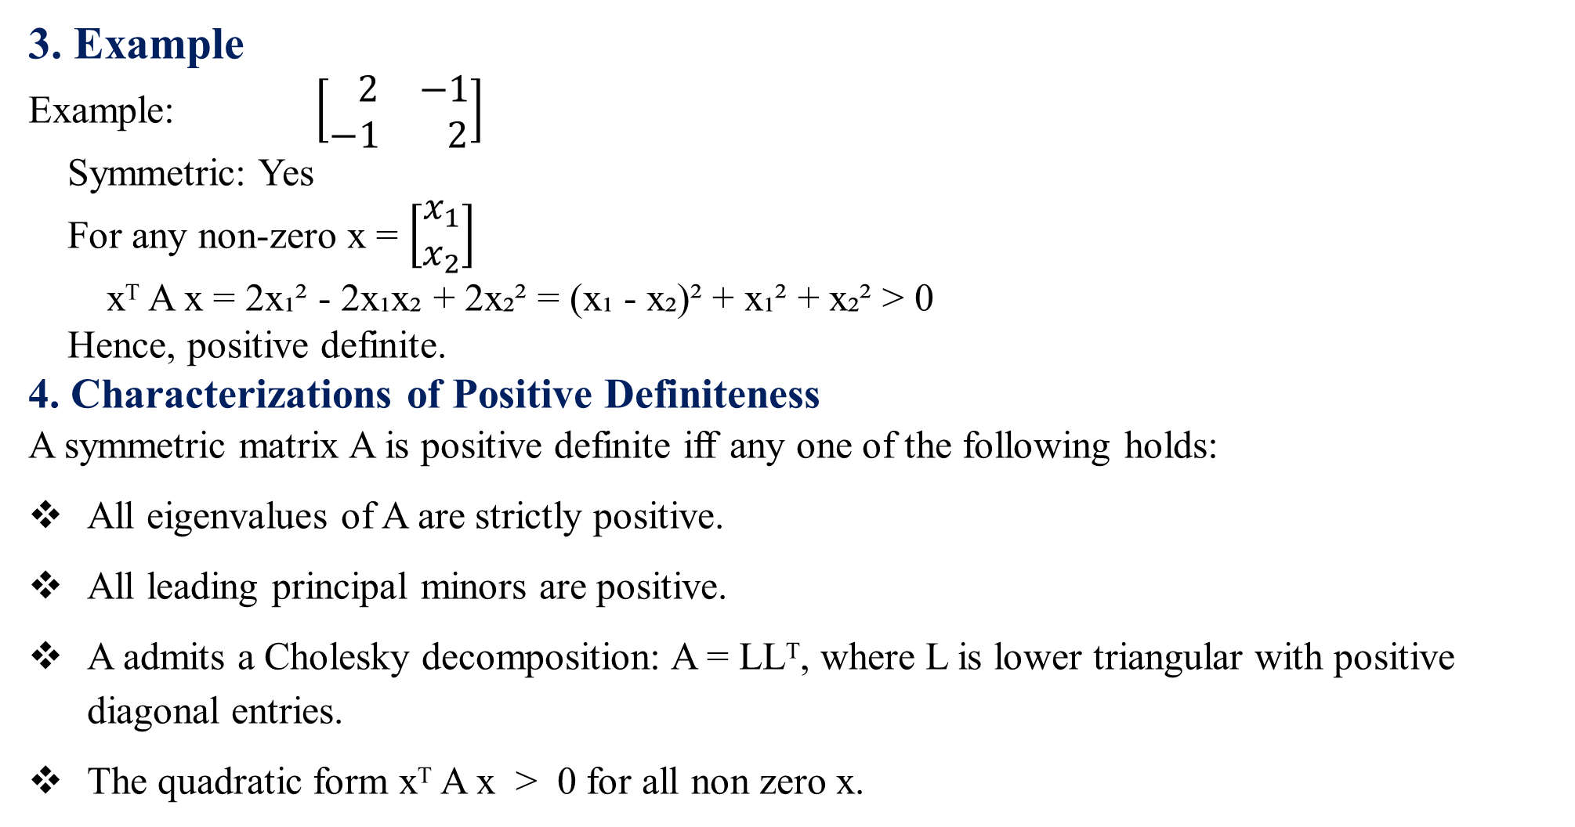
3. Example
Example: $\left[\begin{matrix} 2 & −1 \\ −1 & 2\end{matrix}\right]$ Symmetric: Yes For any non-zero x = $\left[\begin{matrix}x_{1} \\ x_{2}\end{matrix}\right]$ xᵀ A x = 2x₁² - 2x₁x₂ + 2x₂² = (x₁ - x₂)² + x₁² + x₂² > 0 Hence, positive definite.
4. Characterizations of Positive Definiteness
A symmetric matrix A is positive definite iff any one of the following holds:
All eigenvalues of A are strictly positive.
All leading principal minors are positive.
A admits a Cholesky decomposition: A = LLᵀ, where L is lower triangular with positive diagonal entries.
The quadratic form xᵀ A x > 0 for all non zero x.

Slide 62
5. Positive Semi-Definite (PSD) Matrix
A symmetric matrix A is positive semi-definite if: xᵀ A x ≥ 0 for all x ∈ ℝⁿ It allows xᵀ A x = 0 for some non-zero x, unlike PD matrices.
NOTE : The inner product is used in ML because it provides the algebraic tool to measure similarity, length, distance, projections, and to build models like linear regression, SVMs, PCA, and even neural networks. It is the bridge between geometry and learning.

Slide 63
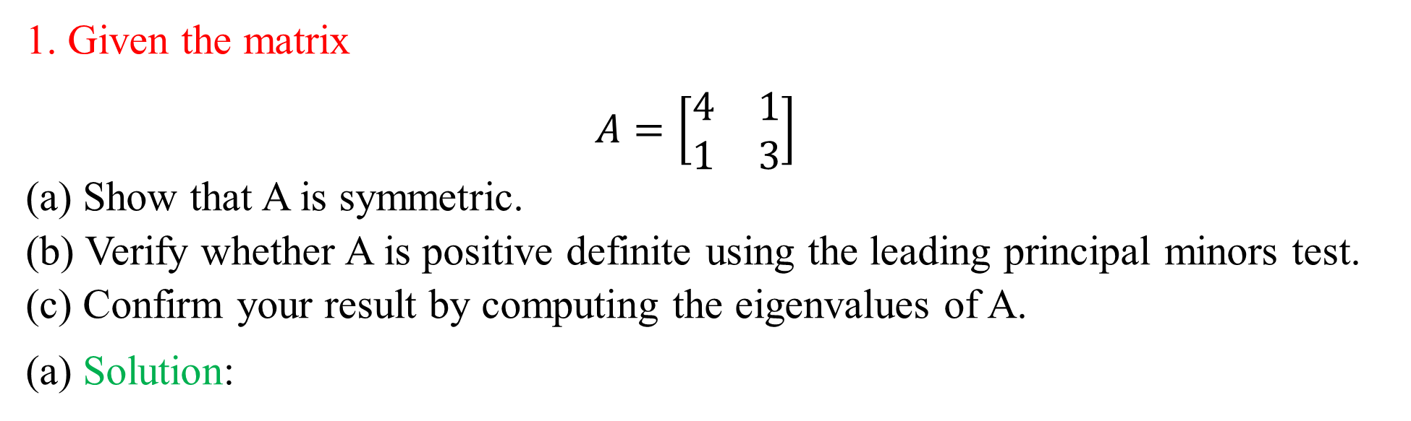
1. Given the matrix
$A=\left[\begin{matrix}4 & 1 \\ 1 & 3\end{matrix}\right]$ (a) Show that A is symmetric. (b) Verify whether A is positive definite using the leading principal minors test. (c) Confirm your result by computing the eigenvalues of A.
(a) Solution:

Slide 64
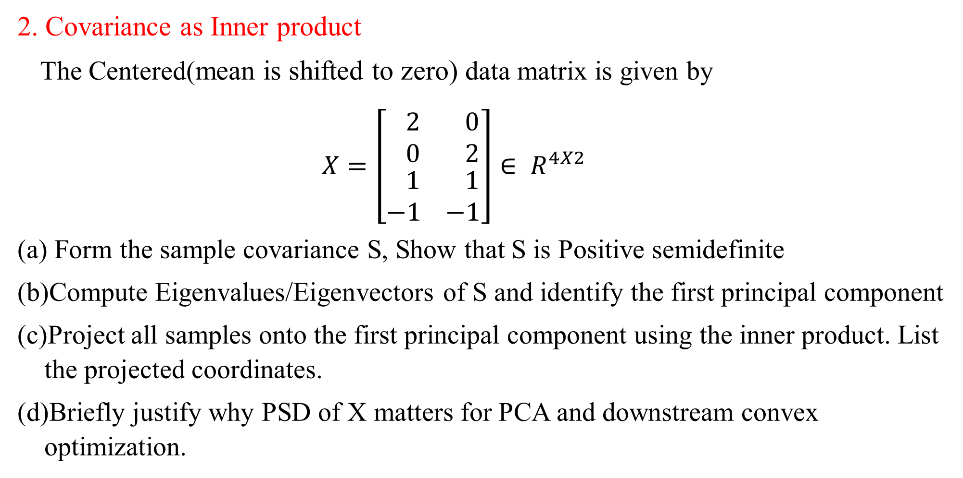
2. Covariance as Inner product
The Centered(mean is shifted to zero) data matrix is given by
$X=\left[\begin{matrix} 2 \\ 0 \\ \begin{matrix} 1 \\ −1\end{matrix}\end{matrix} \begin{matrix} 0 \\ 2 \\ \begin{matrix} 1 \\ −1\end{matrix}\end{matrix}\right]∈ R^{4X2}$
Form the sample covariance S, Show that S is Positive semidefinite
Compute Eigenvalues/Eigenvectors of S and identify the first principal component
Project all samples onto the first principal component using the inner product. List the projected coordinates.
Briefly justify why PSD of X matters for PCA and downstream convex optimization.

Slide 65
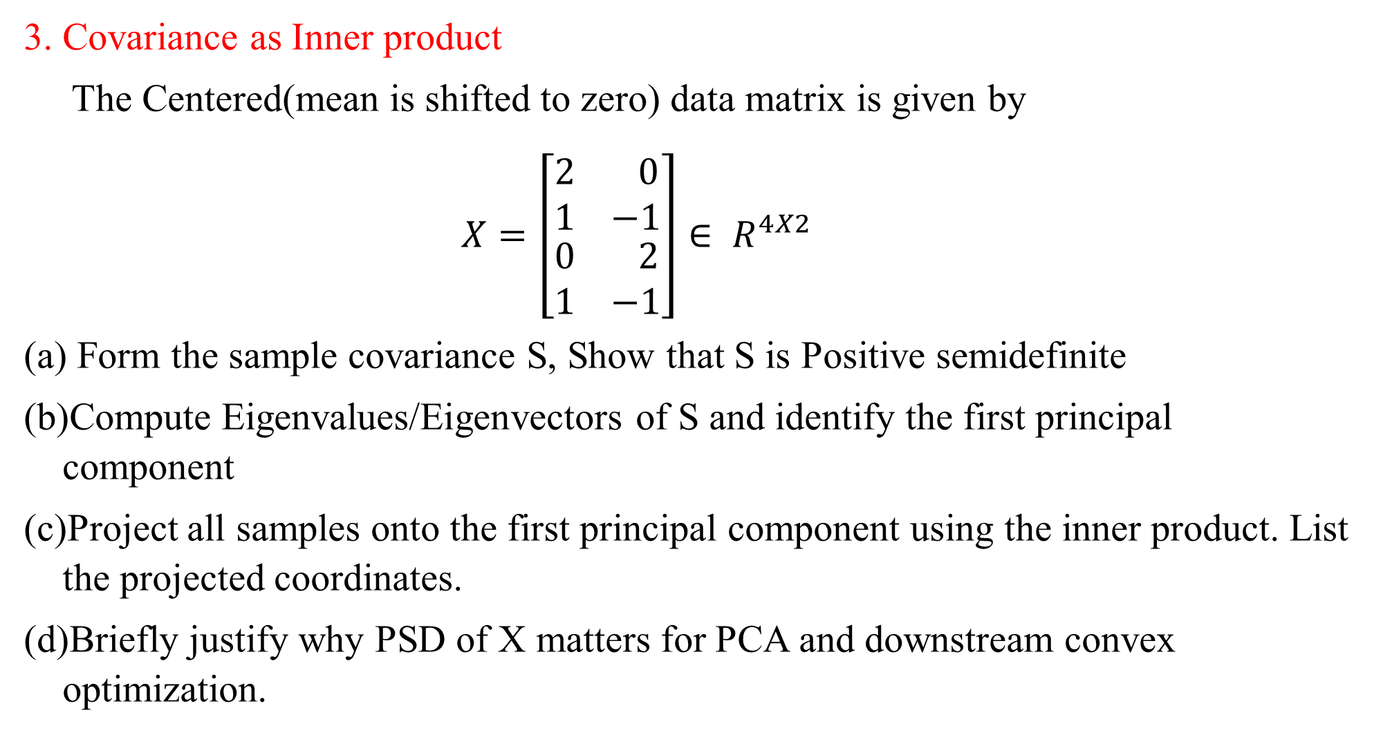
3. Covariance as Inner product
The Centered(mean is shifted to zero) data matrix is given by
$X=\left[\begin{matrix}2 \\ 1 \\ \begin{matrix}0 \\ 1\end{matrix}\end{matrix} \begin{matrix} 0 \\ −1 \\ \begin{matrix} 2 \\ −1\end{matrix}\end{matrix}\right]∈ R^{4X2}$
Form the sample covariance S, Show that S is Positive semidefinite
Compute Eigenvalues/Eigenvectors of S and identify the first principal component
Project all samples onto the first principal component using the inner product. List the projected coordinates.
Briefly justify why PSD of X matters for PCA and downstream convex optimization.

Slide 66
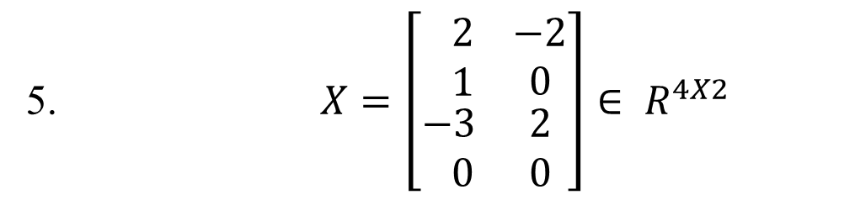
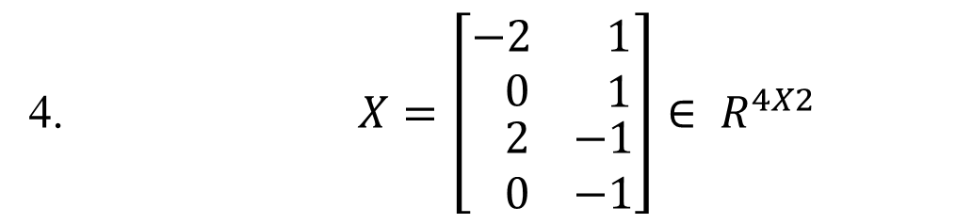
4. $X=\left[\begin{matrix}−2 \\ 0 \\ \begin{matrix} 2 \\ 0\end{matrix}\end{matrix} \begin{matrix} 1 \\ 1 \\ \begin{matrix}−1 \\ −1\end{matrix}\end{matrix}\right]∈ R^{4X2}$
5. $X=\left[\begin{matrix} 2 \\ 1 \\ \begin{matrix}−3 \\ 0\end{matrix}\end{matrix} \begin{matrix}−2 \\ 0 \\ \begin{matrix}2 \\ 0\end{matrix}\end{matrix}\right]∈ R^{4X2}$

Slide 67
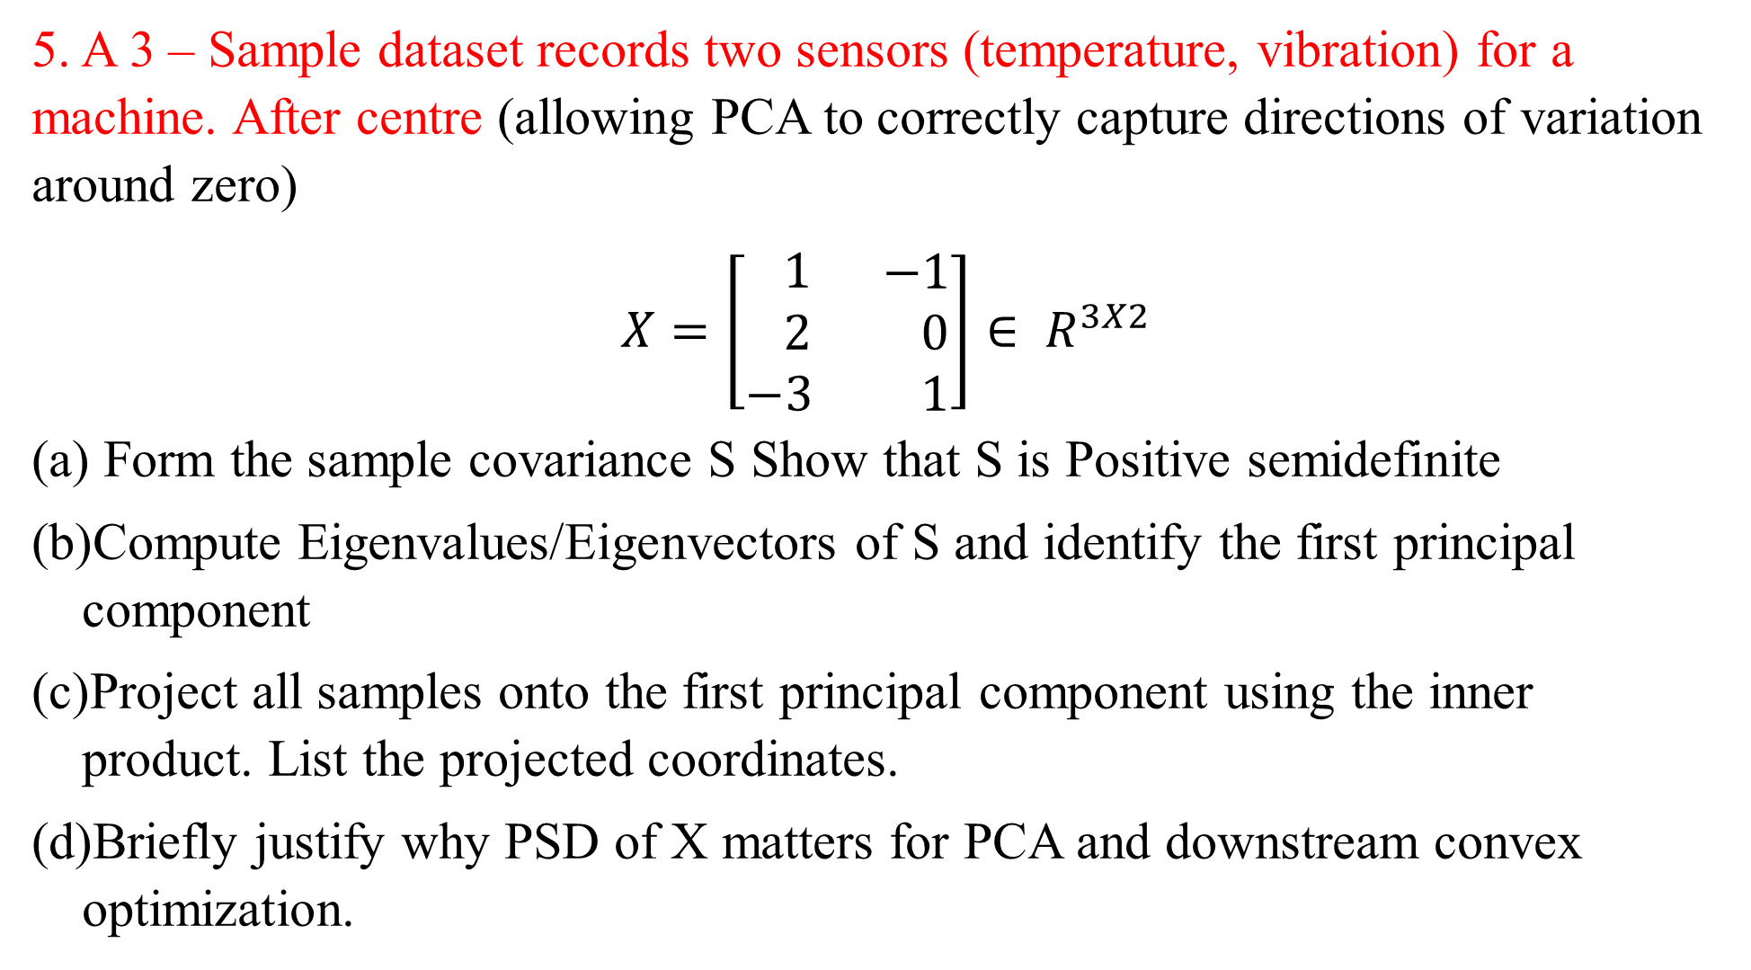
5. A 3 – Sample dataset records two sensors (temperature, vibration) for a machine. After centre (allowing PCA to correctly capture directions of variation around zero)
$X=\left[\begin{matrix} 1 \\ 2 \\ −3\end{matrix} \begin{matrix} −1 \\ 0 \\ 1\end{matrix}\right]∈ R^{3X2}$
Form the sample covariance S Show that S is Positive semidefinite
Compute Eigenvalues/Eigenvectors of S and identify the first principal component
Project all samples onto the first principal component using the inner product. List the projected coordinates.
Briefly justify why PSD of X matters for PCA and downstream convex optimization.

Slide 68
Lengths and Distances in Vector Spaces
1. Vector Length (Norm)
The length (or magnitude) of a vector x ∈ ℝⁿ is measured by its norm. The most common norm is the Euclidean norm (or ℓ₂-norm): ‖x‖ = √(x₁² + x₂² + ... + xₙ²) = √(xᵀx) This gives the geometric length of the vector from the origin to the point x. 2. Distance Between Two Vectors
The distance between two vectors x, y ∈ ℝⁿ is defined as the norm of their difference: distance (x, y) = ‖x − y‖ In Euclidean space: ‖x − y‖ = √((x₁ − y₁)² + (x₂ − y₂)² + ... + (xₙ − yₙ)²)

Slide 69
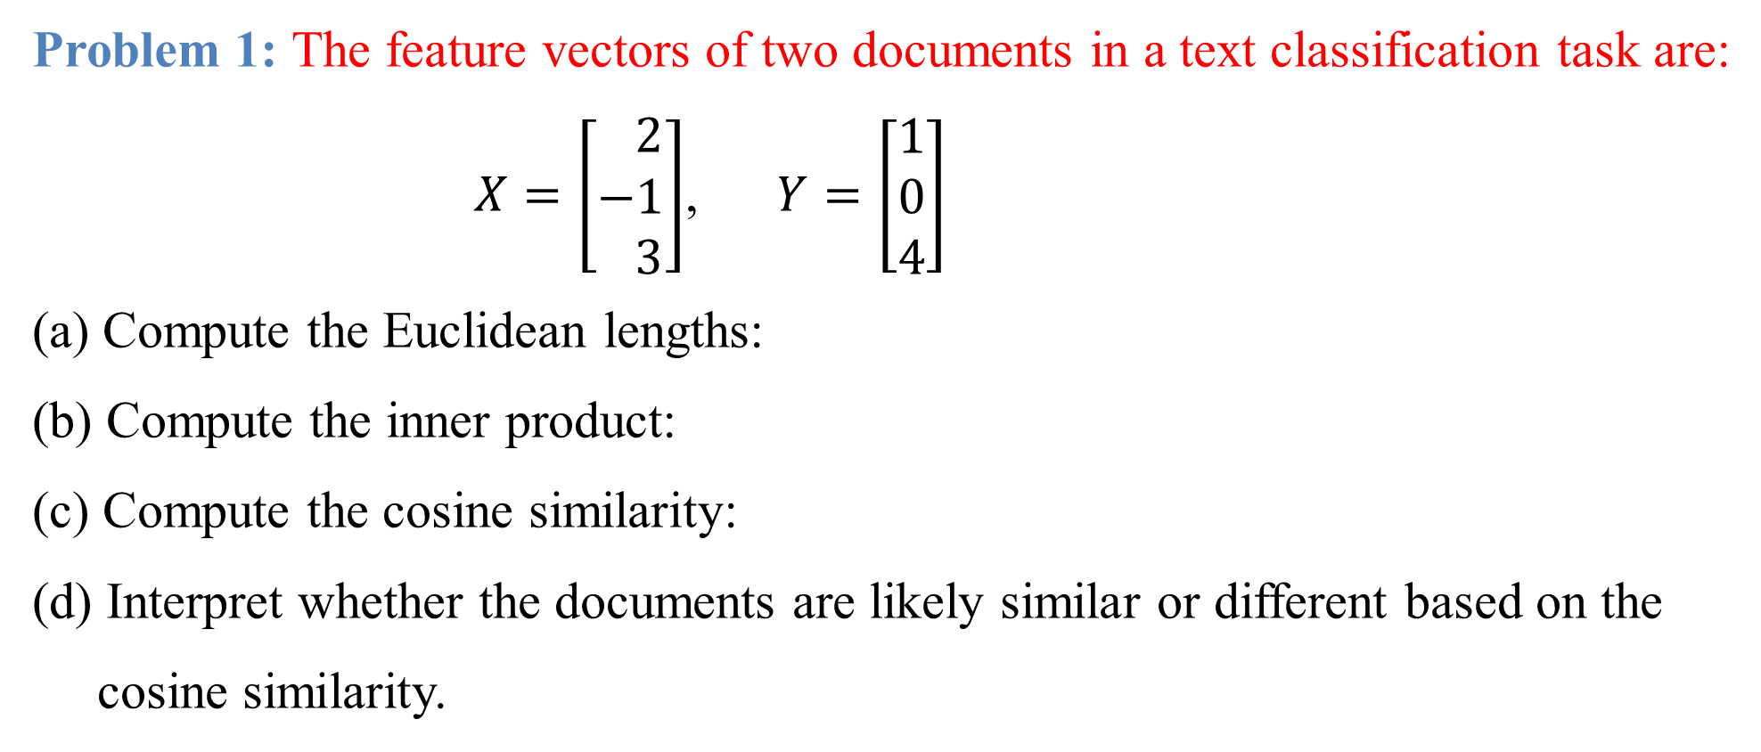
Problem 1: The feature vectors of two documents in a text classification task are:
$X=\left[\begin{matrix} 2 \\ −1 \\ 3\end{matrix}\right]$, $Y=\left[\begin{matrix}1 \\ 0 \\ 4\end{matrix}\right]$
(a) Compute the Euclidean lengths:
(b) Compute the inner product:
(c) Compute the cosine similarity:
(d) Interpret whether the documents are likely similar or different based on the
cosine similarity.

Slide 70
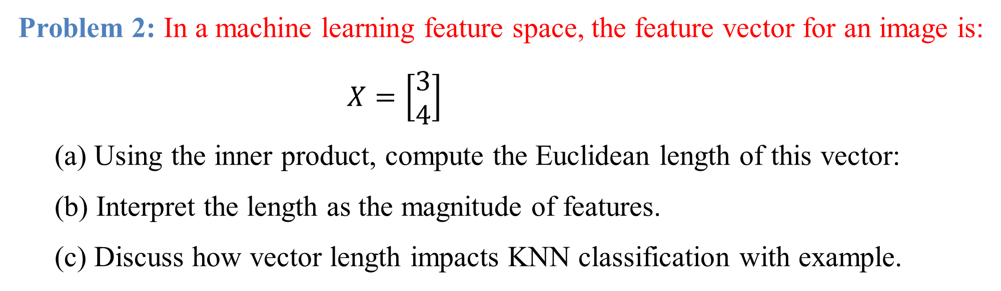
Problem 2: In a machine learning feature space, the feature vector for an image is:
$X=\left[\begin{matrix}3 \\ 4\end{matrix}\right]$
(a) Using the inner product, compute the Euclidean length of this vector:
(b) Interpret the length as the magnitude of features.
(c) Discuss how vector length impacts KNN classification with example.

Slide 71
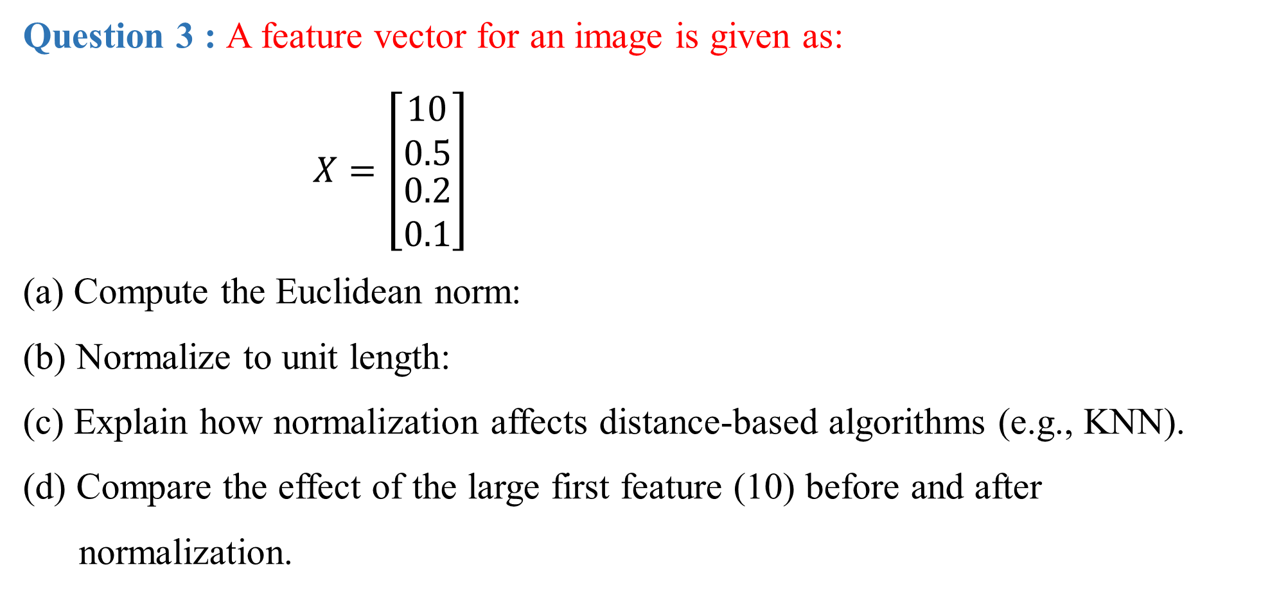
Question 3 : A feature vector for an image is given as:
$X=\left[\begin{matrix}10 \\ 0.5 \\ \begin{matrix}0.2 \\ 0.1\end{matrix}\end{matrix}\right]$
(a) Compute the Euclidean norm:
(b) Normalize to unit length:
(c) Explain how normalization affects distance-based algorithms (e.g., KNN).
(d) Compare the effect of the large first feature (10) before and after
normalization.

Slide 72
Orthogonal Projections
What is Orthogonal Projection?
Orthogonal projection is the process of mapping a point (vector) onto a subspace such that the connecting line is perpendicular to that subspace. • It gives the closest approximation of a vector in a subspace. • Used to simplify data or approximate it using lesser dimensions.
Projection
Definition
A projection is a linear transformation P from a vector space to itself such that applying it twice is the same as applying it once. That is: P² = P This property is called idempotence. Projections are used to map vectors onto subspaces in a way that the mapped vector lies entirely within the subspace.

Slide 73
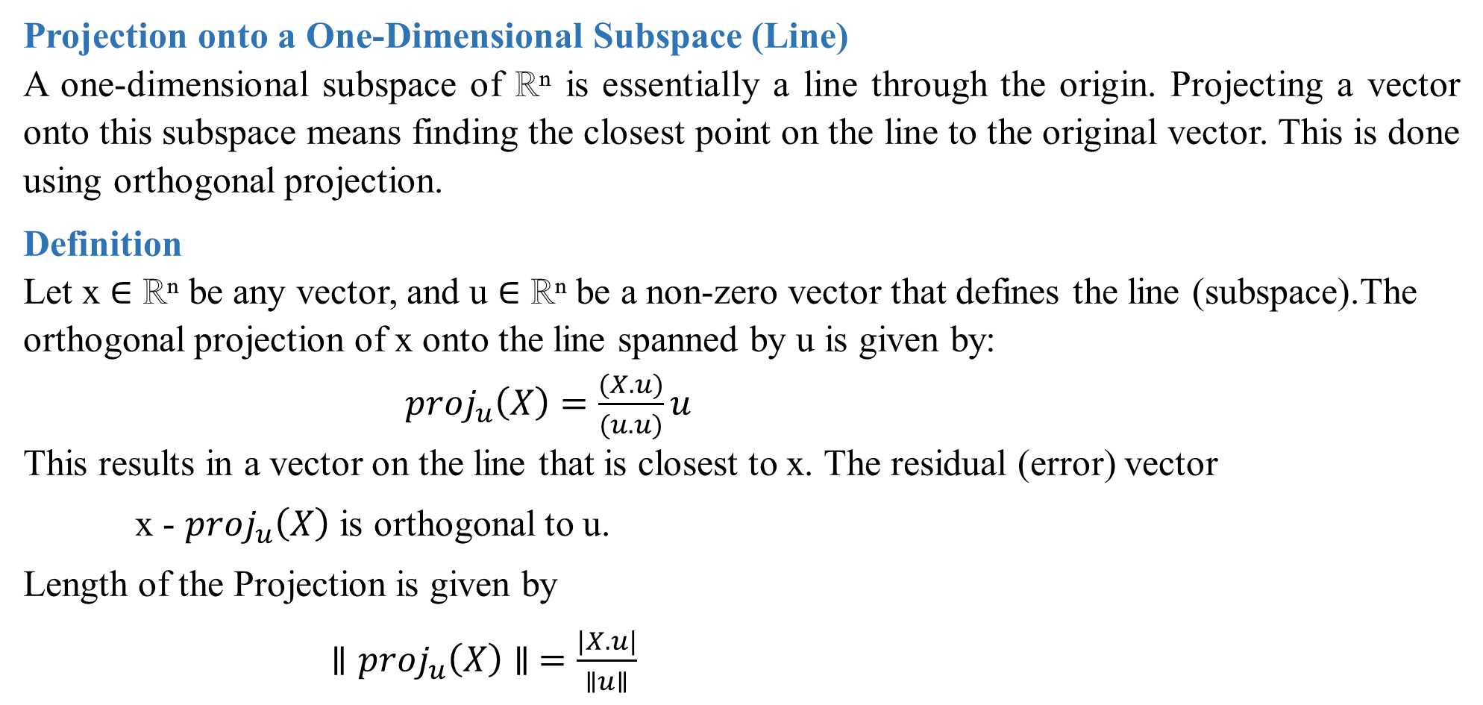
Projection onto a One-Dimensional Subspace (Line)
A one-dimensional subspace of ℝⁿ is essentially a line through the origin. Projecting a vector onto this subspace means finding the closest point on the line to the original vector. This is done using orthogonal projection.
Definition
Let x ∈ ℝⁿ be any vector, and u ∈ ℝⁿ be a non-zero vector that defines the line (subspace).The orthogonal projection of x onto the line spanned by u is given by: ${proj}_{u}\left(X\right)=\frac{(X.u)}{(u.u)}u$ This results in a vector on the line that is closest to x. The residual (error) vector
x - ${proj}_{u}\left(X\right)$ is orthogonal to u.
Length of the Projection is given by
$∥{proj}_{u}\left(X\right)∥ =\frac{|X.u|}{∥u∥}$

Slide 74
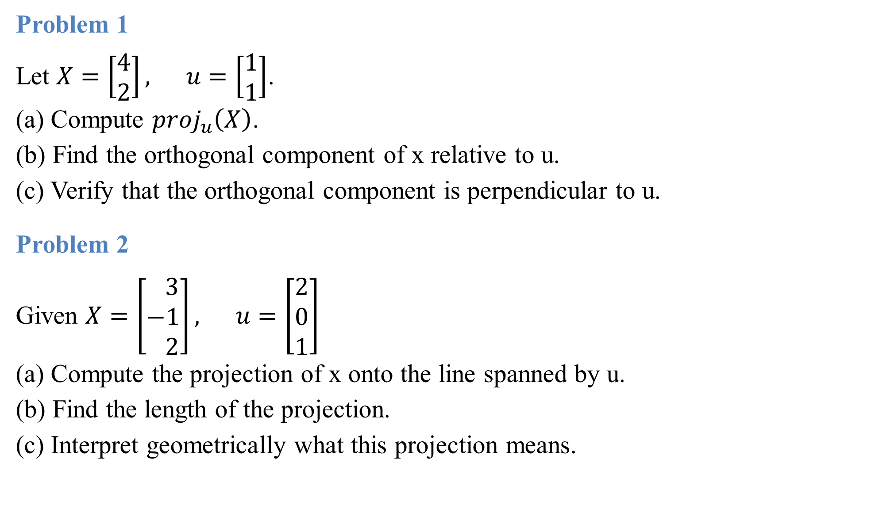
Problem 1
Let $X=\left[\begin{matrix}4 \\ 2\end{matrix}\right], u=\left[\begin{matrix}1 \\ 1\end{matrix}\right]$. (a) Compute ${proj}_{u}\left(X\right)$. (b) Find the orthogonal component of x relative to u. (c) Verify that the orthogonal component is perpendicular to u.
Problem 2
Given $X=\left[\begin{matrix} 3 \\ −1 \\ 2\end{matrix}\right], u=\left[\begin{matrix}2 \\ 0 \\ 1\end{matrix}\right]$ (a) Compute the projection of x onto the line spanned by u. (b) Find the length of the projection. (c) Interpret geometrically what this projection means.

Slide 75
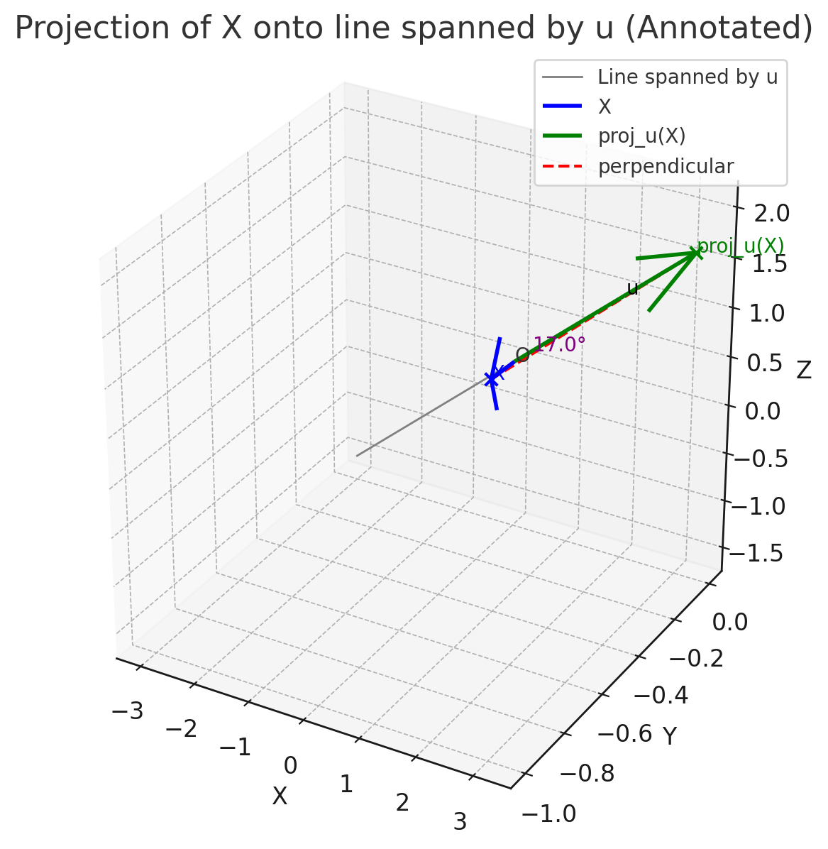
Blue arrow → the original vector X.
Green arrow → the projection of X onto the line spanned by u.
Dashed red line → the perpendicular distance from X to its projection.
Angle label (~17°) → the angle between X and u.

Slide 76
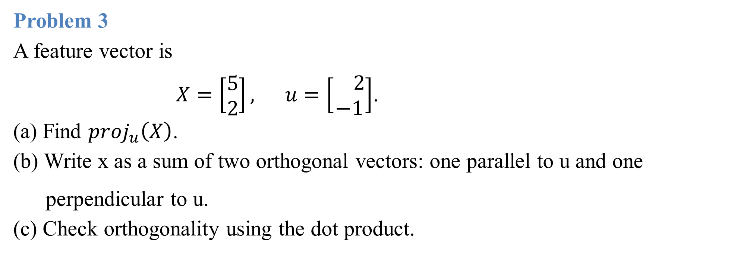
Problem 3
A feature vector is $X=\left[\begin{matrix}5 \\ 2\end{matrix}\right], u=\left[\begin{matrix} 2 \\ −1\end{matrix}\right]$. (a) Find ${proj}_{u}\left(X\right)$. (b) Write x as a sum of two orthogonal vectors: one parallel to u and one
perpendicular to u. (c) Check orthogonality using the dot product.

Slide 77
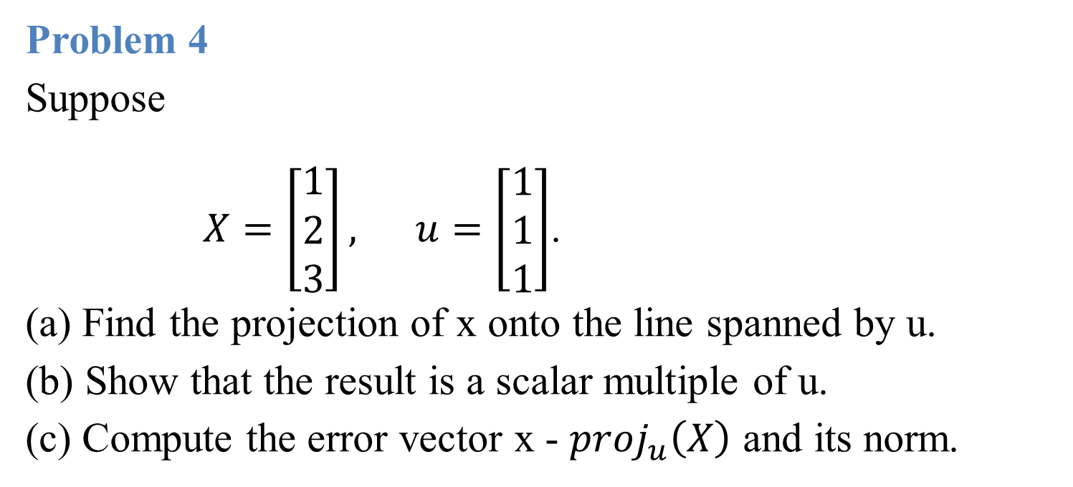
Problem 4
Suppose
$X=\left[\begin{matrix}1 \\ 2 \\ 3\end{matrix}\right], u=\left[\begin{matrix}1 \\ 1 \\ 1\end{matrix}\right]$. (a) Find the projection of x onto the line spanned by u. (b) Show that the result is a scalar multiple of u. (c) Compute the error vector x - ${proj}_{u}\left(X\right)$ and its norm.

Slide 78
Projection on to a Two-Dimensional subspace
Introduction
In linear algebra, the concept of projection plays a key role in decomposing vectors into components that lie within a subspace and those that are orthogonal to it. Projections are widely used in data science, optimization, and signal processing because they allow us to approximate high-dimensional data by its “shadow” or “footprint” on a lower-dimensional space.

Slide 79
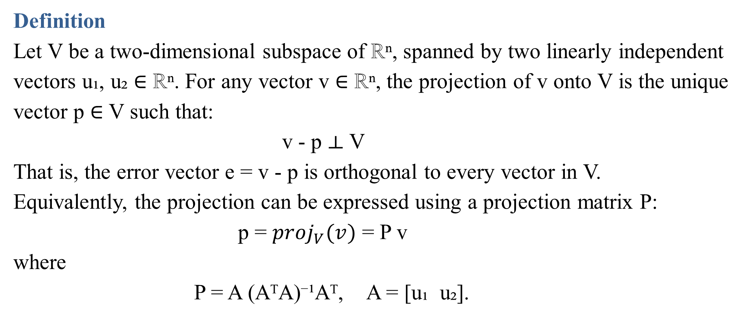
Definition
Let V be a two-dimensional subspace of ℝⁿ, spanned by two linearly independent vectors u₁, u₂ ∈ ℝⁿ. For any vector v ∈ ℝⁿ, the projection of v onto V is the unique vector p ∈ V such that: v - p ⟂ V That is, the error vector e = v - p is orthogonal to every vector in V. Equivalently, the projection can be expressed using a projection matrix P: p = ${proj}_{V}(v)$ = P v where P = A (AᵀA)⁻¹Aᵀ, A = [u₁ u₂].

Slide 80
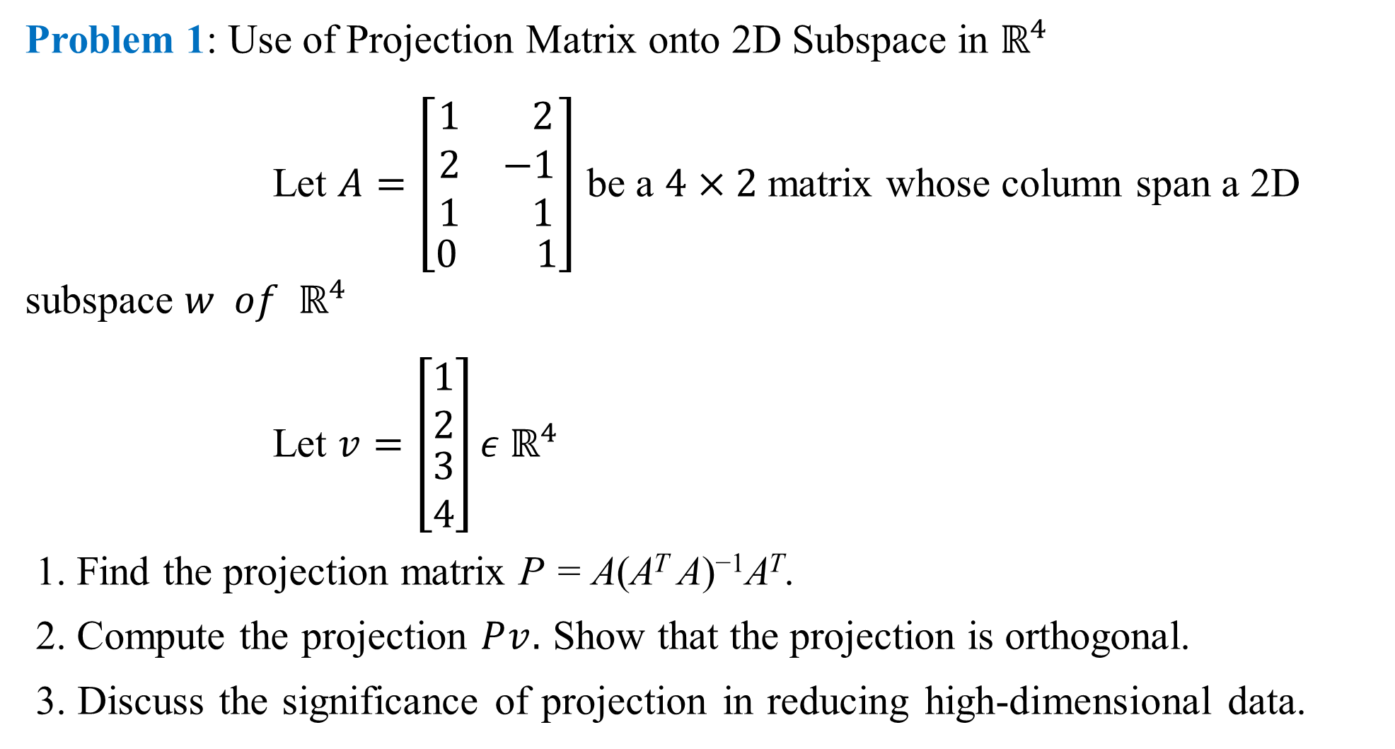
Problem 1: Use of Projection Matrix onto 2D Subspace in $ℝ^{4}$
Let $A=\left[\begin{aligned}\begin{matrix}1 & 2 \\ 2 & −1 \\ 1 & 1\end{matrix} \\ \begin{matrix}0 & 1\end{matrix}\end{aligned}\right]$ be a $4×2$ matrix whose column span a 2D subspace $w of ℝ^{4}$
Let $v=\left[\begin{matrix}1 \\ 2 \\ \begin{matrix}3 \\ 4\end{matrix}\end{matrix}\right]ε ℝ^{4}$
1. Find the projection matrix P = A(A^{T} A)⁻¹A^{T}.
2. Compute the projection $Pv.$ Show that the projection is orthogonal.
3. Discuss the significance of projection in reducing high-dimensional data.

Slide 81
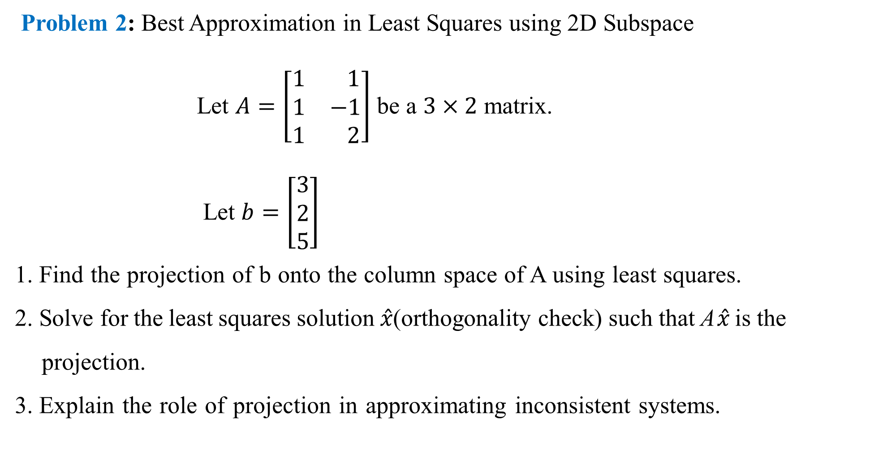
Problem 2: Best Approximation in Least Squares using 2D Subspace
Let $A=\left[\begin{matrix}1 & 1 \\ 1 & −1 \\ 1 & 2\end{matrix}\right]$ be a $3×2$ matrix.
Let $b=\left[\begin{matrix}3 \\ 2 \\ 5\end{matrix}\right]$
1. Find the projection of b onto the column space of A using least squares.
2. Solve for the least squares solution $\hat{x}$(orthogonality check) such that A$\hat{x}$ is the
projection.
3. Explain the role of projection in approximating inconsistent systems.

Slide 82
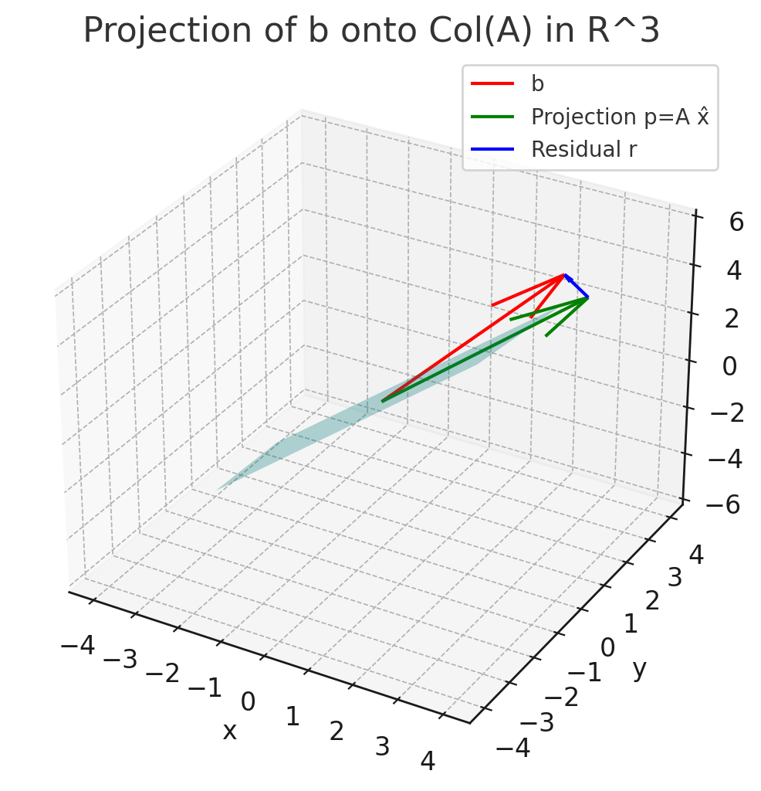

The visual representation of the projection:
The bluish green plane is the column space of 𝐴, i.e., all vectors of the form 𝐴𝑥.
The red vector is 𝑏.
The green vector is the projection $p=A\hat{x}$, the closest point to 𝑏 in the plane.
The blue vector is the residual $r=b−p$, which is perpendicular to the plane.
This picture shows how projection provides the best approximation when the system 𝐴𝑥=𝑏 is inconsistent.

Slide 83

Problem 3 : Use of Projection Matrix onto 2D Subspace in R⁴
Let $A=\left[\begin{aligned}\begin{matrix} 1 & 0 \\ 2 & 1 \\ −1 & 2\end{matrix} \\ \begin{matrix} 3 & −2\end{matrix}\end{aligned}\right]$ be a $4×2$ matrix whose column span a 2D subspace $w of ℝ^{4}$
Let $v=\left[\begin{matrix} 2 \\ −1 \\ \begin{matrix}0 \\ 4\end{matrix}\end{matrix}\right]ε ℝ^{4}$
1. Find the projection matrix P = A(A^{T} A)⁻¹A^{T}.
2. Compute the projection p = $Pv$
3. Explain the significance of projecting v onto a 2D subspace: how does this operation
approximate v using only two basis directions out of four dimensions?

Slide 84
Gram-Schmidt Orthogonalization
Introduction
The Gram-Schmidt process is a method used in linear algebra to convert a set of linearly independent vectors into a set of orthonormal vectors (i.e., vectors that are orthogonal and of unit length).
This technique is especially important in:
Machine Learning for feature orthogonalization.
Principal Component Analysis (PCA) to construct orthogonal basis vectors.
QR Decomposition of matrices.

Slide 85

Definition:
Let {v₁, v₂, ..., vₙ} be a set of linearly independent vectors in ℝⁿ.
The Gram-Schmidt process constructs a set of orthonormal vectors {u₁, u₂, ..., uₙ} as follows:
1. Set: $u_{1}=\frac{v₁}{\left\|v_{1}\right\|}$
2. For $k=2 to n$, define:
$w_{k}=v_{k}−\sum_{j=1}^{k−1}{{proj}_{u_{j}}\left(v_{k}\right)} where {proj}_{u_{j}}\left(v_{k}\right)=\frac{〈v_{k}, u_{j}〉}{〈u_{j}, u_{j}〉}u_{j}$
Then, $u_{k}=\frac{w_{k}}{\left\|w_{k}\right\|}$
Here $〈. , .〉$ is the inner product (dot product for $ℝ^{n}$ ).
Step-by-Step Process
Given linearly independent vectors, $v_{1}, v_{2},…..,v_{n}$, generate orthogonal vectors
$u_{1}, u,…..,u_{n}$:
$u_{1}=v_{1}$
$u_{2}=v_{2}−{proj}_{u_{1}}(v_{2})$
$u_{3}=v_{3}−{proj}_{u_{1}}\left(v_{3}\right)−{proj}_{u_{2}}(v_{3})$
Where:
${proj}_{u}\left(v\right)=\frac{v . u}{u . u}u$

Slide 86

Example 1: Orthogonalize Vectors in $ℝ^{2}$
$v_{1}=\left[\begin{matrix}3 \\ 1\end{matrix}\right]$, $v_{2}=\left[\begin{matrix}2 \\ 2\end{matrix}\right]$
Step 1: $u_{1}=v_{1}$
$u_{1}=\left[\begin{matrix}3 \\ 1\end{matrix}\right]$
Step 2: Compute projection of $v_{2}$ onto $u_{1}$
${proj}_{u_{1}}\left(v_{2}\right)=\frac{\left(2\right)\left(3\right)+(2)(1)}{{(3)}^{2}+{(1)}^{2}}\left[\begin{matrix}3 \\ 1\end{matrix}\right]=\frac{8}{10}\left[\begin{matrix}3 \\ 1\end{matrix}\right]=\left[\begin{matrix}2.4 \\ 0.8\end{matrix}\right]$
Step 3: $u_{2}=v_{2}−{proj}_{u1}(v_{2})$
$u_{2}=\left[\begin{matrix}2 \\ 2\end{matrix}\right]−\left[\begin{matrix}2.4 \\ 0.8\end{matrix}\right]=\left[\begin{matrix}−0.4 \\ 1.2\end{matrix}\right]$
Orthogonal set: $u_{1}=\left[\begin{matrix}3 \\ 1\end{matrix}\right], u_{2}=\left[\begin{matrix}−0.4 \\ 1.2\end{matrix}\right]$
Orthonormal set (if normalized):
$e_{1}=\frac{u_{1}}{\left\|u_{1}\right\|}$, $e_{2}=\frac{u_{2}}{\left\|u_{2}\right\|}$,

Slide 87
Applications in AIML
PCA: Used to orthogonalize principal components.
Dimensionality Reduction: Helps reduce correlated features.
QR Decomposition: Used in solving linear least squares.
Kernel Methods: Useful in building orthonormal bases in feature spaces.

Slide 88

Question 1
In a deep learning model, consider a dataset with three input feature vectors:
$X_{1}=\left[\begin{matrix}1 \\ 1 \\ 0\end{matrix}\right]$, $X_{2}=\left[\begin{matrix}1 \\ 0 \\ 1\end{matrix}\right]$, $X_{3}=\left[\begin{matrix}0 \\ 1 \\ 1\end{matrix}\right]$
Use the Gram-Schmidt Orthogonalization process to convert these into an orthonormal basis. Discuss how orthogonal feature representations can improve convergence and interpretability in neural networks.
Question 2
You are working on reducing the dimensionality of a dataset before feeding it into a neural network. Given the vectors
$v_{1}=\left[\begin{matrix}2 \\ 1\end{matrix}\right]$, $v_{2}=\left[\begin{matrix}1 \\ 2\end{matrix}\right]$
Apply the Gram-Schmidt process to form an orthonormal basis. Explain how orthonormalization benefits Principal Component Analysis (PCA), and its implications in deep learning model performance.

Slide 89

Question 3
In NLP tasks like word embedding (e.g., Word2Vec), orthogonal basis vectors help reduce redundancy. Given three embedding vectors:
$w_{1}=\left[\begin{matrix}1 \\ 2 \\ 2\end{matrix}\right]$, $w_{2}=\left[\begin{matrix}2 \\ 3 \\ 1\end{matrix}\right]$, $w_{3}=\left[\begin{matrix}1 \\ 0 \\ 1\end{matrix}\right]$
Use the Gram-Schmidt process to obtain an orthonormal set of vectors. Then, discuss how such a transformation can help reduce semantic overlap in embeddings.
Question 4
During weight initialization in a deep network, you are advised to use orthogonal initialization for better gradient flow. Given a weight matrix composed of row vectors:
$w_{1}=\left[\begin{matrix}1 \\ 2\end{matrix}\right]$, $w_{2}=\left[\begin{matrix}2 \\ 3\end{matrix}\right]$
Use the Gram-Schmidt process to orthonormalize the rows of this weight matrix. Explain why orthogonal initialization helps in avoiding vanishing or exploding gradients during backpropagation in deep networks.

Slide 90
Projection onto an Affine Subspace
Introduction
In machine learning and optimization, affine subspaces often arise when dealing with constraints or linear transformations. An affine subspace is like a shifted vector subspace — it does not necessarily pass through the origin. Projecting onto an affine subspace is useful in algorithms like constrained optimization, least squares, and in AI/ML for tasks like normalization, dimensionality reduction, and convex optimization.
Definition
Let 𝒜 be an affine subspace of ℝⁿ, defined as: 𝒜 = { x ∈ ℝⁿ | x = x₀ + v, v ∈ V }, where V is a vector subspace and x₀ is a point in ℝⁿ. The orthogonal projection of a point y ∈ ℝⁿ onto 𝒜 is the point ŷ ∈ 𝒜 such that: ‖y − ŷ‖ is minimized. That is, ŷ is the closest point in 𝒜 to y.

Slide 91

Example
Let’s project the point
$y=\left[\begin{matrix}2 \\ 3\end{matrix}\right]$ onto the affine subspace: 𝒜 = { x ∈ ℝ² | x = [1, 1]ᵗ + t·[1, 0]ᵗ, t ∈ ℝ }. This is a line parallel to the x-axis and passing through (1, 1). To find the projection ŷ, we note that we are projecting y onto a horizontal line at y = 1. So, the closest point from y = (2, 3) to the line is: $\hat{y}=\left[\begin{matrix}2 \\ 1\end{matrix}\right]$. That is the orthogonal projection of y onto the affine subspace 𝒜.

Slide 92

Question 1: Feature Normalization using Projection
In a feature space $ℝ^{3}$, the input features of a deep learning model must be constrained to lie in an affine subspace defined by:
$𝒜=\left\{ x∈ℝ^{3}/ x= \left[\begin{matrix}1 \\ 0 \\ 1\end{matrix}\right]+t.\left[\begin{matrix}1 \\ 1 \\ 0\end{matrix}\right] \right\}$
Given a data point $y=\left[\begin{matrix}3 \\ 2 \\ 2\end{matrix}\right]$​​, project it onto the affine subspace 𝒜. Explain how such projections help in feature normalization or constraint handling in deep learning models.
Question 2:
In a denoising autoencoder, suppose the decoder output must satisfy an affine constraint due to a physical system constraint: 𝒜 = $\left\{x ∈ ℝ² | \left[\begin{matrix}1 \\ 1\end{matrix}\right]+t.\left[\begin{matrix} 2 \\ −1\end{matrix}\right]\right\}$. Given a noisy reconstruction output $y=\left[\begin{matrix}4 \\ 0\end{matrix}\right]$, compute the orthogonal projection of y onto the affine subspace 𝒜. Discuss how enforcing such affine constraints during decoding improves the robustness of learning.

Slide 93

Question 3
In training a neural network under constraints, gradients must lie in the affine subspace defined by:
𝒜 = $\left\{g ∈ ℝ² |g= \left[\begin{matrix}0 \\ 1\end{matrix}\right]+t.\left[\begin{matrix} 1 \\ −1\end{matrix}\right]\right\}$. Given the original (unconstrained) gradient $y=\left[\begin{matrix}1 \\ 3\end{matrix}\right]$, compute the projection of y onto 𝒜. Explain how projecting gradients onto an affine subspace helps enforce fairness, balance, or domain-specific constraints in model training.
Question 4
Suppose a neural network outputs class probabilities p ∈ ℝ³, but due to label imbalance, the corrected output must lie in an affine subspace:
$$𝒜=\left\{ p∈ℝ^{3}/ p= \left[\begin{matrix}0.3 \\ 0.4 \\ 0.3\end{matrix}\right]+t.\left[\begin{matrix} 1 \\ −1 \\ 0\end{matrix}\right] \right\}$$
Given predicted probabilities $y=\left[\begin{matrix}0.6 \\ 0.1 \\ 0.3\end{matrix}\right]$
Compute the projection of y onto 𝒜. Explain how projection onto such affine constraints can improve calibration and interpretability in classification models.

Slide 94

Rotations in ℝ²
Definition
A rotation in ℝ² is a linear transformation that turns every vector in the plane about the origin by a fixed angle θ, counter clockwise (or clockwise if negative). This transformation preserves the length of vectors and the angle between them. The standard rotation matrix R(θ) in ℝ² is: $R\left(θ\right)=\left[\begin{matrix}cosθ & −sinθ \\ sinθ & cosθ\end{matrix}\right]$ For any vector $v=\left[\begin{matrix}x \\ y\end{matrix}\right]$, the rotated vector is: $v_{rotated}=R\left(θ\right)∗v$
Geometric Interpretation
The vector is rotated around the origin. The transformation does not stretch or shrink the vector — it only changes direction. The matrix R(θ) is orthogonal, and its determinant is 1.

Slide 95

Example
Rotate the vector $v=\left[\begin{matrix}1 \\ 0\end{matrix}\right]$ θ = 45° = π/4 radians. $R\left(\frac{π}{4}\right)=\left[\begin{matrix}cos\frac{π}{4} & −sin\frac{π}{4} \\ sin\frac{π}{4} & cos\frac{π}{4}\end{matrix}\right]=\left[\begin{matrix}\frac{1}{\sqrt{2}} & −\frac{1}{\sqrt{2}} \\ \frac{1}{\sqrt{2}} & \frac{1}{\sqrt{2}}\end{matrix}\right]$ Now multiply:
$v_{rotated}=\left[\begin{matrix}\frac{1}{\sqrt{2}} & −\frac{1}{\sqrt{2}} \\ \frac{1}{\sqrt{2}} & \frac{1}{\sqrt{2}}\end{matrix}\right] . \left[\begin{matrix}1 \\ 0\end{matrix}\right]=\left[\begin{matrix}\frac{1}{\sqrt{2}} \\ \frac{1}{\sqrt{2}}\end{matrix}\right]$ So the rotated vector lies at a 45° angle from the original vector, maintaining its magnitude.

Slide 96

Problem 1: Data Augmentation via Rotation
In image classification tasks, data augmentation techniques are used to increase dataset diversity. One such technique is rotating images. Given a 2D point P = (3, 4) representing the center of a feature in an image, compute the coordinates of the point after rotating it by 90° counterclockwise around the origin using a rotation matrix. Explain how such transformations help in reducing overfitting in deep learning models.
Problem 2: Feature Transformation in PCA
Principal Component Analysis (PCA) involves rotating the data to align with principal components. Consider two 2D vectors: $x_{1}=\left[\begin{matrix}2 \\ 0\end{matrix}\right]$, $x_{2}=\left[\begin{matrix}1 \\ 1\end{matrix}\right]$ Suppose the dataset needs to be rotated by 45° clockwise to align with a new basis. 1. Derive the 2D rotation matrix for 45° clockwise. 2. Apply this rotation matrix to both vectors. 3. Discuss how such rotation aligns with the goal of PCA in reducing redundancy in data.

Slide 97
Problem 3: Rotation-Invariant Feature Engineering
In certain ML models, especially in object recognition, rotation-invariant features are desirable. Given a 2D input point (x, y) = (5, 0), write a function that computes its rotated coordinates for arbitrary angle θ. Then, evaluate the rotated coordinates when θ = 120°. Explain how this computation contributes to rotation-invariant models like SIFT or Capsule Networks in deep learning.
Problem 4: Neural Network Weight Visualization
Suppose you are visualizing the weight vectors of a neuron in a 2D space. You rotate the weight vector w = [1, 2] by θ = 60° counter clockwise. Compute the rotated weight vector using the rotation matrix.

Slide 98

Definition of Rotations in ℝ³
A rotation in ℝ³ (three-dimensional real space) is a linear transformation that: Preserves the origin (i.e., it is a transformation around the origin), Preserves distances and angles (i.e., it is an orthogonal transformation with determinant +1), Rotates points around a specified axis by a given angle.
Mathematical Definition
A rotation in ℝ³ about one of the coordinate axes by an angle θ can be represented by a rotation matrix R ∈ ℝ³ˣ³, which is orthogonal and has determinant +1.
Rotation About the x-axis: Rotation About the y-axis: Rotation About the z-axis:
Rₓ(θ) = $\left[\begin{matrix}1 & 0 & 0 \\ 0 & cosθ & −sinθ \\ 0 & sinθ & cosθ\end{matrix}\right]$ Ry $R_{y}$(θ) = $\left[\begin{matrix}cosθ & 0 & sinθ \\ 0 & 1 & 0 \\ −sinθ & 0 & cosθ\end{matrix}\right]$ R𝓏(θ) = $\left[\begin{matrix}cosθ & −sinθ & 0 \\ sinθ & cosθ & 0 \\ 0 & 0 & 1\end{matrix}\right]$

Slide 99
Key Properties
Rotations are isometries: they preserve lengths and angles.
A rotation matrix R satisfies: RᵀR = I and det(R) = +1
Any general 3D rotation can be described as a rotation about an arbitrary axis, using Rodrigues’ rotation formula or quaternions.
Applications in AI/ML and Deep Learning
3D data augmentation in computer vision (e.g., rotating 3D medical scans or LiDAR data).
Pose estimation and object tracking in robotics and autonomous systems.
Equivariant neural networks where model behavior is consistent under rotation.
3D point cloud classification and generation using models like PointNet, which are designed to be rotation-invariant or rotation-equivariant.

Slide 100
Problem 1: 3D Data Augmentation in Point Clouds
In 3D object recognition tasks, such as in autonomous vehicles or robotics, point cloud data (x, y, z) needs to be augmented through 3D rotation. Given a point P = (1, 0, 0), rotate it 90° about the z-axis. 1. Derive the rotation matrix for this operation. 2. Compute the new coordinates. Explain how this helps in building rotation-robust 3D classifiers using neural networks like Point Net.
Problem 2: Understanding Orientation in Pose Estimation
In deep learning models for human pose estimation, body joints are represented as 3D coordinates. Rotations help simulate different viewpoints. Given a 3D vector v = (0, 1, 1), apply a rotation of 45° about the x-axis. 1. Write down the rotation matrix for this transformation. 2. Find the rotated coordinates. Discuss how such rotations are used in pose estimation networks and affect the interpretability of model predictions.

Slide 101
Problem 3: Orientation Alignment using Rotation Matrices
In reinforcement learning for robotics, an agent often aligns its orientation to a goal direction. Given a rotation matrix R that rotates by 60° about the y-axis, and a robot’s forward direction vector v = (1, 0, 0), 1. Compute the rotated direction. 2. Interpret the result in the context of 3D navigation in simulation environments like MuJoCo or PyBullet.
Problem 4: Rotational Equivariance in Neural Networks
Explain the idea of rotational equivariance in the context of 3D convolutional neural networks (CNNs). Given a point (2, 2, 0), rotate it by 90° about the x-axis, and find the resulting coordinates using the appropriate matrix. Discuss why preserving equivariance under rotation is important for tasks like 3D medical imaging or protein folding prediction.

Slide 102
Matrix Decomposition
Introduction:
Matrix decomposition (or matrix factorization) is a fundamental technique in linear algebra where a matrix is broken down into a product of simpler or structured matrices. These decompositions simplify complex matrix operations and are essential in various areas of applied mathematics, computer science, and especially in artificial intelligence (AI) and machine learning (ML).
Why Matrix Decomposition?
- To simplify matrix computations like solving systems of linear equations. - To efficiently compute eigenvalues, eigenvectors, and inverses. - To reduce data dimensionality (as in PCA). - To improve numerical stability in algorithms. - To discover latent structure in data (e.g., in recommender systems).

Slide 103
Common Types of Matrix Decomposition
1. LU Decomposition
Decomposes a square matrix A into a lower triangular matrix L and an upper triangular matrix U: A = LU Useful for solving systems of linear equations.
2. QR Decomposition
Decomposes A into an orthogonal matrix Q and an upper triangular matrix R: A = QR Important in least squares regression.
3. Eigen Decomposition
For square matrices with enough eigenvectors, A can be decomposed as: A = PDP⁻¹ where D is a diagonal matrix of eigenvalues.
4. Singular Value Decomposition (SVD)
Decomposes any m × n matrix A as: A = UΣVᵀ where U and V are orthogonal, and Σ is diagonal. Widely used in PCA, image compression, and collaborative filtering.

Slide 104
5. Cholesky Decomposition
For symmetric positive-definite matrices: A = LLᵀ where L is lower triangular.
Relevance to AI/ML
- Principal Component Analysis (PCA) uses SVD for dimensionality reduction. - Neural networks often involve decompositions for optimization (e.g., Hessian matrices). - Latent Semantic Analysis (LSA) in NLP relies on SVD. - Recommender systems use matrix factorization to predict missing user-item interactions.

Slide 105
Eigenvalues and Eigenvectors
Introduction
In linear algebra, eigenvalues and eigenvectors are fundamental concepts associated with square matrices. They help us understand the structure of linear transformations and how these transformations act on different directions in space. These concepts are extensively used in various fields, including: - Machine Learning (e.g., PCA – Principal Component Analysis) - Data Science - Physics - Computer Graphics - Deep Learning (e.g., analyzing weight matrices) Eigenvectors reveal invariant directions under a transformation, and eigenvalues quantify how much the vectors are stretched or shrunk along those directions.
Definition
Let A be an n × n square matrix. A non-zero vector v ∈ ℝⁿ is called an eigenvector of A if there exists a scalar λ ∈ ℝ (or ℂ) such that: A·v = λ·v Here, λ is called the eigenvalue corresponding to the eigenvector v.

Slide 106
Collinearity and Co-direction
Definition: Collinearity
Collinearity is a geometric property of points or vectors lying on the same straight line. In Vectors: Two or more vectors are said to be collinear if they lie along the same line, regardless of their direction or magnitude. Mathematical Condition: Vectors a and b are collinear if there exists a scalar λ ∈ ℝ such that: a = λb - If λ > 0, they point in the same direction. - If λ < 0, they point in opposite directions. - If λ = 0, a is the zero vector, which is considered trivially collinear.
Definition: Co-direction
Co-direction refers to vectors having the same direction. In Vectors: Two non-zero vectors a and b are said to be codirectional if they are collinear and the scalar λ such that a = λb is positive. That is: a = λb where λ > 0

Slide 107

Eigenspace and Eigen Spectrum
Definition: Eigenspace
The eigenspace corresponding to a given eigenvalue λ of a matrix A is the set of all eigenvectors associated with λ, along with the zero vector. Mathematically, for a square matrix A ∈ ℝⁿˣⁿ, the eigenspace for eigenvalue λ is defined as: $E_{λ}$ = { v ∈ ℝⁿ | Av = λv } = null(A − λI) - $E_{λ}$ is a subspace of ℝⁿ. - It includes all eigenvectors corresponding to λ and the zero vector. - The dimension of the eigenspace is called the geometric multiplicity of λ.
Definition: Eigen Spectrum
The eigen spectrum (or simply, spectrum) of a matrix A is the set of all its eigenvalues. Formally, for A ∈ ℝⁿˣⁿ: Spec(A) = { λ₁, λ₂, ..., $λ_{k}$} - This set may include repeated eigenvalues. - The spectrum gives insight into the structure, stability, and behavior of linear transformations. - In applications like PCA, the spectrum helps identify important directions (principal components) based on eigenvalues.

Slide 108
Problem 1: PCA-Based Dimensionality Reduction You are given a dataset with 1000 samples and 50 features. To reduce the dimensionality, you perform Principal Component Analysis (PCA). After computing the covariance matrix, you find that the top 5 eigenvalues are significantly larger than the remaining 45. 1. Explain how eigenvalues and eigenvectors are used in PCA to reduce dimensions. 2. How do the eigenvectors correspond to the new features (principal components)? 3. Why are the top 5 eigenvalues retained?
Problem 2: Stability Analysis of a Neural Network Training Step During training, you approximate the Hessian matrix of the loss function with respect to the model parameters. The eigenvalues of this Hessian matrix are used to understand the curvature of the loss surface. 1. Explain what information the eigenvalues of the Hessian convey about the loss function near a critical point. 2. If the eigenvalues are all positive, what does it indicate about the point? 3. Apply this knowledge to determine whether a given point is a local minimum or saddle point.

Slide 109
Problem 3: Spectral Clustering in Unsupervised Learning In spectral clustering, the Laplacian matrix ( L ) of a graph is computed, and the clustering is done using the eigenvectors corresponding to the smallest non-zero eigenvalues of ( L ). 1. Construct a Laplacian matrix for a simple undirected graph with 4 nodes and some edges. 2. Find its eigenvalues and corresponding eigenspace. 3. Use the second smallest eigenvector (Fiedler vector) to explain how clusters can be formed.
Problem 4: Feature Transformation using Eigenvectors You are working on a digit recognition problem using 8×8 grayscale images. To reduce redundancy, you transform each image using the eigenvectors of the image covariance matrix. 1. Given a 64-dimensional image vector and its covariance matrix, explain how eigenvectors can be used to transform the data. 2. How does this transformation help in decorrelating the features? 3. Apply this concept to describe how the transformed features could improve model training.

Slide 110

Eigenspectrum of a Biological Neural Network
Introduction
In recent years, researchers have applied mathematical tools such as linear algebra and spectral analysis to understand the functional architecture of biological neural networks, such as those found in the brain. One key concept is the eigenspectrum, which refers to the set of eigenvalues of a matrix representing the network—such as a connectivity matrix of synaptic weights between neurons. The eigenspectrum provides insights into the stability, dynamics, and information-processing capabilities of the network.
Definition
The eigenspectrum of a biological neural network is the collection of all eigenvalues (real or complex) of a matrix that represents the network’s structure or function. Typically, this matrix is the synaptic weight matrix W, where $W_{ij}$ represents the strength of the synapse from neuron j to neuron i. Mathematically: If W is an n × n weight matrix, then the eigenspectrum is the set of λ such that: Wv = λv, where v is a non-zero eigenvector corresponding to eigenvalue λ.

Slide 111

Simple Example
Consider a simple network of 2 neurons with the synaptic weight matrix: W = $\left[\begin{matrix}0.8 & 0.2 \\ 0.1 & 0.9\end{matrix}\right]$ To find the eigenspectrum, solve the characteristic equation: |W - λI| = 0 This gives:
$\left|\begin{matrix}0.8−λ & 0.2 \\ 0.1 & 0.9−λ\end{matrix}\right|$ = (0.8−λ)(0.9−λ) − (0.1)(0.2)
= λ² − 1.7λ + 0.7 = 0 Solving this quadratic equation gives the eigenvalues (approx.): λ₁ ≈ 1.0, λ₂ ≈ 0.7 Hence, the eigenspectrum of this neural network is {1.0, 0.7}.

Slide 112

Problem 1: Eigenvalue Distribution and Network Stability
A biological neural network is modelled using a recurrent weight matrix W ∈ ℝ³ˣ³:
$w=\left[\begin{matrix} 0.8 & −0.3 & 0.1 \\ 0.4 & 0.6 & −0.2 \\ −0.1 & 0.5 & 0.7\end{matrix}\right]$ Task: 1. Compute the eigenvalues of W. 2. Determine whether the network is asymptotically stable, i.e., whether the neuron activations die out over time. 3. Relate this to the behavior of recurrent neural networks (RNNs) in AI/ML.
Problem 2: Eigenspectrum and Dimensionality Reduction in Neural Activity
A data matrix X ∈ ℝ¹⁰⁰ˣ⁵⁰ represents the firing rates of 50 biological neurons across 100 time points. Task: 1. Compute the covariance matrix C = (1/n) XᵀX. 2. Derive the eigenspectrum of C (symbolically, using notation like λ₁, λ₂, ..., λ₅₀). 3. Explain how retaining the top k eigenvalues relates to principal component analysis (PCA) in both biological and artificial networks.

Slide 113
Problem 3: Synaptic Plasticity and Spectral Shift
Let W₀ be the initial synaptic weight matrix of a neural system, and ΔW be the matrix after learning via Hebbian rule: ΔW = η · XᵀX, where X ∈ ℝⁿˣᵈ The updated weight matrix is W = W₀ + ΔW. Task: 1. Show that if W₀ is symmetric, W remains symmetric after update. 2. Use Rayleigh quotient to discuss how the dominant eigenvalue of W changes with learning. 3. Interpret how this spectral shift represents neural strengthening in both brain and AI networks.
Problem 4: Functional Connectivity via Eigenmodes
In a biological brain simulation, the functional connectivity matrix F ∈ ℝⁿˣⁿ is modeled as a symmetric matrix where Fᵢⱼ captures the correlation between firing of neuron i and neuron j. Suppose F has eigen-decomposition: F = QΛQᵀ Task: 1. Mathematically explain the meaning of the matrix Q (eigenvectors) and Λ (eigenvalues). 2. Suppose the top-3 eigenvalues are significantly larger than the rest. What does this imply about latent neural patterns? 3. How does this relate to low-rank approximations in Deep Learning models like transformers?

Slide 114
Google's PageRank: Webpages as Eigenvectors
1. The Web as a Directed Graph
Each webpage is a node in a directed graph, and hyperlinks are directed edges. If there are N pages (P₁, P₂, ..., Pₙ), the web can be modelled as a graph structure.
2. The Link Matrix (Hyperlink Matrix)
Let M be an N×N matrix where: Mᵢⱼ = 1/Lⱼ if page j links to page i, otherwise 0, where Lⱼ is the number of outbound links from page j. This matrix M is column-stochastic (columns sum to 1).
3. The PageRank Vector
Let r ∈ ℝⁿ be the PageRank vector with rᵢ representing the rank of page i. We solve the eigenvector equation: r = M r Here, r is the principal eigenvector of matrix M with eigenvalue 1.

Slide 115
4. Damping Factor (Teleportation)
To handle issues like dead ends and disconnected graphs, a damping factor d ∈ (0, 1) is introduced (typically d = 0.85): r = d M r + (1 - d) v Where v is usually the uniform vector (1/n for all entries). This leads to the Google Matrix: G = dM + (1 - d)(1/N)11ᵀ We solve: r = G r
5. Computation via Power Iteration
To find r, use the iterative method: 1. Initialize r⁽⁰⁾ = (1/N) * 1 2. Repeat: r⁽ᵏ⁺¹⁾ = G r⁽ᵏ⁾ until convergence.

Slide 116
Problem 1: Compute PageRank for a Web Graph Using Linear Algebra PageRank is an example of using Markov chains and eigenvector centrality, which also appear in graph-based machine learning and NLP (e.g., TextRank for summarization). Problem Statement: Given a web graph with 4 pages A, B, C, D, and the following link structure: - A links to B and C - B links to C - C links to A - D links to C Tasks: a) Construct the stochastic transition matrix M for the graph assuming a damping factor d = 0.85. b) Use the power iteration method to compute the PageRank vector up to two iterations, starting from a uniform distribution. c) Explain how this vector represents a stationary distribution and how it relates to eigenvalues and eigenvectors.

Slide 117

Problem 2: PageRank as an Eigenvector Problem in Graph-based Semi-Supervised Learning In graph-based semi-supervised learning, we model data as a graph and use spectral techniques for label propagation. PageRank plays a role in estimating node importance. Problem Statement: You are given a weighted graph G with 5 nodes representing unlabelled and labelled data points in a classification problem. The adjacency matrix is: $A=\left[\begin{matrix}0 1 1 0 0 \\ 1 0 1 1 0 \\ \begin{matrix}1 1 0 1 1 \\ 0 1 1 0 1 \\ 0 0 1 1 0 \end{matrix}\end{matrix}\right]$ a) Construct the column-stochastic transition matrix from this graph. b) Compute the Google matrix G = dM + (1 - d)(1/n)E for d = 0.85, where E is a matrix of all ones. c) Explain how computing the principal eigenvector of G gives PageRank scores and how this can be used to
weight label influence in semi-supervised learning.

Slide 118
Cholesky Decomposition:
Introduction
Cholesky Decomposition is a powerful matrix factorization technique used in many areas of machine learning and data science, especially when dealing with symmetric positive definite matrices. It is commonly used in: - Solving systems of linear equations - Optimization algorithms (e.g., in Gaussian Processes) - Sampling from multivariate normal distributions - Efficient computation in Bayesian inference and Kalman filters It is a numerically stable and faster alternative to LU decomposition when the matrix is symmetric and positive definite.
Definition
Let A ∈ ℝⁿˣⁿ be a symmetric positive definite matrix. Then Cholesky Decomposition is: A = LLᵀ Where: - L is a lower triangular matrix with positive diagonal entries - Lᵀ is the transpose of L Alternatively, we can write: A = UᵀU where U is an upper triangular matrix.

Slide 119

Example (Relevant to AIML)
Problem: In Bayesian Linear Regression, we often need to compute the inverse of a covariance matrix A, where: A = XᵀX + λI Let’s say X is the following design matrix for 2 data points with 2 features: X = $\left[\begin{matrix}1 & 2 \\ 3 & 4\end{matrix}\right]$, λ = 1 Then, A = XᵀX + λI = $\left[\begin{matrix}10 & 14 \\ 14 & 20\end{matrix}\right]+\left[\begin{matrix}1 & 0 \\ 0 & 1\end{matrix}\right]$ = $\left[\begin{matrix}11 & 14 \\ 14 & 21\end{matrix}\right]$ Check that this matrix is symmetric positive definite. Now decompose: A = LLᵀ Using Cholesky Decomposition (approximate values): L = $\left[\begin{matrix}\sqrt{11} & 0 \\ \frac{14}{\sqrt{11}} & \sqrt{21−\frac{{14}^{2}}{\sqrt{11}}}\end{matrix}\right]$= $\left[\begin{matrix}3.3166 & 0 \\ 4.2164 & 0.1826\end{matrix}\right]$ You can now solve Ax = b by solving: 1. Ly = b 2. Lᵀx = y Which is computationally efficient.

Slide 120
Application in AIML
- In Gaussian Processes, the covariance matrix of the kernel must be inverted, and Cholesky decomposition enables efficient sampling and likelihood evaluation. - In Bayesian linear regression, it helps compute the posterior distribution over weights without explicitly inverting the covariance matrix. - In deep learning, it is used for regularization and sampling in variational inference, such as in Variational Autoencoders (VAEs).

Slide 121

Problem 1: Covariance Matrix Decomposition in Gaussian Process Regression
In a Gaussian Process Regression setting, you are given a kernel (covariance) matrix: K = $\left[\begin{matrix}4 & 2 \\ 2 & 3\end{matrix}\right]$ This matrix arises from evaluating a squared exponential kernel function. (a) Show that the matrix K is symmetric and positive definite. (b) Use Cholesky Decomposition to factor K = LLᵀ. (c) Explain how this factorization helps in computing K⁻¹y efficiently during GP prediction for a target vector y = $\left[\begin{matrix}1 \\ 2\end{matrix}\right]$.
Problem 2: Bayesian Linear Regression Posterior
In Bayesian Linear Regression, the posterior distribution over weights is Gaussian with covariance matrix: Σ = (XᵀX + λI)⁻¹ Let: X = $\left[\begin{matrix}1 & 1 \\ 1 & 2 \\ 1 & 3\end{matrix}\right]$, λ = 1 (a) Compute A = XᵀX + λI. (b) Perform Cholesky Decomposition A = LLᵀ. (c) Explain how this is used to sample weights from the posterior distribution w ~ N(0, Σ).

Slide 122

Problem 3: Solving Linear Systems in Kalman Filters
In Kalman filtering, the update step involves solving Sx = b, where S is the innovation covariance matrix and symmetric positive definite. Let: S = $\left[\begin{matrix}2 & 1 \\ 1 & 2\end{matrix}\right]$ b = $\left[\begin{matrix}1 \\ 3\end{matrix}\right]$ (a) Perform Cholesky decomposition S = LLᵀ. (b) Use it to solve Sx = b via forward and backward substitution. (c) Discuss why Cholesky is preferred over directly inverting S in real-time systems like robotics.
Problem 4: Sampling from Multivariate Gaussian Distribution
Let a 2D random variable follow a multivariate normal distribution with mean vector μ = [0, 0]^T and covariance matrix: Σ = $\left[\begin{matrix}2 & 1 \\ 1 & 2\end{matrix}\right]$ (a) Show that Σ is symmetric positive definite. (b) Use Cholesky decomposition to factor Σ = LLᵀ. (c) Describe the process to generate a sample x ~ N(μ, Σ) using standard normal samples and L.

Slide 123
Eigendecomposition and Diagonalization
1. Introduction
Eigendecomposition is a fundamental concept in linear algebra used extensively in AI/ML, data science, and other mathematical applications. It involves breaking down a square matrix into its eigenvalues and eigenvectors, revealing its fundamental properties. Diagonalization is a special case of eigendecomposition where a matrix is transformed into a diagonal matrix using its eigenvalues and eigenvectors. These concepts are crucial for simplifying matrix operations, understanding linear transformations, and enabling methods like PCA (Principal Component Analysis).
2. Definition
Eigendecomposition: For a square matrix A, if it can be expressed as: A = V Λ V⁻¹ where: V = matrix of eigenvectors of A Λ = diagonal matrix of eigenvalues of A This is called the eigendecomposition of A.

Slide 124

Problem 1
In a Principal Component Analysis (PCA) task, the covariance matrix of a dataset is given as:
$C=\left[\begin{matrix}2 & 1 \\ 1 & 2\end{matrix}\right]$ a) Perform eigendecomposition of the covariance matrix C. b) Interpret how the eigenvalues and eigenvectors represent the principal components in dimensionality reduction.
Problem 2
Consider a weight matrix in a neural network layer: $W=\left[\begin{matrix}4 & 2 \\ 1 & 3\end{matrix}\right]$ a) Compute the eigenvalues and eigenvectors of W. b) Explain how diagonalization of W could be used to analyze stability and transformation properties of the layer.

Slide 125

Problem 3
In reinforcement learning, the state transition matrix of a Markov Decision Process (MDP) is: $P=\left[\begin{matrix}0.7 & 0.3 \\ 0.4 & 0.6\end{matrix}\right]$ a) Perform eigendecomposition of P. b) Discuss how the eigenvalues relate to the long-term behavior and convergence of the MDP.
Problem 4
A graph-based semi-supervised learning algorithm uses the adjacency matrix:
$A=\left[\begin{matrix}0 & 1 & 1 \\ 1 & 0 & 1 \\ 1 & 1 & 0\end{matrix}\right]$ a) Perform eigendecomposition of A. b) Explain how eigenvalues and eigenvectors of A can be used in spectral clustering for grouping similar data points.

Slide 126
Singular Value Decomposition (SVD):
1. Introduction
Singular Value Decomposition (SVD) is a fundamental matrix factorization technique in linear algebra. It extends the concept of eigendecomposition to any m×n matrix (square or rectangular). SVD is extensively used in AI/ML for dimensionality reduction, feature extraction, noise filtering, and data compression.
2. Definition
For any real or complex matrix A of size m × n, SVD decomposes A into three matrices: A = U Σ Vᵀ Where: U is an m × m orthogonal matrix (columns are left singular vectors), Σ is an m × n diagonal matrix with non-negative real numbers (singular values), V is an n × n orthogonal matrix (columns are right singular vectors).

Slide 127
Problem 1: Image Compression using SVD
An image is represented as a 256 × 256 grayscale matrix. 1. Perform SVD on this image matrix A. 2. Reconstruct the image using only the top 20 singular values. 3. Calculate the compression ratio and discuss the trade-off between compression and image quality. AI/ML Context: Image compression and storage efficiency in computer vision tasks.
Problem 2: Dimensionality Reduction in PCA using SVD
You are given a dataset X of 500 samples with 50 features. 1. Show how PCA uses SVD of the covariance matrix XᵀX. 2. Reduce the dataset to 2 principal components using SVD and plot the transformed data. 3. Explain how the singular values indicate the amount of variance preserved. AI/ML Context: Feature extraction and visualization using PCA.

Slide 128
Problem 3: SVD in Latent Semantic Analysis (NLP)
Given a term-document matrix A of size 1000 × 500: 1. Apply SVD (A = U Σ Vᵀ) to reduce the matrix to rank 50. 2. Explain how the reduced representation captures semantic relationships between words and documents. 3. Provide an example query showing how SVD can be used to retrieve semantically similar documents. AI/ML Context: Information retrieval and text similarity in NLP.
Problem 4: Recommender System with SVD
A user-item rating matrix R of size 100 × 50 is partially filled. 1. Use truncated SVD (retain top 10 singular values) to approximate missing ratings. 2. Predict a missing rating for a specific user-item pair. 3. Discuss how SVD helps in collaborative filtering and its limitations when data is sparse. AI/ML Context: Recommendation engines in e-commerce or streaming services.

Slide 129
Construction of Singular Value Decomposition (SVD): Existence and Computation
1. Why Does SVD Exist?
The Singular Value Decomposition (SVD) exists for every real or complex matrix A ∈ ℝ^{(m×n)}, regardless of whether it is square, invertible, or full rank. Reason for Existence: Any matrix A induces a linear transformation from ℝⁿ to ℝᵐ. The Spectral Theorem guarantees that symmetric matrices AᵀA and AAᵀ can be diagonalized by orthogonal matrices. SVD is derived from the eigendecomposition of these symmetric matrices: AᵀA = V Λ Vᵀ and AAᵀ = U Λ Uᵀ where Λ contains eigenvalues λᵢ ≥ 0. The square roots of these eigenvalues are the singular values of A. Thus, A = U Σ Vᵀ always exists because it is constructed from orthogonal eigendecompositions of AᵀA and AAᵀ.

Slide 130
2. Detailed Steps to Compute SVD
Step 1: Form AᵀA and AAᵀ Compute AᵀA (size n×n) and AAᵀ (size m×m). Both are symmetric and positive semi-definite.
Step 2: Eigen-decomposition of AᵀA Find eigenvalues λᵢ of AᵀA (non-negative). Sort them in descending order λ₁ ≥ λ₂ ≥ … ≥ λᵣ > 0. Compute corresponding eigenvectors vᵢ → these form columns of V.
Step 3: Compute Singular Values Singular values σᵢ are given by σᵢ = √λᵢ. Arrange them in descending order to form the diagonal matrix Σ.

Slide 131
Step 4: Compute Left Singular Vectors For each vᵢ, compute uᵢ = (A vᵢ) / σᵢ.
These uᵢ form columns of U.
Step 5: Construct Full Matrices Extend U and V to orthogonal bases (if necessary). Final SVD is A = U Σ Vᵀ.
Step 6: Verification Verify that A vᵢ = σᵢ uᵢ and Aᵀ uᵢ = σᵢ vᵢ. Check orthogonality: UᵀU = I and VᵀV = I.

Slide 132

3. Example
Let $A=\left[\begin{matrix}3 & 1 \\ 0 & 2\end{matrix}\right]$ i) Compute AᵀA: AᵀA = $\left[\begin{matrix}3 & 0 \\ 1 & 2\end{matrix}\right]×\left[\begin{matrix}3 & 1 \\ 0 & 2\end{matrix}\right]=\left[\begin{matrix}9 & 3 \\ 3 & 5\end{matrix}\right]$ ii) Eigenvalues of AᵀA: λ₁ = 10.77, λ₂ = 3.23 iii) Singular values: σ₁ = √10.77 ≈ 3.28, σ₂ = √3.23 ≈ 1.80 iv) Eigenvectors → V: Compute normalized eigenvectors of AᵀA. v) Compute U: uᵢ = (A vᵢ) / σᵢ. Finally, A = U Σ Vᵀ.
4. Applications in AI/ML
PCA (Principal Component Analysis): Uses SVD to extract dominant features. Image Compression: Retain top singular values for lossy compression. Recommender Systems: Factorize user-item rating matrices. NLP (Latent Semantic Analysis): Reduce word-document matrices to latent space.

Slide 133
Problem 1: Image Compression using SVD
A 256 × 256 grayscale image is represented as a matrix A. 1. Compute the SVD of A (A = U Σ Vᵀ). 2. Reconstruct the image using the top 50 singular values. 3. Calculate the compression ratio and discuss image quality loss. AI/ML Context: Show how SVD compresses images in computer vision tasks.
Problem 2: Dimensionality Reduction in PCA using SVD
A dataset X of 1000 samples with 50 features is given. 1. Compute the covariance matrix XᵀX. 2. Perform SVD to obtain principal components. 3. Reduce X to 2 dimensions using the top singular vectors and visualize the result. AI/ML Context: Demonstrate feature extraction and visualization using PCA via SVD.

Slide 134
Problem 3: Latent Semantic Analysis (NLP) using SVD
A term-document matrix A of size 500 × 300 is provided. 1. Perform SVD and reduce it to rank 50. 2. Explain how the reduced U Σ captures semantic structure. 3. Use this reduced representation to find the most similar document to a given query vector. AI/ML Context: Apply SVD in text mining for semantic similarity and information retrieval.
Problem 4: Recommender Systems using SVD
A user-item rating matrix R of size 200 × 100 is partially filled. 1. Compute truncated SVD with the top 10 singular values. 2. Reconstruct R and predict missing ratings for unobserved user-item pairs. 3. Discuss how SVD improves collaborative filtering in recommender systems. AI/ML Context: Show SVD in predicting personalized recommendations.

Slide 135
Finding Structure in Movie Ratings and Consumers:
Problem 1: Low-Rank Approximation for Recommendation
A movie rating matrix R (users × movies) is given. Tasks: 1. Perform SVD: R = U Σ V^T. 2. Reconstruct R using the top 2 singular values. 3. Predict the missing rating for a user on an unrated movie. 4. Explain how this low-rank approximation captures latent factors (user preferences & movie genres).
Problem 2: Noise Reduction in Ratings
A rating matrix contains inconsistent/noisy ratings. Tasks: 1. Decompose R using SVD. 2. Truncate small singular values and reconstruct a denoised matrix. 3. Compare the original and denoised matrices visually or numerically. 4. Discuss how truncation filters noise while retaining major preference patterns.

Slide 136
Problem 3: Discovering Hidden Movie Genres
Given R: Tasks: 1. Perform SVD and analyze the right singular vectors V. 2. Show how movies cluster in latent space (top-2 singular vectors). 3. Interpret clusters as hidden genres (e.g., 'Action', 'Comedy'). 4. Suggest how these latent factors can be used for content-based recommendations.
Problem 4: Cold Start User Prediction
For a new user who rated only 2 movies: Tasks: 1. Use existing SVD R = U Σ V^T from historical ratings. 2. Project this sparse rating into latent space using V and Σ. 3. Predict ratings for all other movies. 4. Explain why SVD is effective for cold-start problems compared to memory-based methods.

Slide 137

Matrix Approximation using Singular Value Decomposition (SVD)
1. SVD Definition
For any matrix A ∈ ℝ^(m×n), the Singular Value Decomposition (SVD) is: A = U Σ V^T Where: • U ∈ ℝ^{(m×m)}: Orthogonal matrix of left singular vectors (columns are eigenvectors of AA^{T}) • Σ ∈ ℝ^{(m×n)}: Diagonal matrix of singular values (σ1 ≥ σ2 ≥ ...) • V ∈ ℝ^{(n×n)}: Orthogonal matrix of right singular vectors (columns are eigenvectors of A^{T}A)
2. Rank-k Approximation
A rank-k approximation of A is obtained by retaining only the top k singular values: $A_{k}=U_{k}ΣkV_{k}^{T}$ Where: • U_{k}: first k columns of U • Σ_{k}: k×k diagonal matrix with top k singular values • $V_{k}^{T}$: first k rows of V^{T} This is the best rank-k approximation of A in the Frobenius norm.

Slide 138

3. Eckart–Young Theorem
The Eckart–Young theorem states: $A_{k}=arg\frac{min}{rankB=k}$||A-B||_{F} The approximation error is:
$${\left\|A−A_{k}\right\|}_{F}=\sqrt{σ_{k+1}^{2}+σ_{k+2}^{2}+…}$$
4. Numerical Example
Consider the matrix: $A=\left[\begin{matrix}5 & 4 \\ 4 & 3 \\ 1 & 1\end{matrix}\right]$ Step 1: Compute SVD → A = U Σ V^{T} Suppose Σ = $\left[\begin{matrix}9.01 & 0 \\ 0 & 0.63\end{matrix}\right]$

Slide 139

Step 2: Rank-1 Approximation Keep the top singular value (σ1=9.01): $A_{1}=U_{1}Σ_{1}V_{1}^{T}$ This gives:
$A_{1}≈\left[\begin{matrix}4.83 & 3.74 \\ 3.78 & 2.93 \\ 1.26 & 0.98\end{matrix}\right]$ This low-rank matrix approximates A while removing smaller variations.
5. Applications in AI/ML
• Recommender Systems: Predict missing ratings (user-item matrices) • Image Compression: Store only top singular values (reduce file size) • Noise Reduction: Remove small singular values to denoise data • Feature Extraction: Latent factor analysis for clustering/classification

Slide 140
Matrix Approximation using SVD
Problem 1: Image Compression using SVD
You are given a grayscale image represented as a 50 × 50 pixel intensity matrix A. 1. Compute the SVD of A as A = U Σ V^{T}. 2. Construct a rank-10 approximation A₁₀ by retaining only the top 10 singular values. 3. Calculate the Frobenius norm error ||A - A₁₀||_{F}. 4. Explain how reducing rank affects image storage and quality in ML applications.
Problem 2: Latent Semantic Analysis (LSA) in NLP using SVD
Consider a term-document matrix A of size 6 × 5 (terms vs. documents) in an NLP task. 1. Perform SVD on A and approximate it using a rank-2 approximation A₂. 2. Interpret how A₂ captures the latent semantic structure. 3. Explain how such low-rank approximations are used in information retrieval or topic modelling in ML.

Slide 141
Problem 3: Collaborative Filtering in Recommender Systems
A user-item rating matrix R of size 8 × 6 is sparse, with missing ratings to be predicted. 1. Apply SVD-based low-rank matrix approximation Rₖ (for k=3) to reconstruct missing values. 2. Compute the predicted rating for a user-item pair (e.g., User 4, Item 5). 3. Discuss why low-rank structure is justified in recommender systems.
Problem 4: Dimensionality Reduction in ML via SVD
You are given a data matrix X ∈ ℝ^{(100 × 20)} (100 samples, 20 features). 1. Standardize X and compute its SVD. 2. Construct a rank-5 approximation X₅ to reduce feature dimensionality. 3. Show mathematically how X₅ approximates PCA projection. 4. Explain how this aids in overfitting reduction in ML models.

